Slide 1
World War II: Rise of Dictators Activity
Unit 8: WWII #3

Slide 2
Collecting Data:
Around the classroom, I have posted biographical information about 6 important leaders that emerged in the world during the 1930s.
Your job is to research each leader to develop a biographical profile on them.
Go around the room to collect data on your handout. We will use these handouts in class to assess each man’s leadership style.

Slide 3
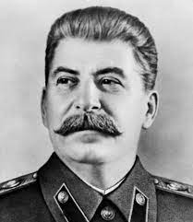
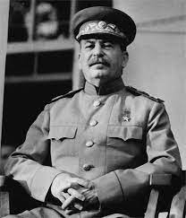
Russia: Joseph Stalin
“The Man of Steel”
A civil war in Russia resulted in a communist state
In 1924, Stalin took control of the country
Stalin’s first step was to abolish all farms and replace them with collectives (large government owned farms)
Stalin transformed Russia from a rural nation into a industrial power
By 1937, Russia had become the world’s 2nd largest industrial power

Slide 4
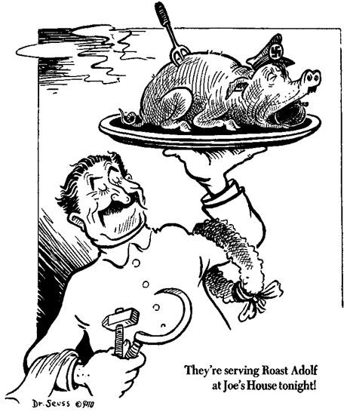
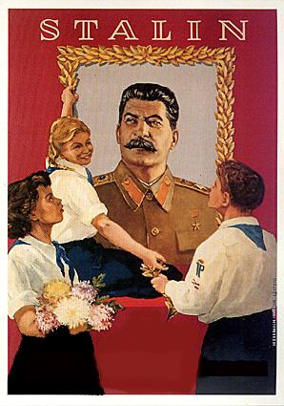
“Death is the solution to all problems. No man - no problem”
Joseph Stalin
The human cost of Stalin’s transformation of Russia was enormous
Stalin eliminated anyone who threatened his power
It is estimated that Stalin was responsible for the deaths of 8 - 13 million people
By 1939, Stalin had established a totalitarian government (maintains complete control over its citizens)

Slide 5
Stalin’s Goals:
State owned collective farms
Communist party as only authority
State planning of the economy

Slide 6
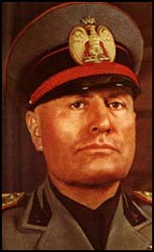
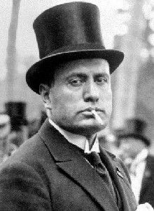
Italy: Benito Mussolini
“Il Duce” (The Leader)
Unemployment and inflation produced bitter strikes in Italy
Alarmed by these strikes the middle and upper class demanded leadership
Mussolini marched on Rome with thousands of his followers (The Black Shirts)
The Italian King gave up and appointed Mussolini the head of government
Mussolini played on fears of economic collapse and communism
He won the support of the army, police, and government officials

Slide 7
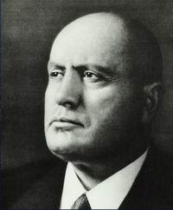
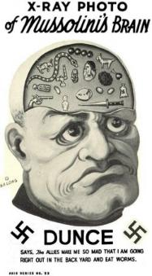
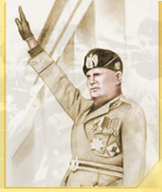
Mussolini established fascism
The fascist party stressed nationalism and placed the interests of the state above those of individuals
Fascists argued that power must rest with a single strong leader and a small group of devoted members

Slide 8
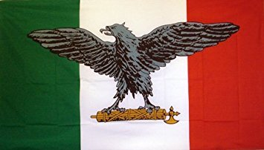
Mussolini’s Goals:
Bring back the glory of ancient Rome
Individual liberties crushed to create national strength

Slide 9
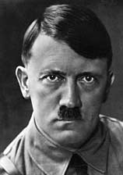
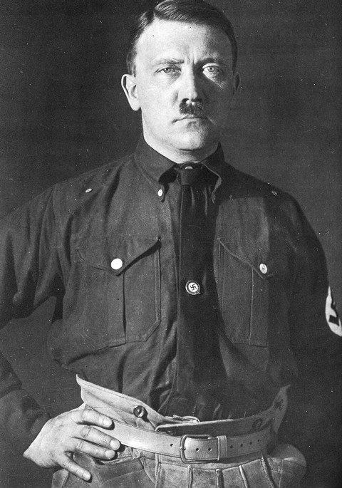
Germany: Adolf Hitler
Der Fuhrer “The Leader”
At the end of WWI, Hitler had been a jobless soldier drifting around Germany
The German economy had been hit hard
He joined a struggling group called the National Socialist German Workers’ Party (NAZI)
Hitler quickly became the party’s leader
In 1933, Hitler was appointed Prime Minister
Adolf Hitler was elected in a democratic election

Slide 10
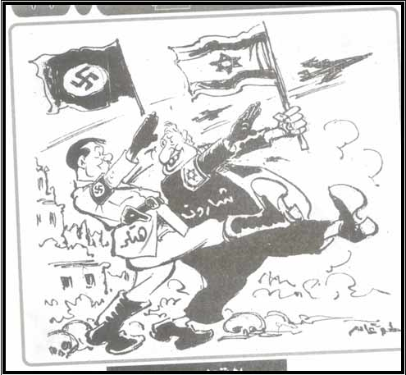
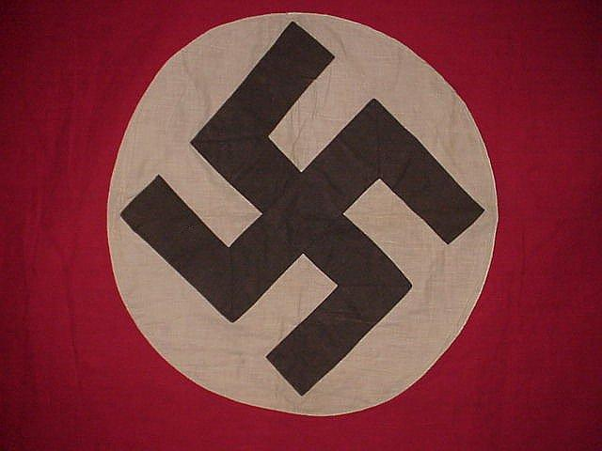
Once in power, Hitler dismantled Germany’s democratic republic
In its place he established the Third Reich (3rd German Empire)
Hitler, who had been born in Austria, dreamed of uniting all German-speaking people in a Great German Empire
Hitler also wanted to enforce racial “purification” (blond hair & blue eyed) Aryans
Jews and non-whites were deemed fit only to serve the Aryans

Slide 11
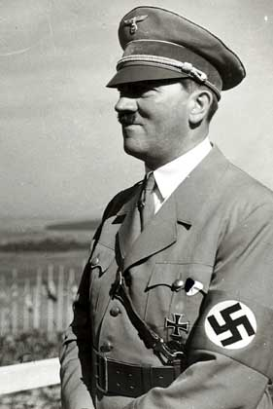
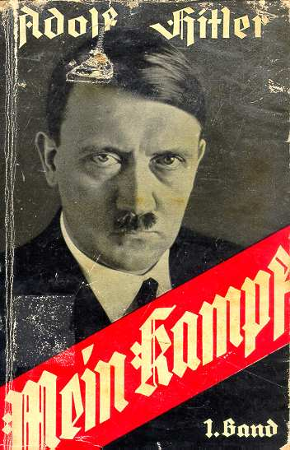
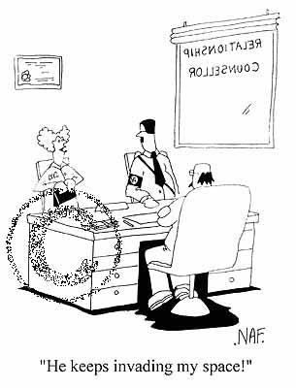
Hitler believed that in order for Germany to thrive, it needed more living space
Even if it could be accomplished by “the might of a sword”
Hitler’s plan for the Nazis was known as Nazism (the German brand of fascism, was based on extreme nationalism)

Slide 12
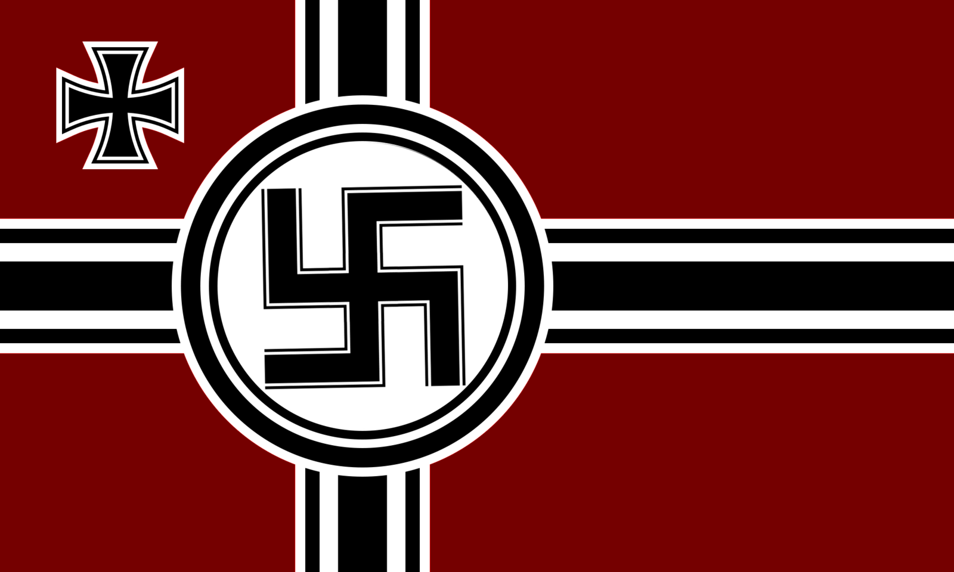
Hitler’s Goals:
Territorial Expansion
Establish a new empire for the “Master Race”
Use force to eliminate opposition
Essential conquer the world

Slide 13
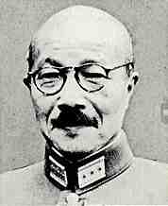
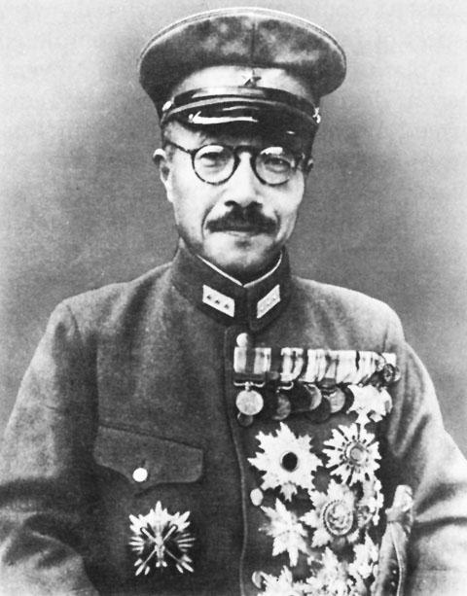
Japan: Hideki Tojo
“The Son of Satan”
In 1937, Tojo was Chief of Staff to the army and led a successful invasion of China
After becoming the Prime Minister of Japan, Tojo used his military success to gain dictatorial power
He believed like Hitler that there was a need for more living space for Japan
Hideki believed in militarism - an extreme form of nationalism

Slide 14
Tojo’s Goals:
Military control of civilian government
Territorial expansion to obtain raw materials
Domination of East & Southeast Asia

Slide 15
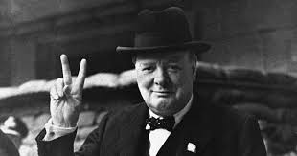
United Kingdom: Winston Churchill
His party became the ruling party in the British Parliament in 1940 and nominated him to be Prime Minister
British Prime Minister from 1940-1945 and from 1951-1955
Formed close alliance and friendship with President FDR
He was a gifted speaker and politician and became Britain’s most powerful “weapon” during the war
“Politics is more dangerous than war, for in war you are only killed once.”
WC

Slide 16
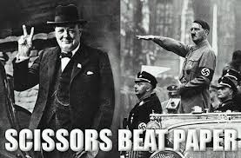
Did not believe in the British policy of appeasement
He felt that giving into Hitler’s demands was a bad idea
Once the war started, Churchill vowed to fight Germany and defend Great Britain with every resource at his disposal
“We shall not tire nor fail. We shall go to the end. We shall fight on the seas and oceans… We shall fight with growing confidence and growing strength… We shall never surrender.”
WC

Slide 17
Churchill’s Goals:
Stop the expansion of dictatorships in Europe
Withstand attacks of dictators on Great Britain and her allies

Slide 18
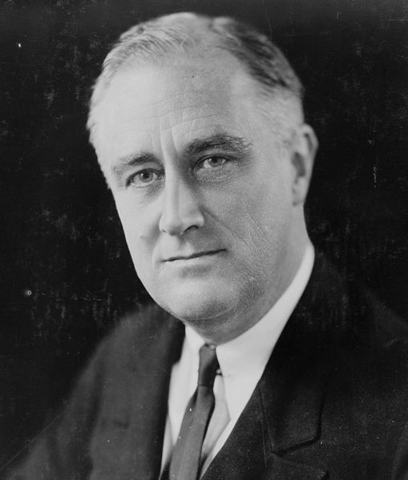
United States: Franklin D. Roosevelt
President of the U.S. from 1933-1945
Only president elected to 4 terms
Encouraged interaction with foreign nations
Did not want to stay neutral, but had to follow wishes of citizens calling for isolation & neutrality
Sent arms to China (during Japanese invasion, 1937) and the Allies (part of the Lend-Lease Act)
Worked closely with Churchill once the war in Europe was inevitable

Slide 19
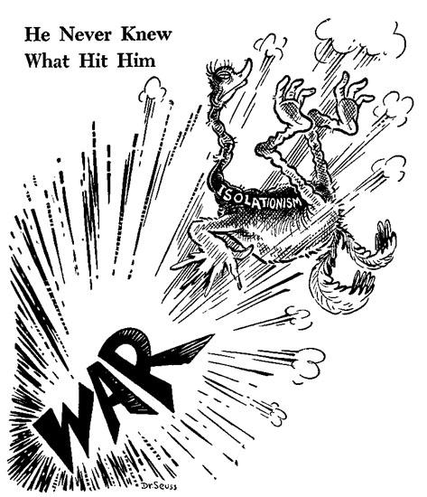
“Hostilities exist. Our people, our territory, and our interests are in grave danger.”
FDR
Americans wanted to help their allies, the French & British, but were fearful of another European war
On December 7, 1941, Japan bombed the U.S. Naval base at Pearl Harbor
The U.S. declared war on Japan & Germany and began to mobilize for war
“There is a mysterious cycle in human events. To some generations, much is given. Of other generations, much is expected. This generation of Americans had a rendezvous with history.”
FDR

Slide 20
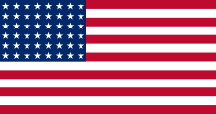
Roosevelt’s Goals:
Economic recovery from Great Depression
Initially, remain neutral through the war
Once joined the war, stop spread of dictatorships in Europe and China
Make world safe for democracy
Increase power of government (especially executive branch)

Slide 21
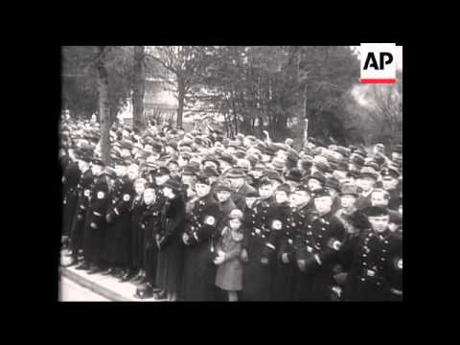
Hitler’s Speech

Slide 22
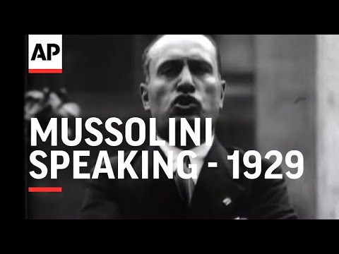
Mussolini’s Speech

Slide 23
Mussolini’s Speech

Slide 24
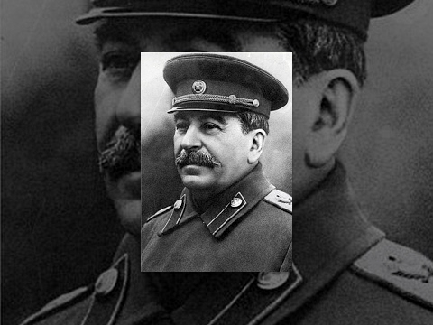
Stalin’s Speech

Slide 25
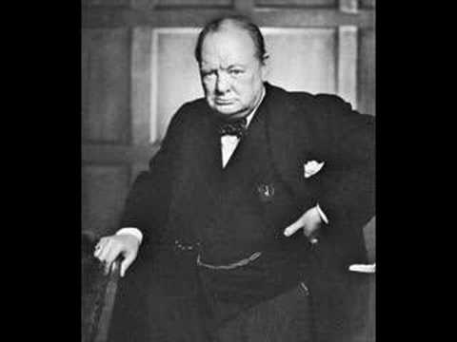
Churchill’s Most Famous Speech

Slide 26
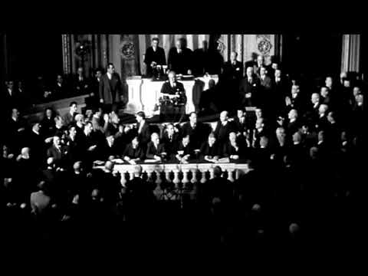
FDR Addressing Congress to Declare War

Slide 27
Let’s discuss the speeches:
What type of mannerisms did they display?
What tone did they have (the sound of their voices)?
What does the speech indicate about each leader?

Slide 28
Political Continuum
Pure Democracy:
People have ALL the power in their gov’t
Pure Dictatorship:
A leader has ALL the power in the gov’t
On your paper you have a section with a line like this one. Label Pure Democracy & Pure Dictatorship like I have done on the slide.
Now that you have collected data for each of these world leaders, write their names where you think they fit on this scale.
Underneath your scale, explain why you put each person where you chose.

