Slide 1
Law of Supply
Producers offer more of a good as its price increase and less as its price falls
as
as
Offer More Goods
Price Increases
Offer Less Goods
Price Decreases

Slide 2
Law of Demand
Consumers will buy more of a good when its price is lower and less if its price is higher
when
when
Buy More Goods
Price is Lower
Buy Less Goods
Price is Higher

Slide 3
Demand
The desire to own something and the ability to pay for it

Slide 4
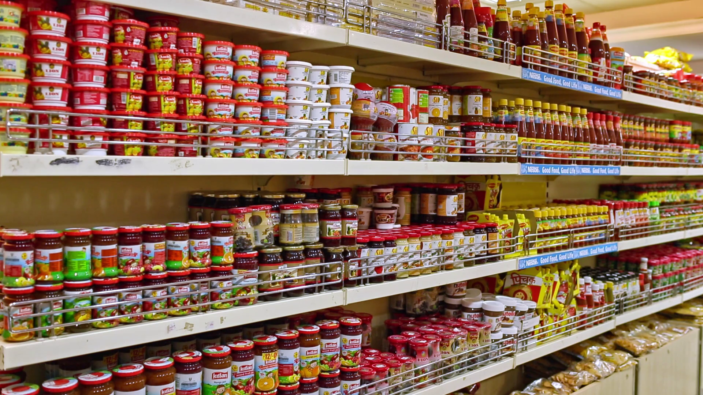
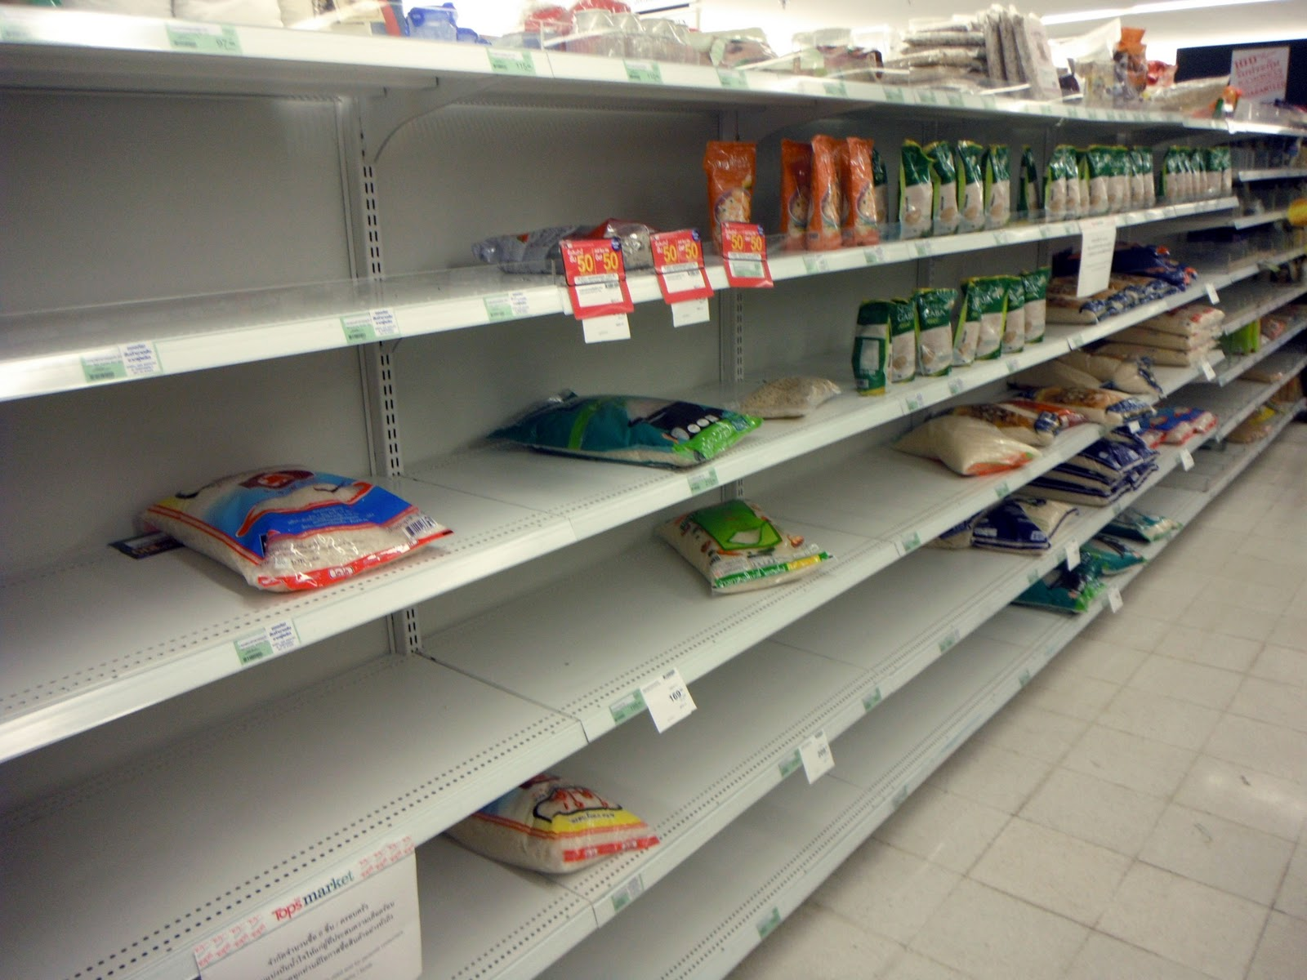
Supply
The amount of goods available

Slide 5
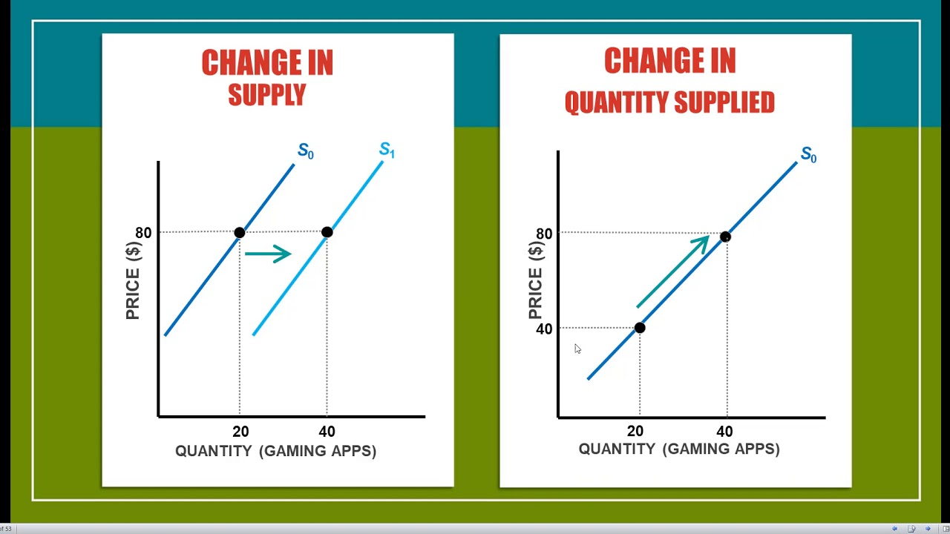
Quantity Supplied
The amount that a supplier is willing and able to supply at a specific price

Slide 6
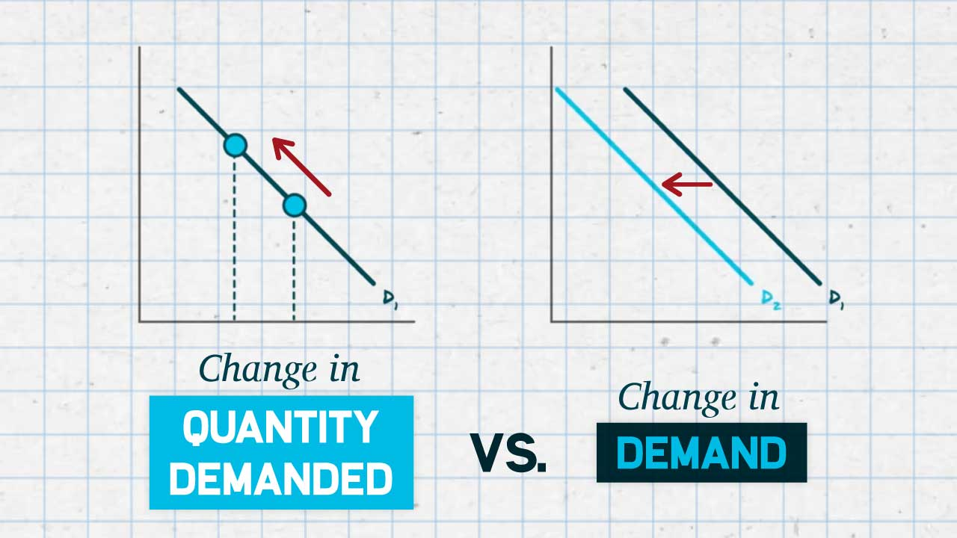
Quantity Demanded
The amount of a good that is demanded by customers within a certain time period at a specific price

Slide 7
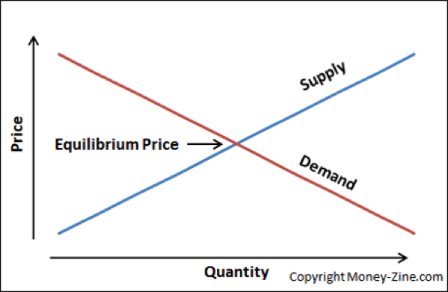
Equilibrium Price
Price where the demand for a product or service balances its supply

Slide 8
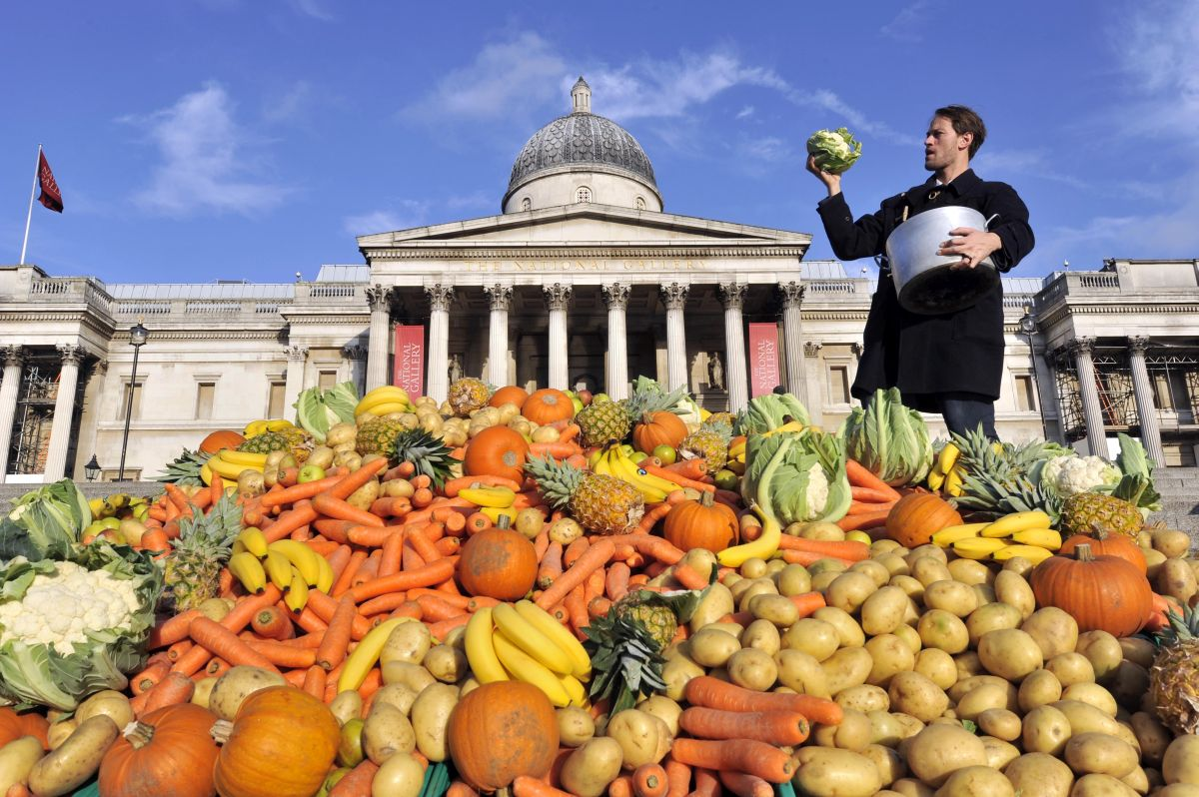
Surplus
Excess of production or supply over demand

Slide 9
Shortage
A condition where the quantity demanded is greater than the quantity supplied

