Slide 1
1970s & The End of the Cold War
Vocab

Slide 2
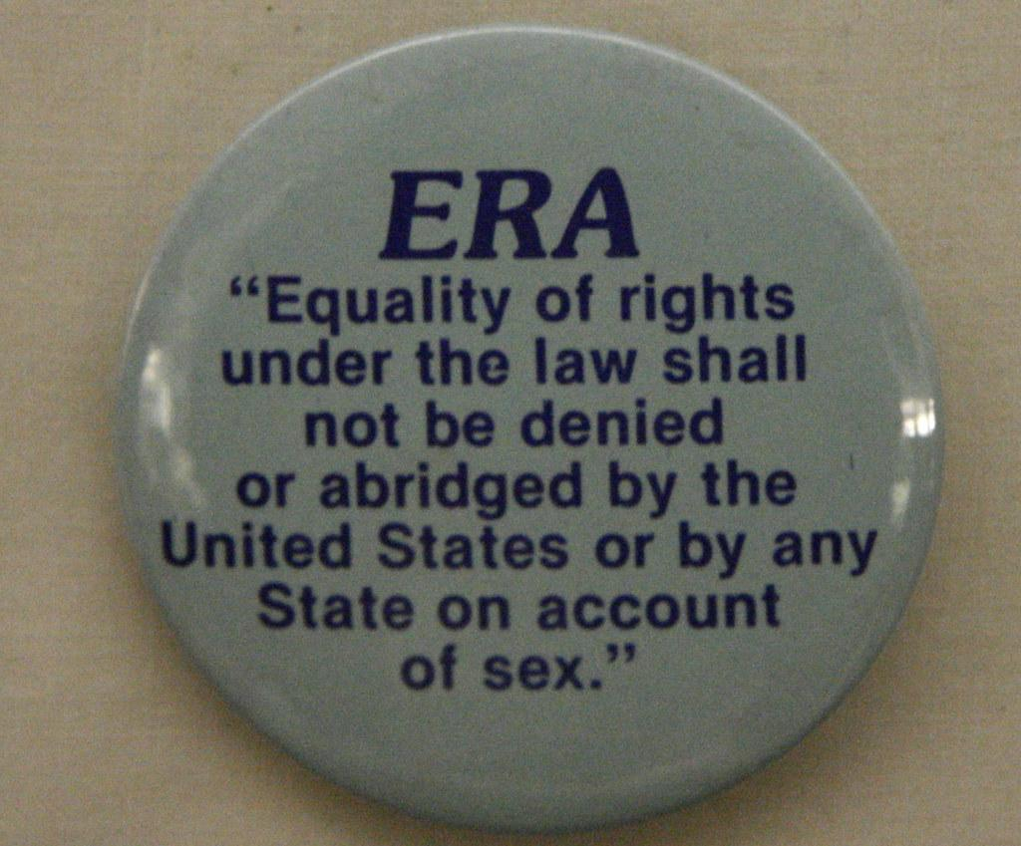
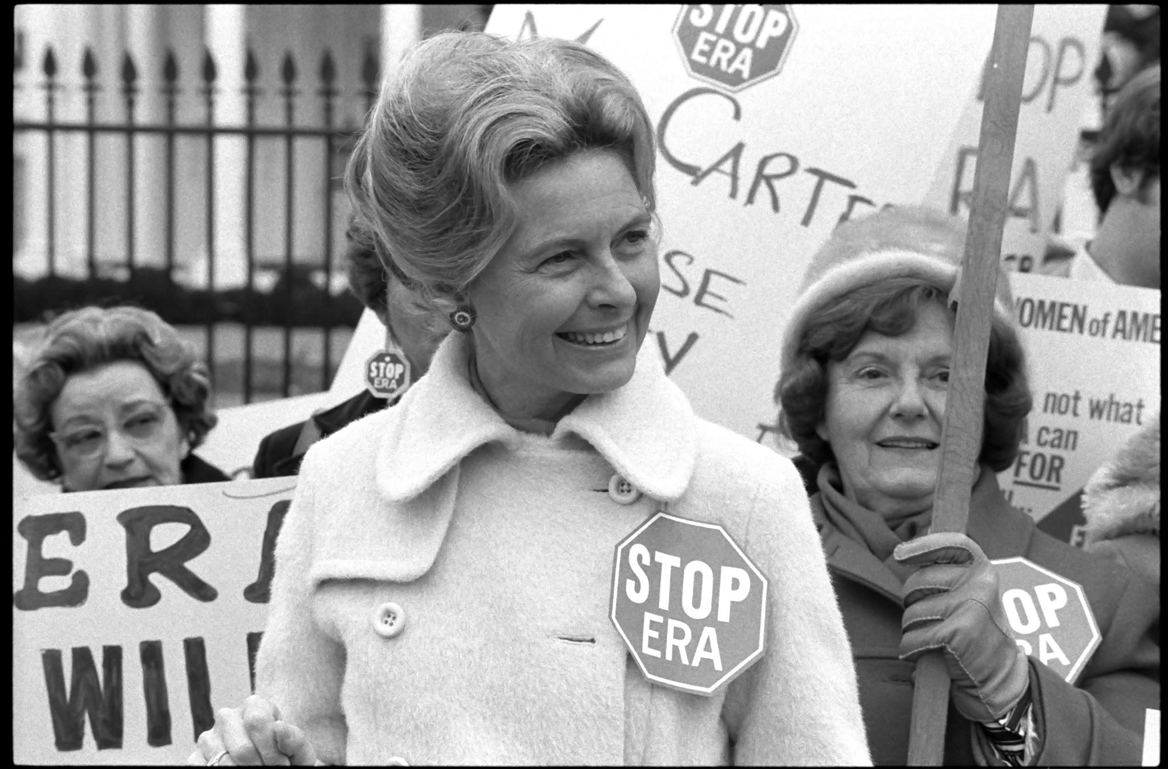
ERA (Equal Rights Amendment)
Proposed amendment to US Constitution, would have prohibited discrimination on basis sex. It wasn’t passed.

Slide 3
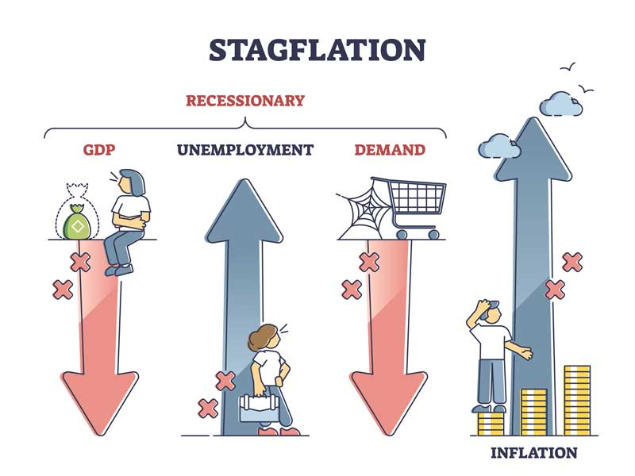
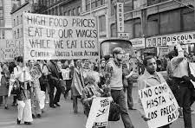
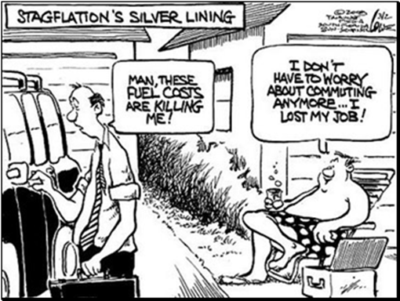
Stagflation
Economic condition marked by inflation and high unemployment.

Slide 4
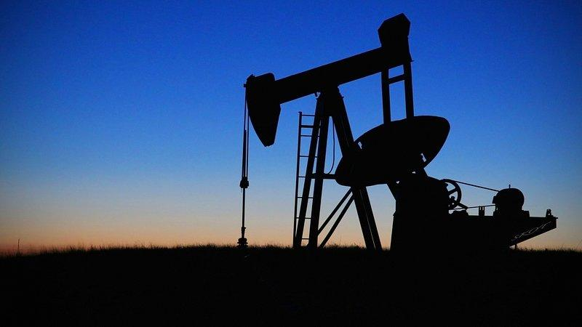
Organization of Petroleum Exporting Countries (OPEC)
Oil-producing countries in the Middle East started a cartel called the Organization of Petroleum Exporting Countries.

Slide 5
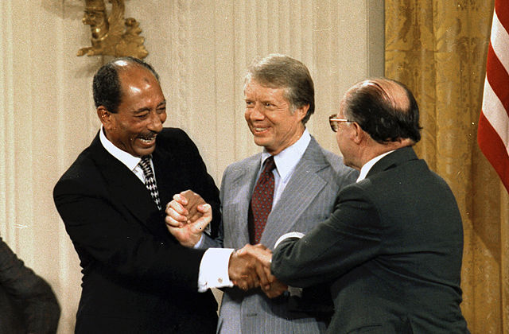
Camp David Accords
Agreements between Israel and Egypt, Negotiated by President Carter at Camp David in 1978.

Slide 6
Environmental Protection Agency (EPA)
1970 federal agency regulating water and air pollution, toxic waste, pesticides, and radiation.

Slide 7
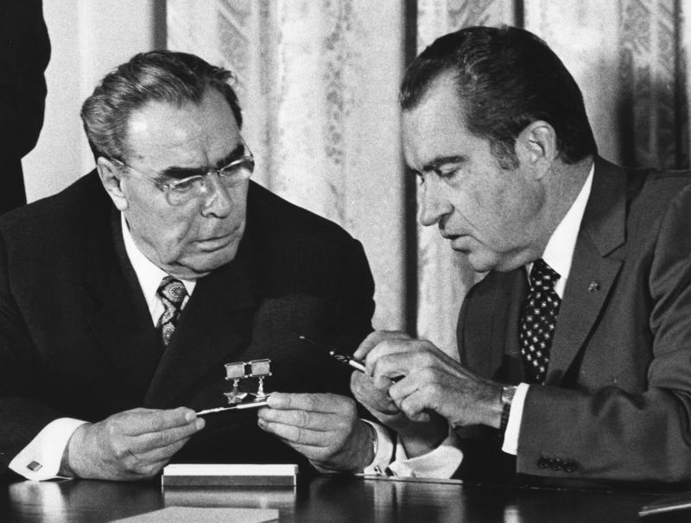
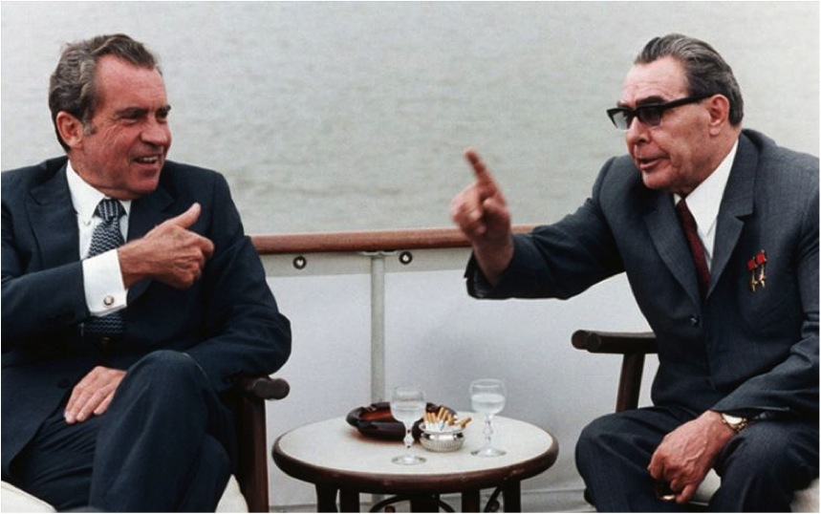
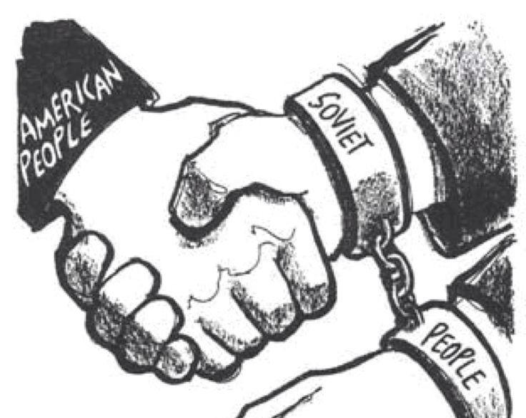
Détente
Flexible policy, involving a willingness to negotiate and an easing of tensions, adopted by Nixon and Henry Kissinger in dealings with communist nations.

Slide 8
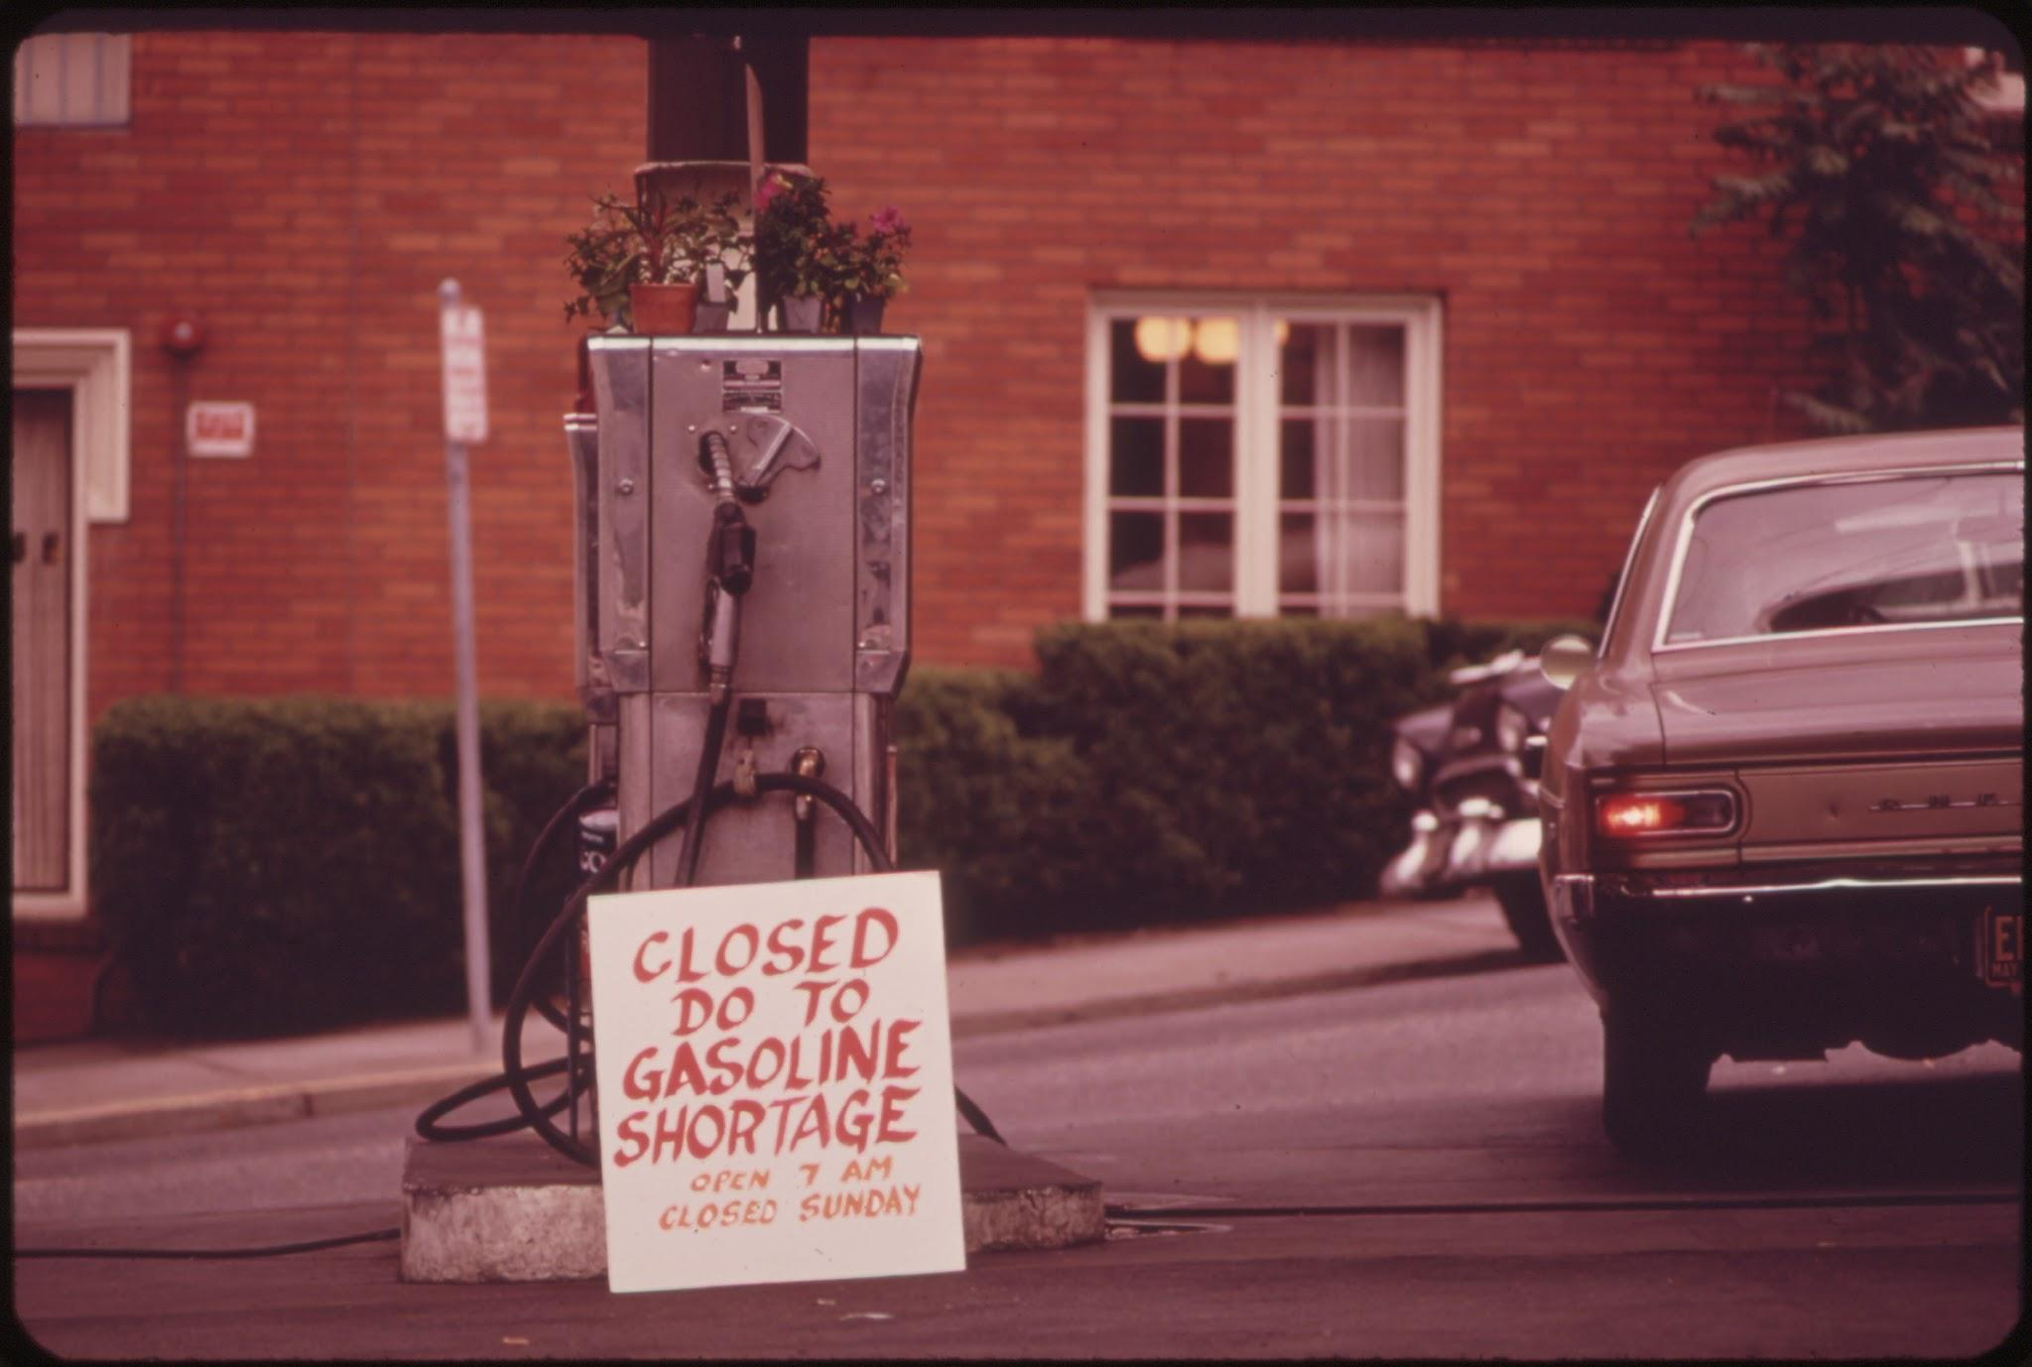
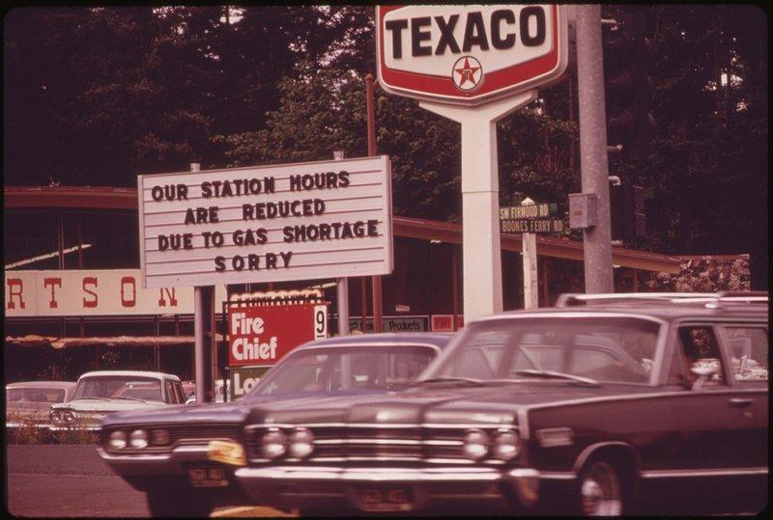
Energy Crisis
Lack of energy resources (coal, oil, etc.) that the U.S experienced during this time period.

Slide 9
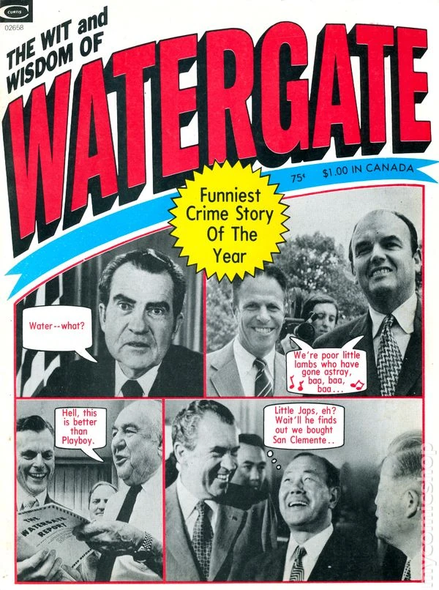
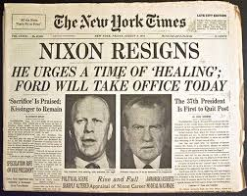
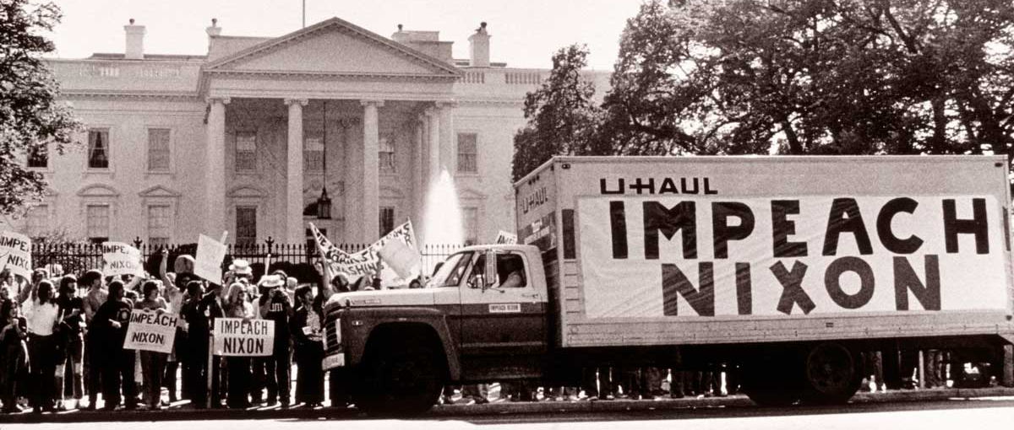
Watergate
Scandal of Nixon’s administration attempt to cover up the 1972 break-in at the Democratic National Committee headquarters in the Watergate building.

Slide 10
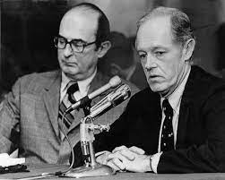
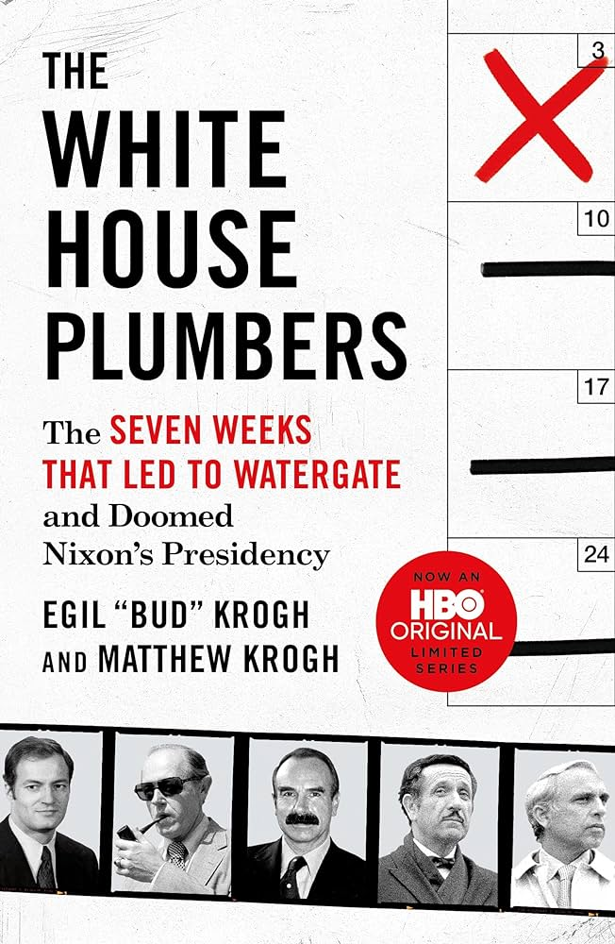
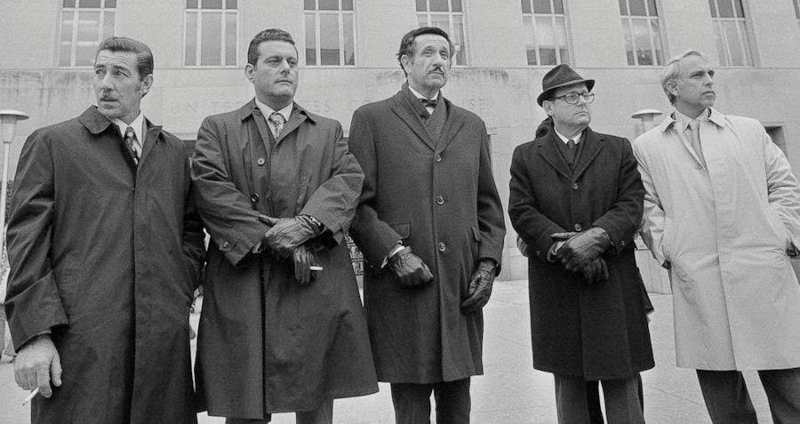
White House Plumbers
Nixon’s secret investigation group tasked with preventing top secret leaks.

Slide 11
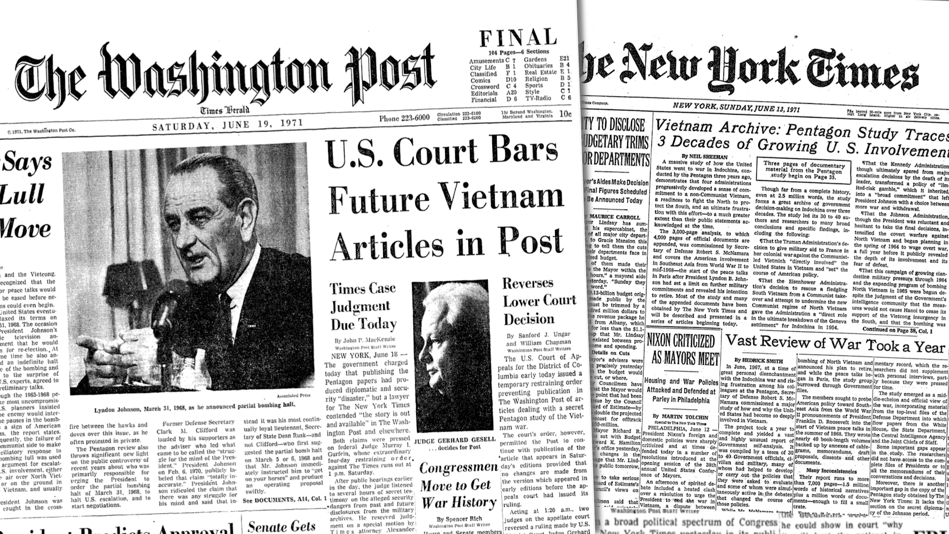
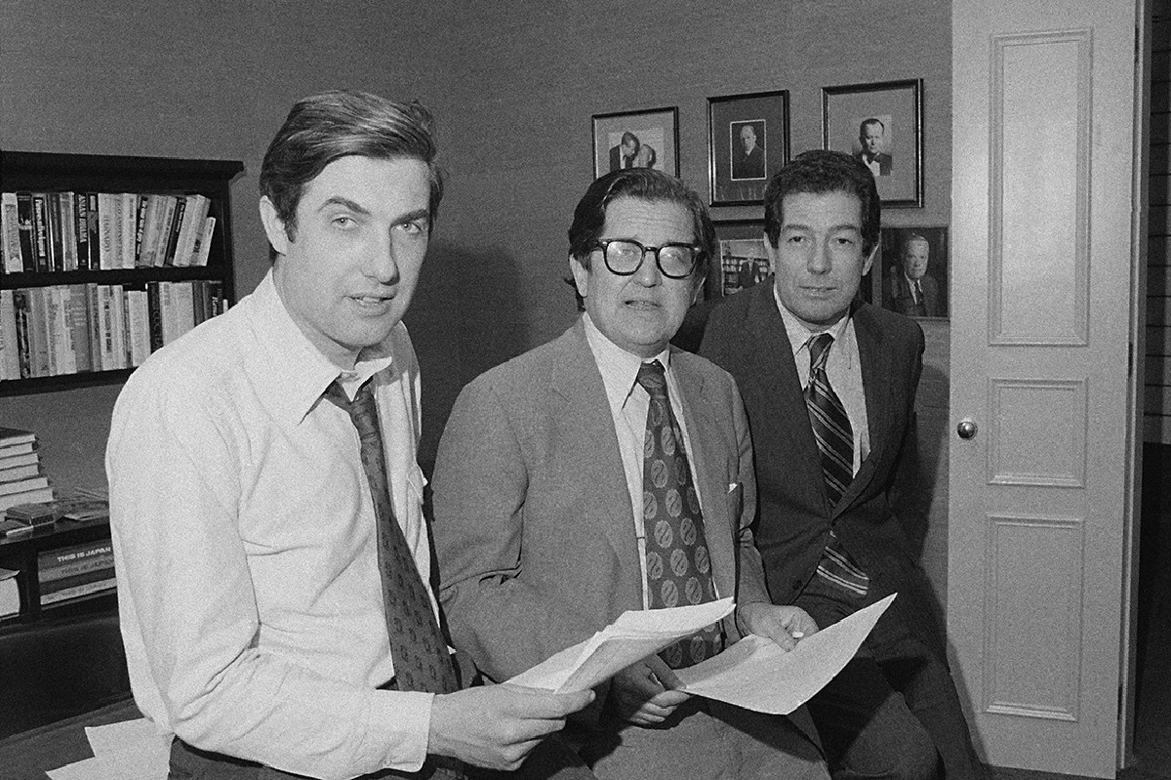
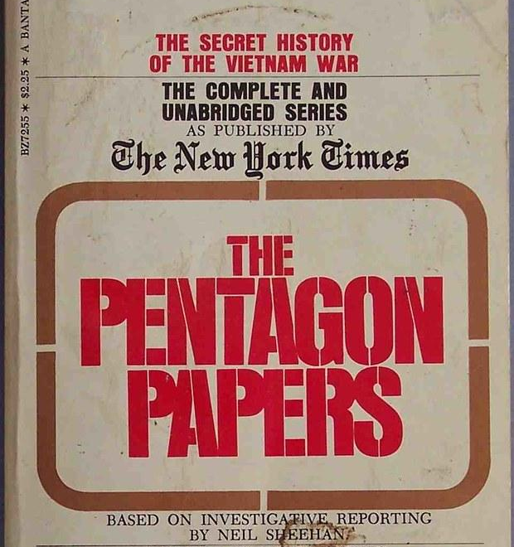
Pentagon Papers
1971 document leaked to the press; revealed US wasn’t honest about its intentions in Vietnam War.

Slide 12
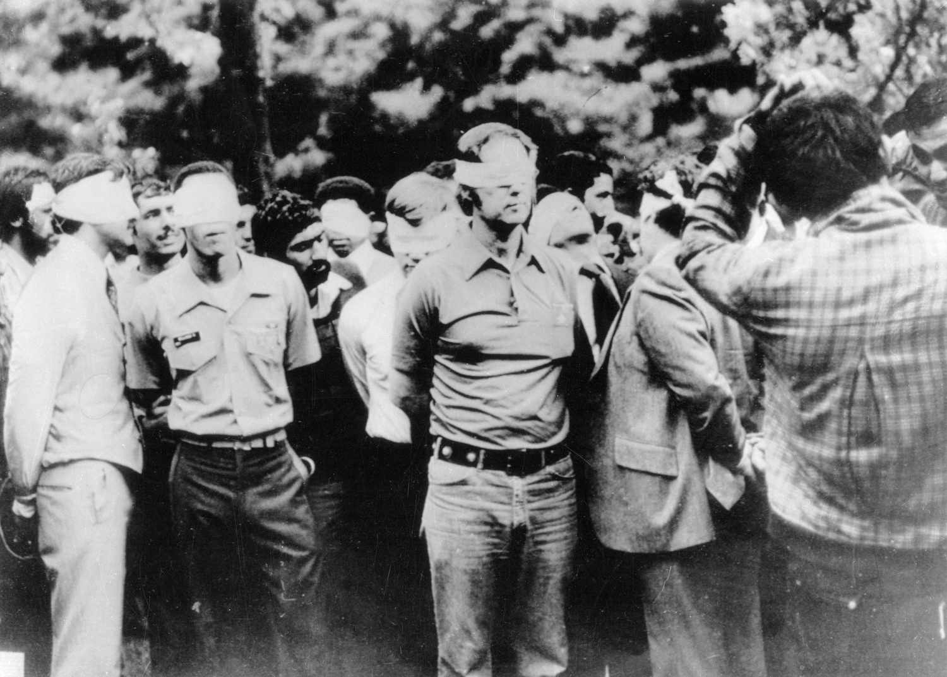
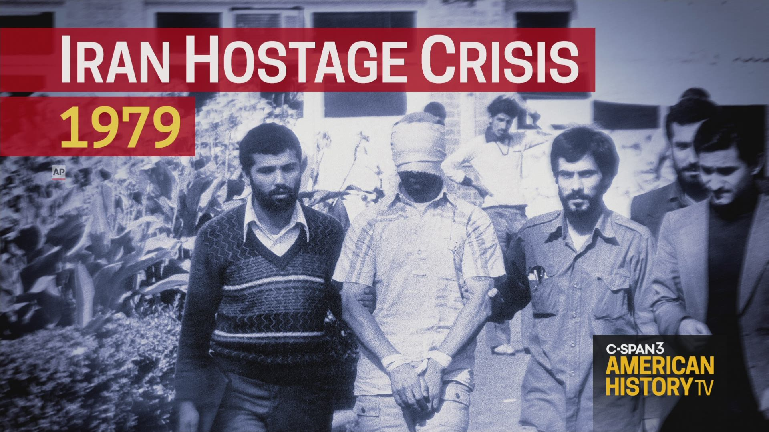
Iran-Hostage Crisis
Islamic students took over U.S. embassy in Tehran, took the American diplomats there hostage because the US allowed the exiled Shah to enter the US.

Slide 13
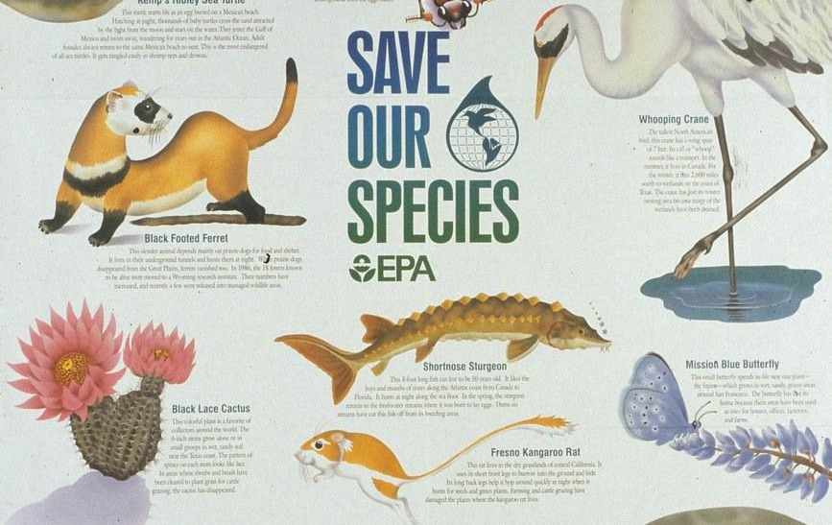
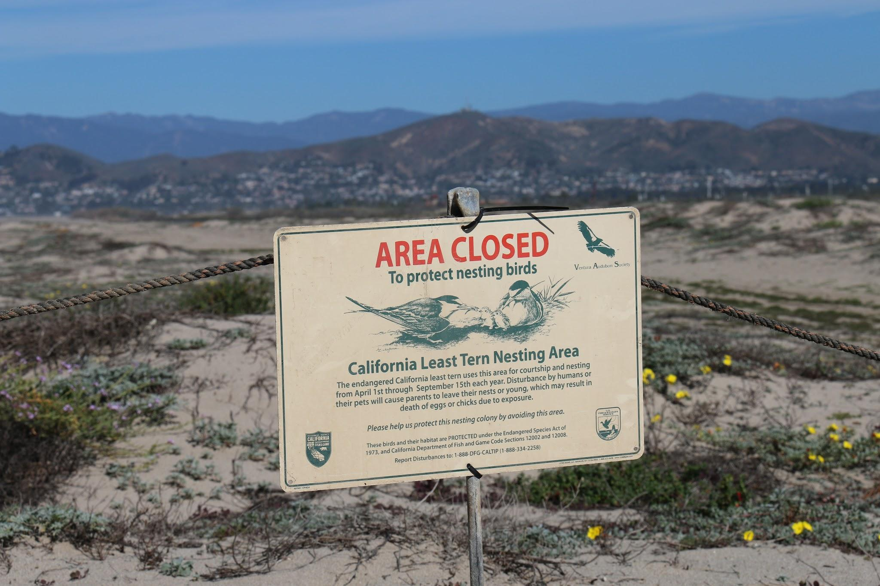
Endangered Species Act
Requires wildlife services to list endangered species and take measures to protect them.

Slide 14
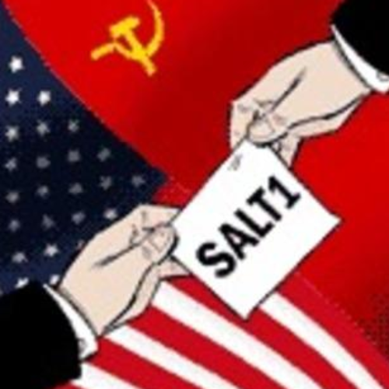
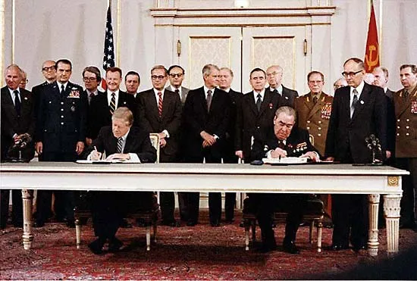
SALT (Strategic Arms Limitations Talks)
Limited the development of U.S. and Soviet defensive missile systems

Slide 15
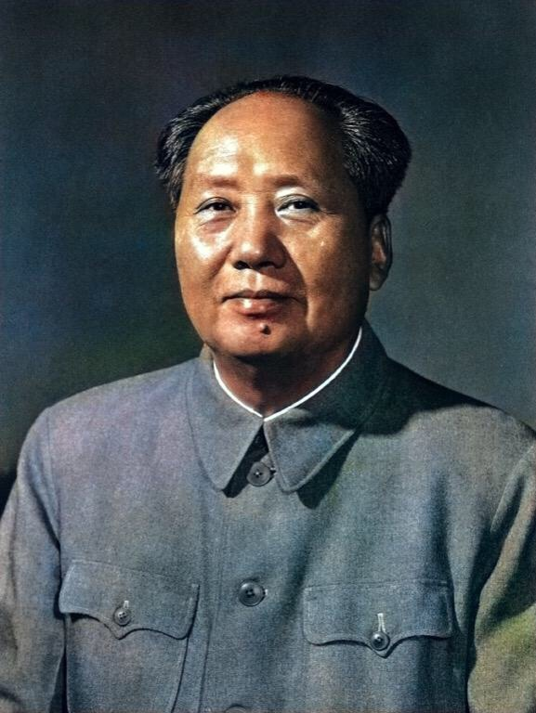
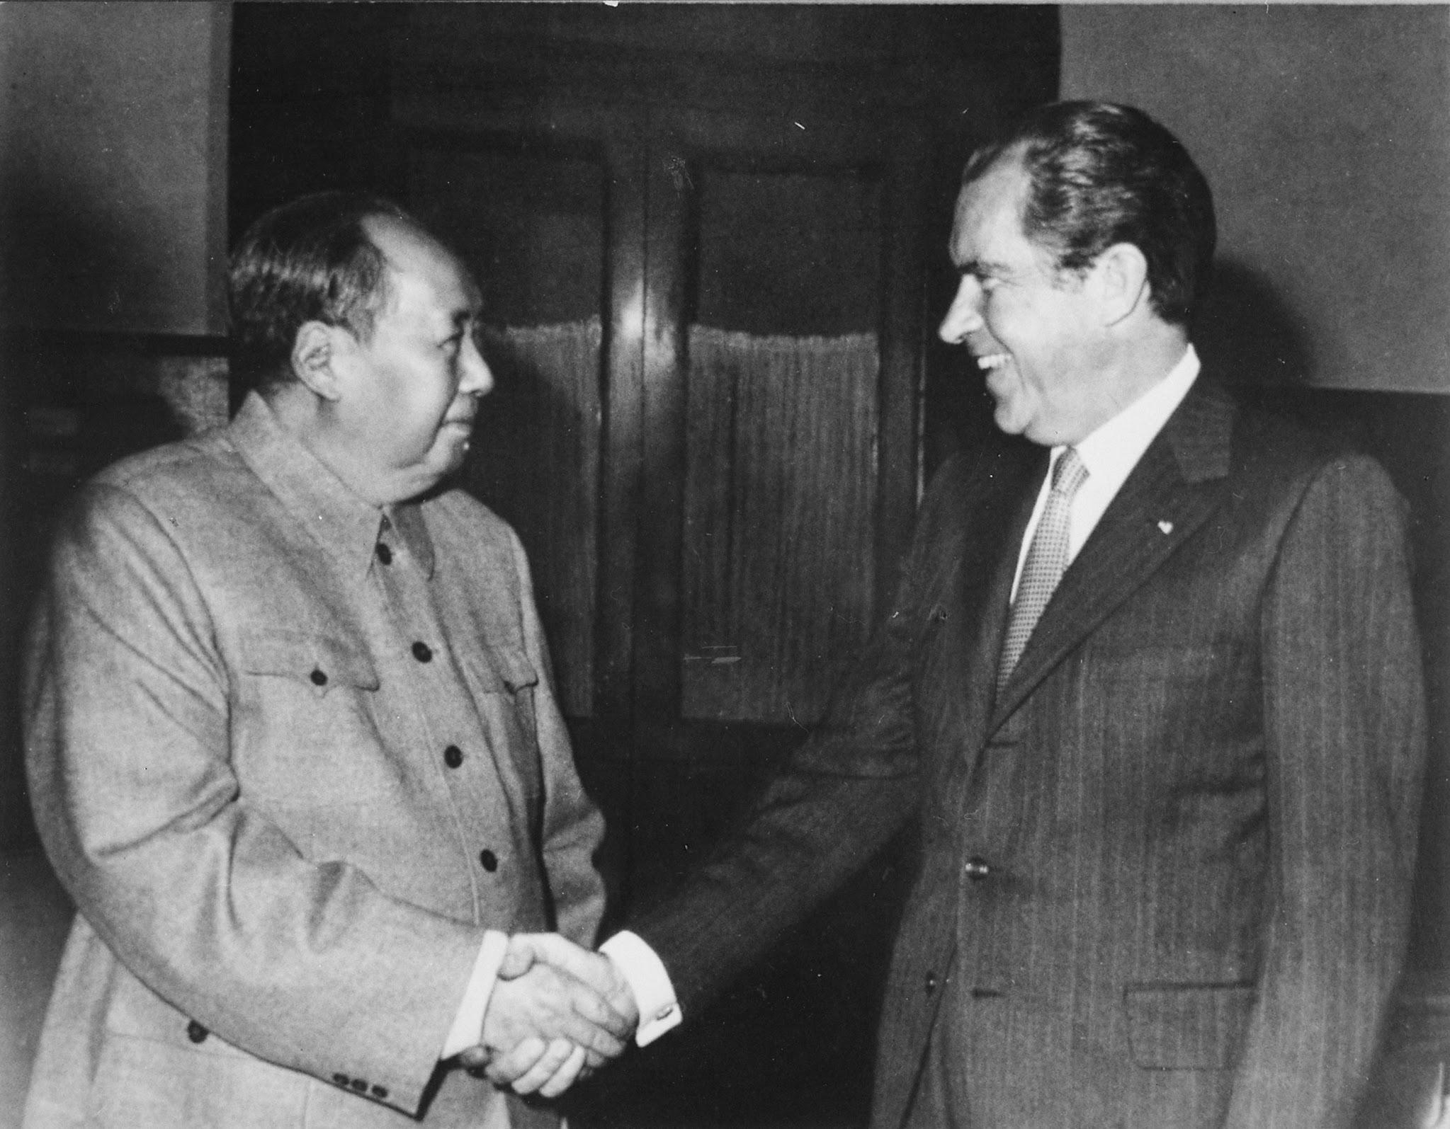
Mao Zedong
Communist leader of China who met with Nixon in 1972, re-opening relation between the US and China.

Slide 16
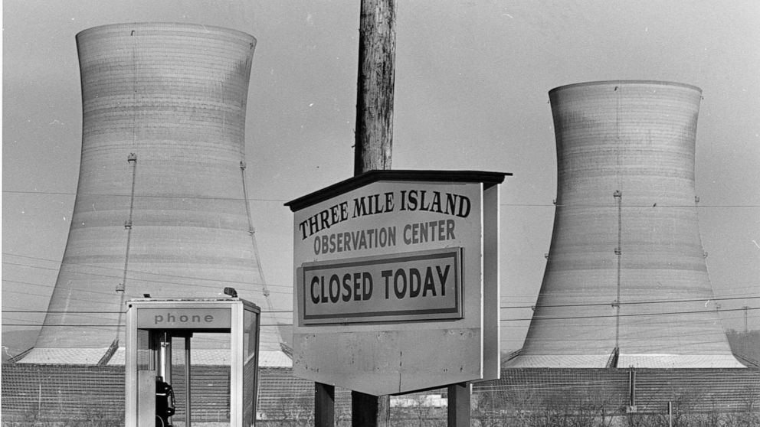
Three Mile Disaster
Serious nuclear accident in Pennsylvania which alerted people to the dangers of nuclear power. No nuclear power plants have been built in the U.S. since 1979.

Slide 17
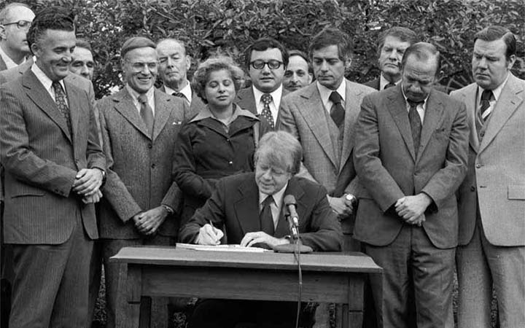
Community Reinvestment Act
Signed by President Carter to encourage banks to reduce discriminatory credit practices against low-income neighborhoods.

Slide 18
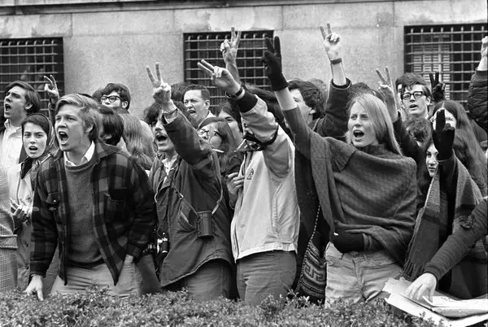
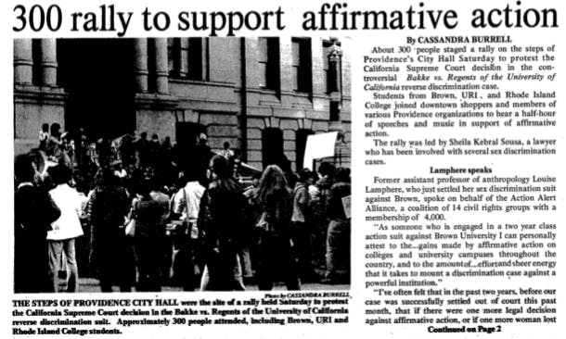
Affirmative Action
Encouragement of increased representation of women and minorities in employment.

Slide 19
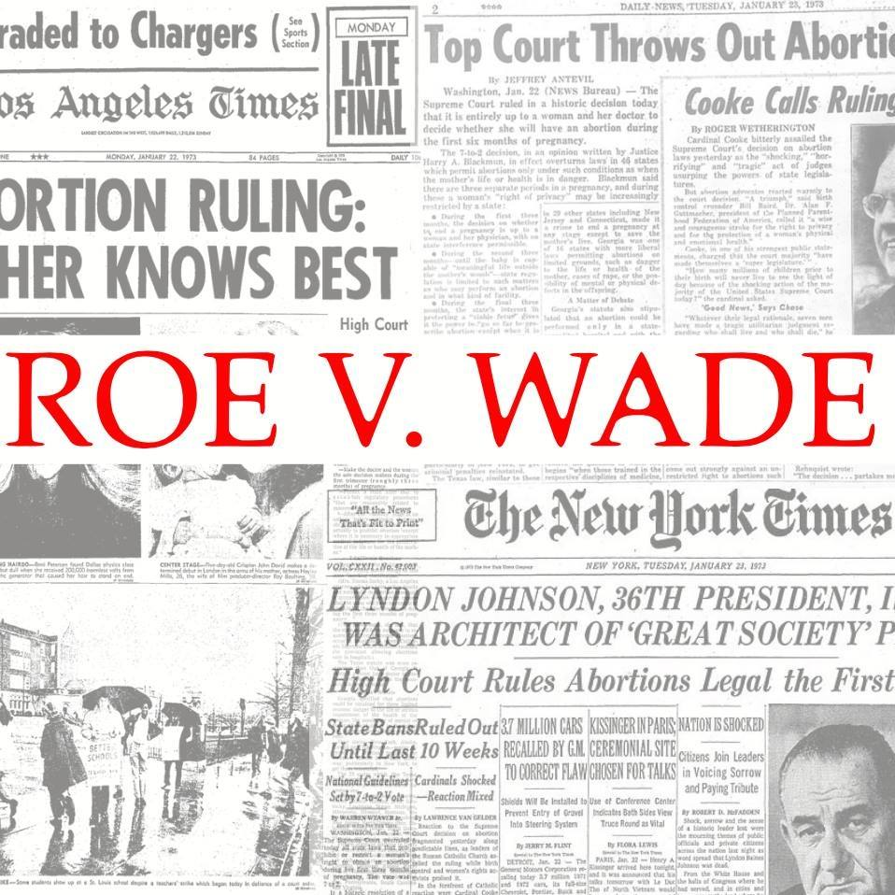
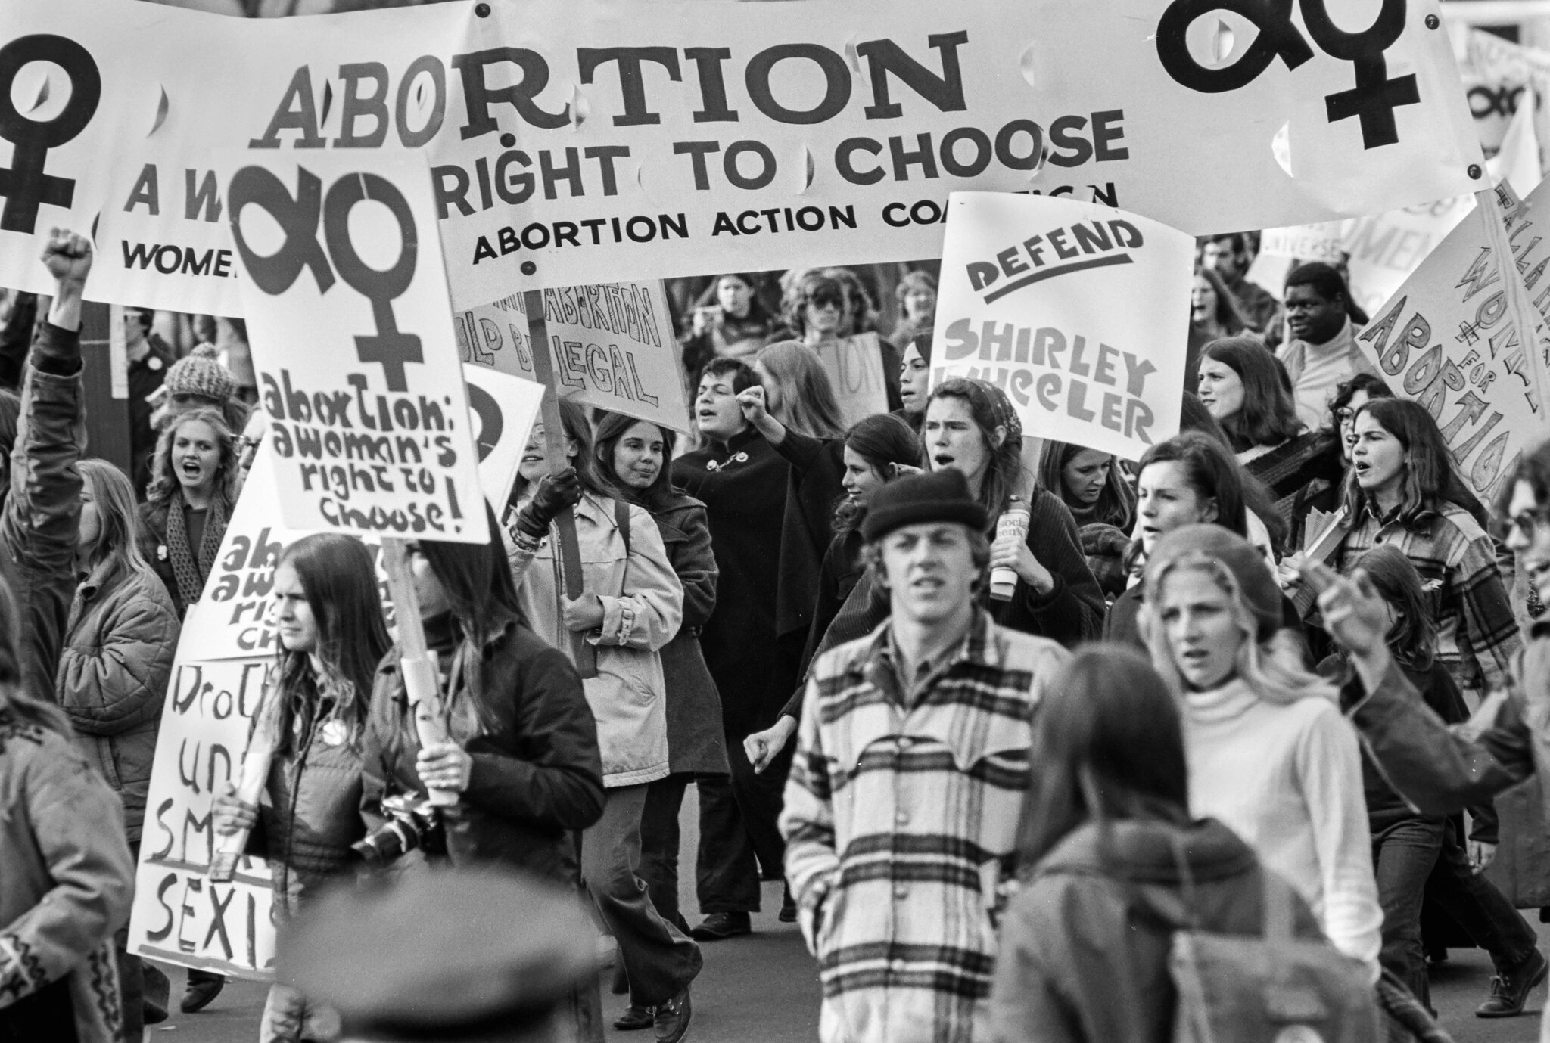
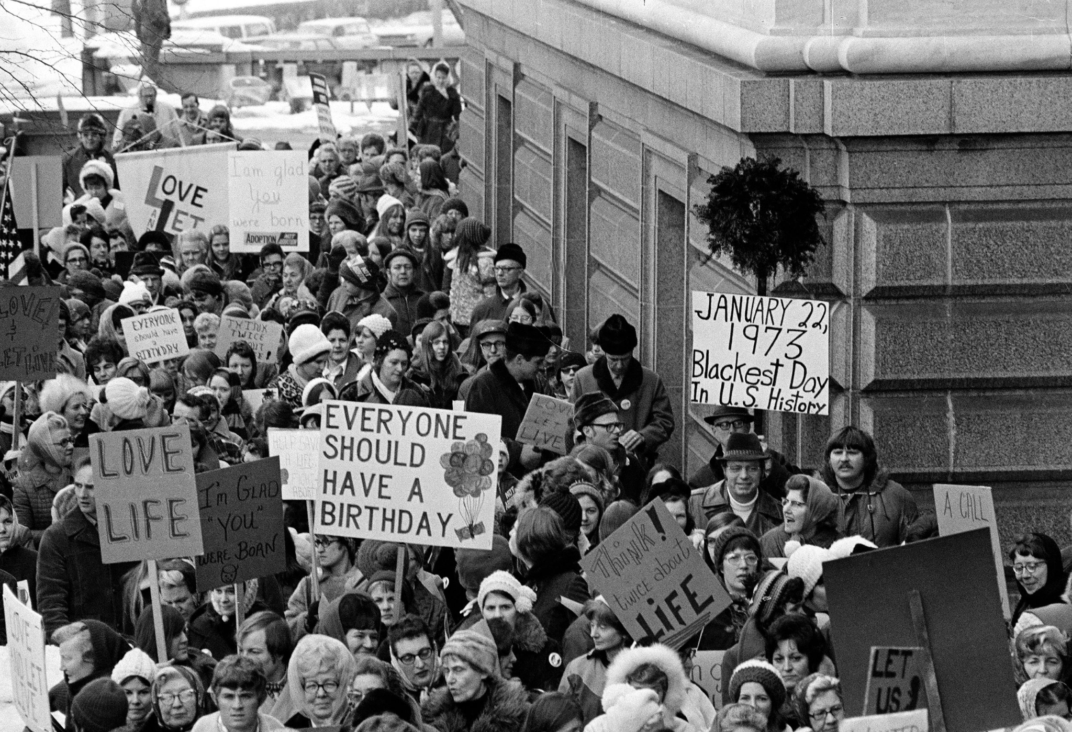
Roe v. Wade
1973 the Supreme Court ruled that women do have the right to choose an abortion during the first three months of pregnancy.

Slide 20
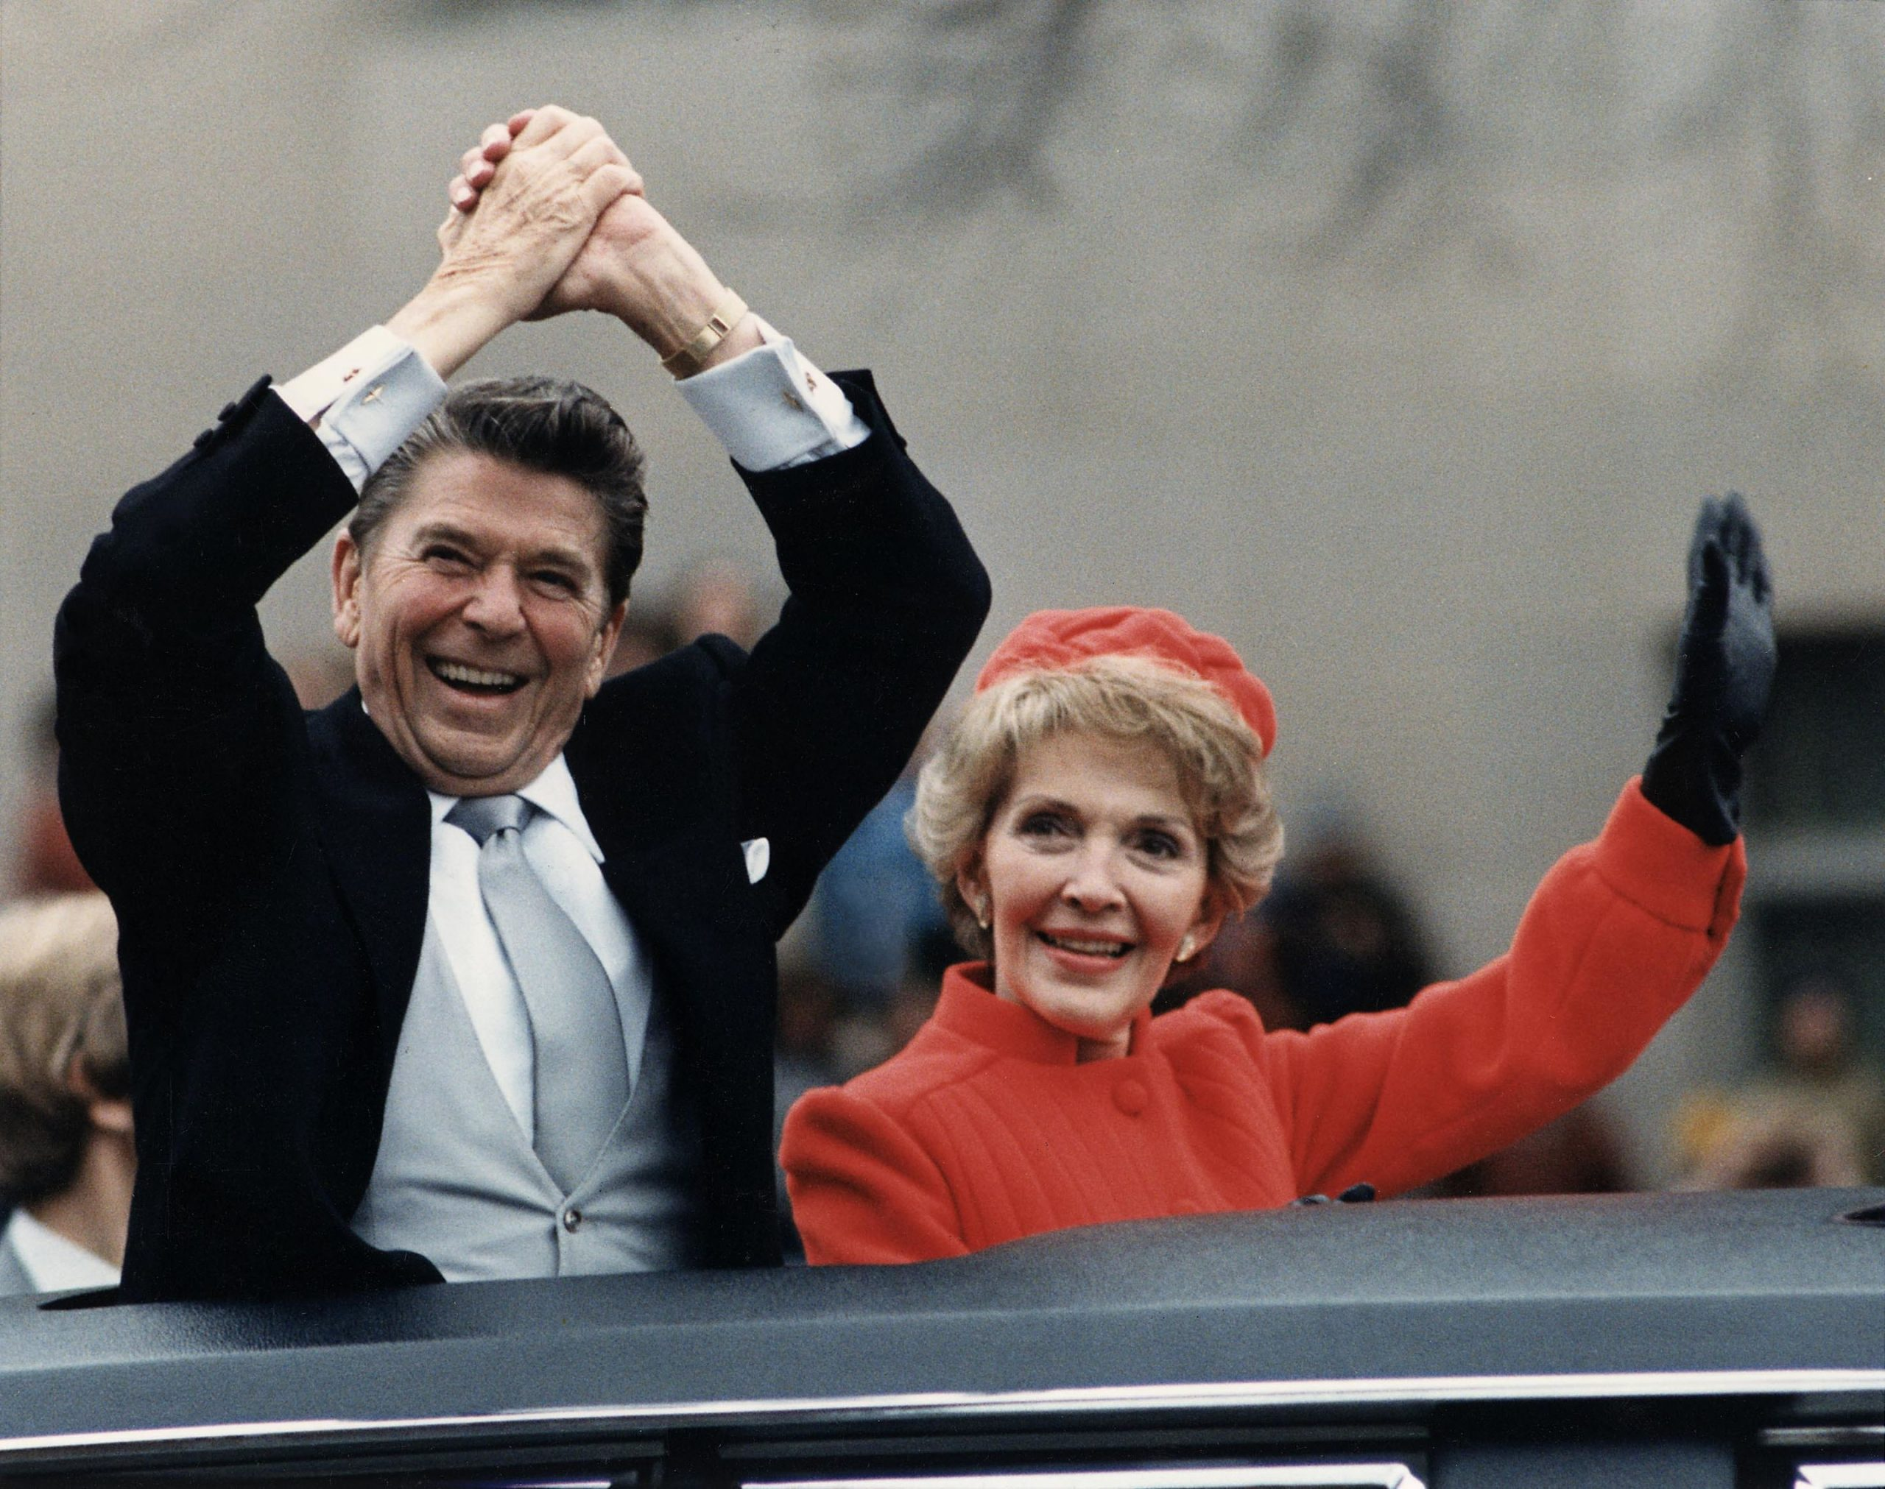
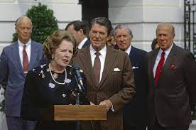
New Right
Late 20th-century alliance of conservative special-interest groups… cultural, social, and moral issues.

Slide 21
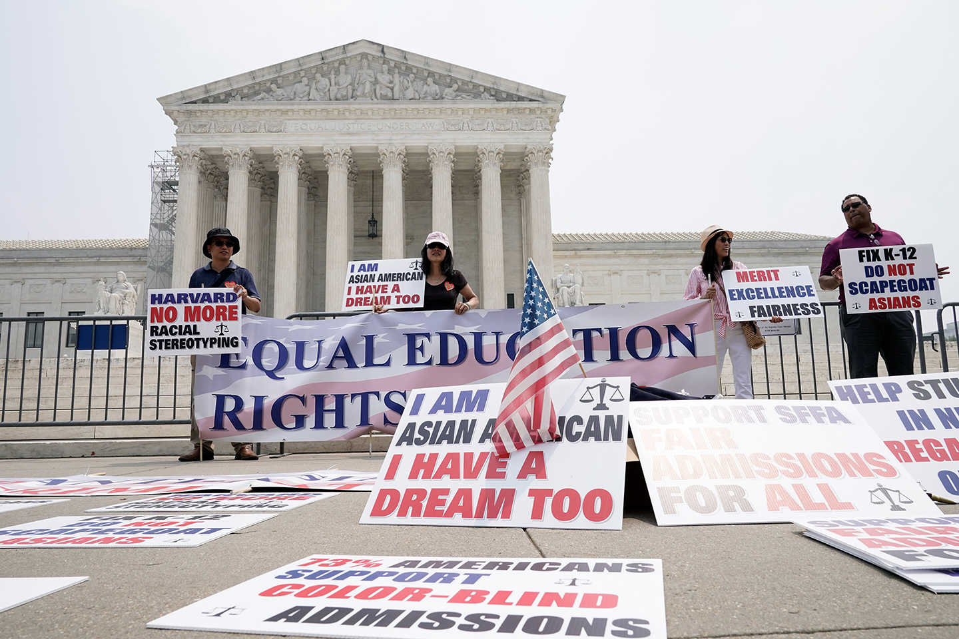
Affirmative Action
Seeks to correct past discrimination by favoring the groups who were previously disadvantaged.

Slide 22
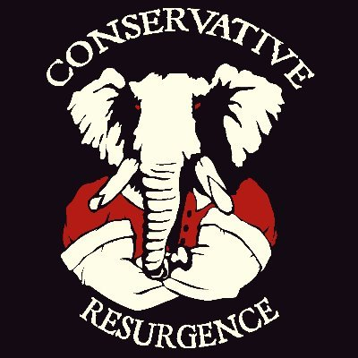
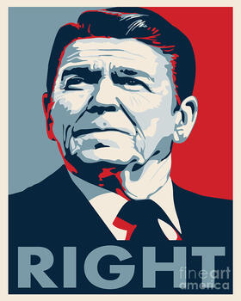
Conservative Resurgence
Backlash against hippies, big push toward conservative values

Slide 23
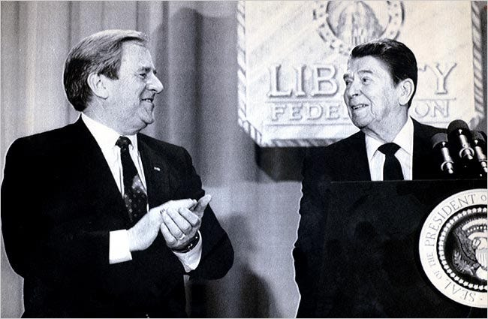
Moral Majority
Political alliance of religious groups, evangelical and fundamental Christians in the 1970's and 1980's, condemning liberal attitudes and behavior

Slide 24
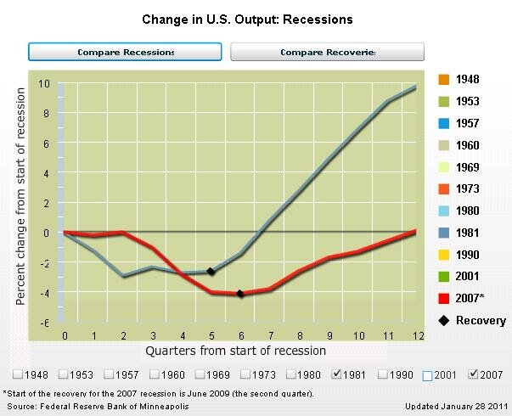
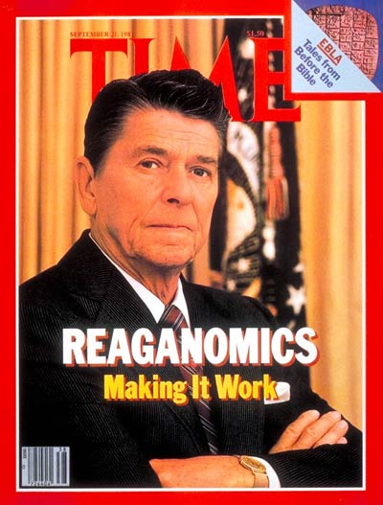
Reaganomics
Economic policies of President Ronald Reagan which focused on budget cuts and the granting of large tax cuts in order to increase private investment.

Slide 25
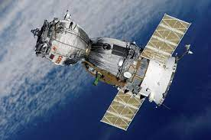
Strategic Defense Initiative (SDI)
Proposed defense system- popularly (Star Wars) intended to protect the US against missile attacks.

Slide 26
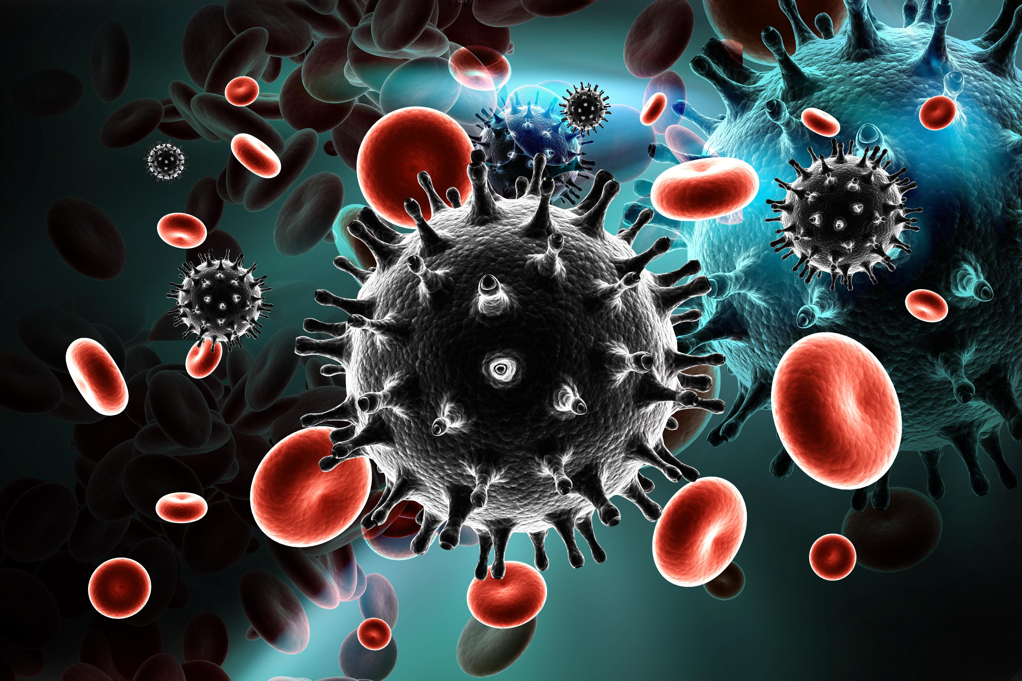
Acquired Immune Deficiency Syndrome (AIDS)
Disease caused by a virus that weakens the immune system, making the body prone to infections and otherwise rare forms of cancer. (HIV)

Slide 27
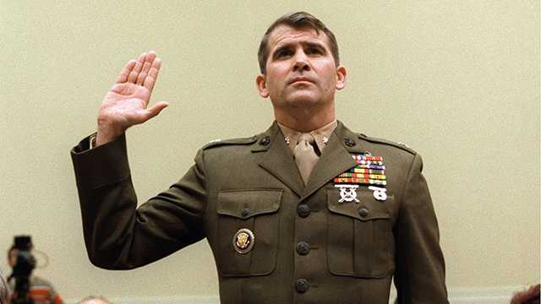
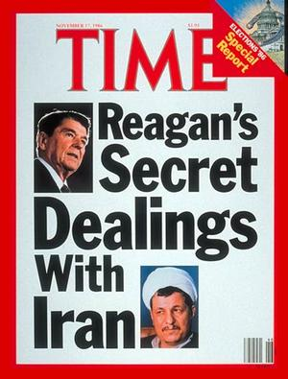
Iran Contra Scandal
Uncovering that President Reagan had approved the sale of arms to Iran in exchange for the release of seven American hostages held in Lebanon.

Slide 28
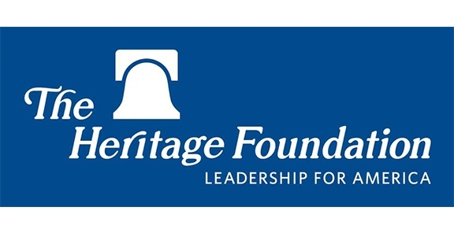
Heritage Foundation
Scholars wrote policy papers/opinion pieces for newspapers/journals; helped influence public debate.

Slide 29
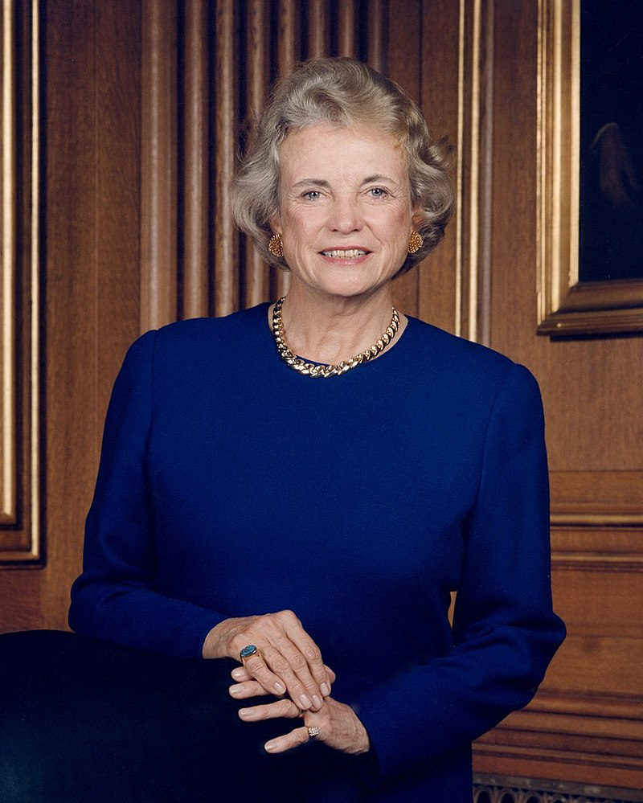
Sandra Day O’Conner
First female Justice on the U.S. Supreme Court;
Appointed by Reagan.

Slide 30
Mikhail Gorbachev
Soviet Leader who ends the Cold War through revolutionary programs "perestroika" and "glasnost.”

Slide 31
Tiananmen Square Massacre
Chinese troops and tanks moved into the square to crush the protests in Beijing against communism.

Slide 32
National Rifle Association (NRA)
Supports 2nd Amendment right to bear arms.

Slide 33
Ronald Reagan
President from 1981-1989; he was Democrat, but became more conservative… Republican president.

Slide 34
George H. Bush
Republican president 1989-1993 when Cold War ended and during the Persian Gulf War.

