Slide 1
QUESTION OF THE DAY
Types of Credit
Q:
What is #1 reason that people give for paying their credit card bill late?
View blog post
ngpf.org 10/19/20

Slide 2
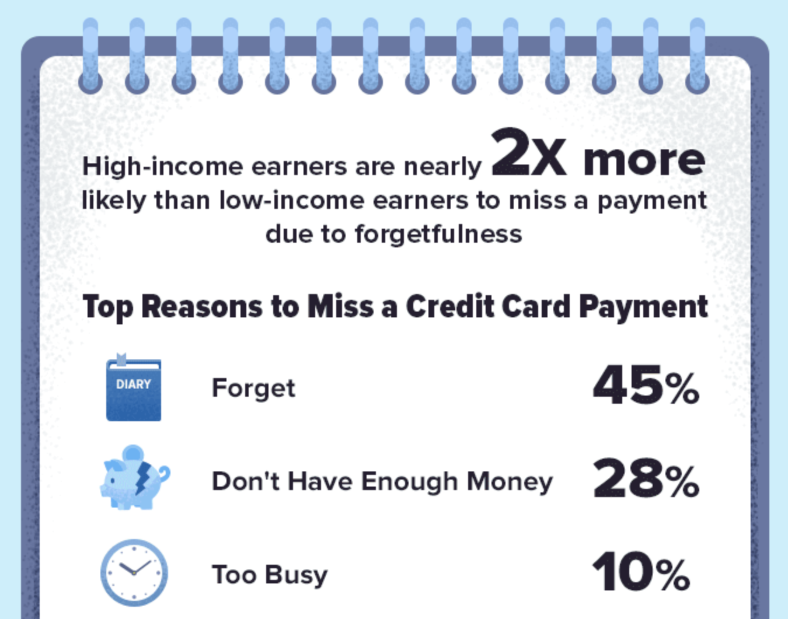
QUESTION OF THE DAY
Types of Credit
A:
45%
Forgot to make the payment
Click here for more info on this topic

Slide 3
FOLLOW-UP QUESTIONS
Why do you think that so many people forget to pay their credit card bill?
What do you think are some of the consequences of not paying your bill on time?
What are steps that you can take to avoid being one of those "forgetful" people who don't pay their bills on time?

