Slide 1
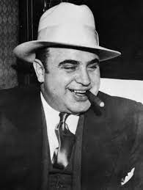
Al Capone
Bootlegging gangster who ran 1000s of speakeasies, organized crime skyrocketed

Slide 2
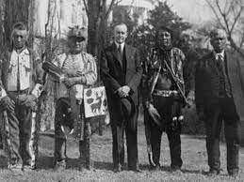
American Indian Citizenship Act
Granted citizenship to all American Indians born in the U.S.; signed by President Coolidge in 1924

Slide 3
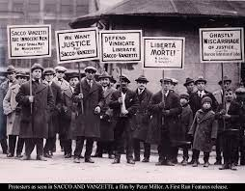
Anarchists
People that believe that all government and authority is bad and should be removed

Slide 4
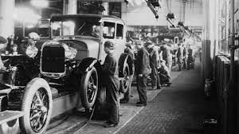
Assembly Line
Henry Ford; mass production, Model T car less expensive

Slide 5
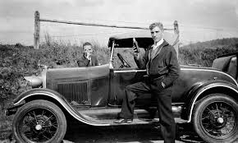
Bootleggers
People who manufactured and smuggled illegal liquor

Slide 6
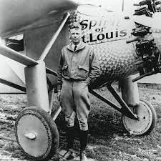
Charles Lindbergh
First man to fly across the Atlantic Ocean

Slide 7
Communism
Political system based on a single party government ruled by a dictatorship

Slide 8
Consumer
People who purchase goods and services for personal use

Slide 9
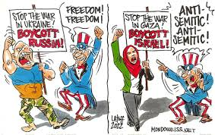
Double Standard
When society sets behavior standards for men that are different for women

Slide 10
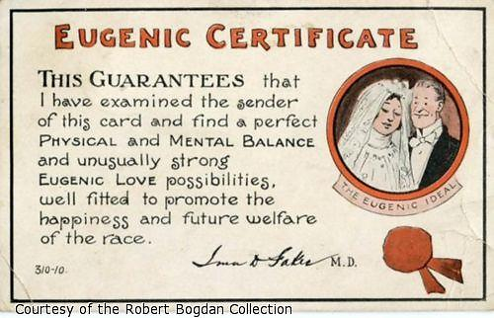
Eugenics
Human gene pool can be improved by decisions about who has children with whom; historically, eugenicists advocated selective breeding to achieve these goals

Slide 11
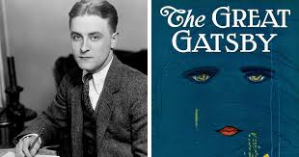
F. Scott Fitzgerald
“The Great Gatsby” represented economic prosperity

Slide 12
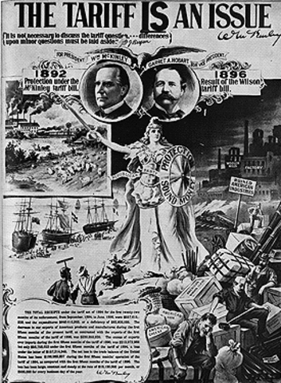
Fordney-McCumber Tariff
Law that raised American tariffs on many imported goods to protect factories and farms; triggered a tariff war

Slide 13
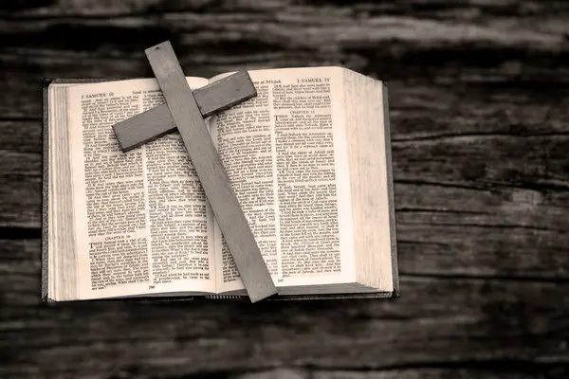
Fundamentalism
The belief that all important information can be found in the Bible; anti-science

Slide 14
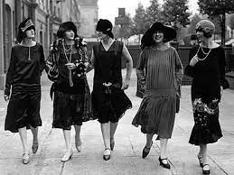
Flapper
A fashionable young woman, going against traditional standards of behavior

Slide 15
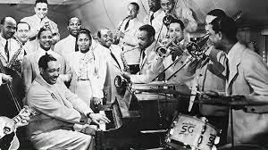
Harlem Renaissance
Explosion of African American literature, art, music, and culture

Slide 16
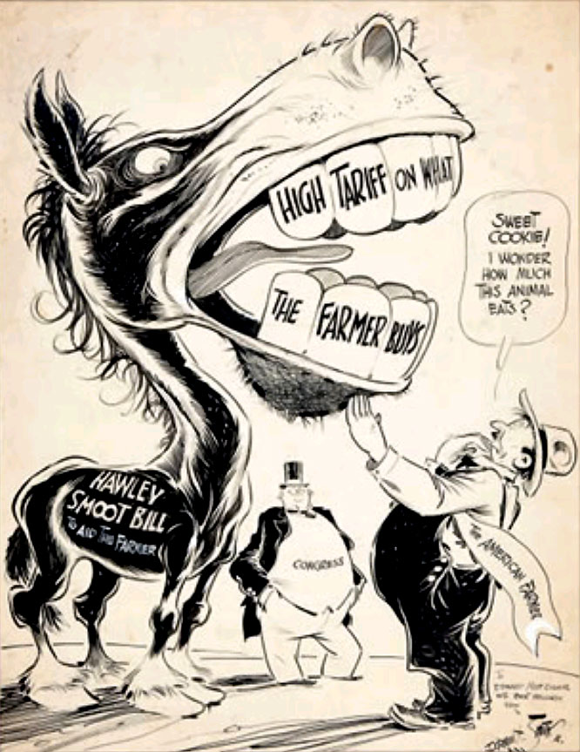
Hawley Smoot Tariff
Increased tariffs on foreign imports to the U.S. by about 20%; global trade plummeted, contributing to the ill effects of the Great Depression

Slide 17
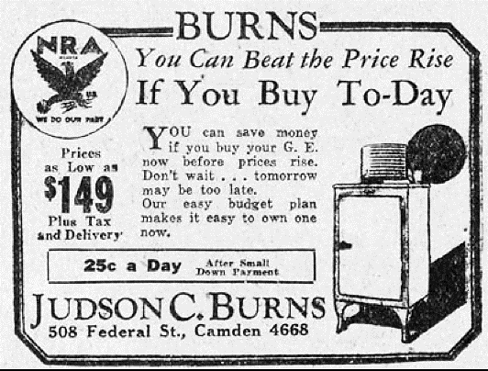
Installment Plan
A way of buying items you cannot afford on credit and with interest

Slide 18
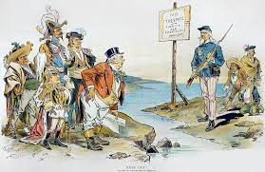
Isolationism
American policy of staying out of world affairs; the U.S. practiced this after World War I

Slide 19
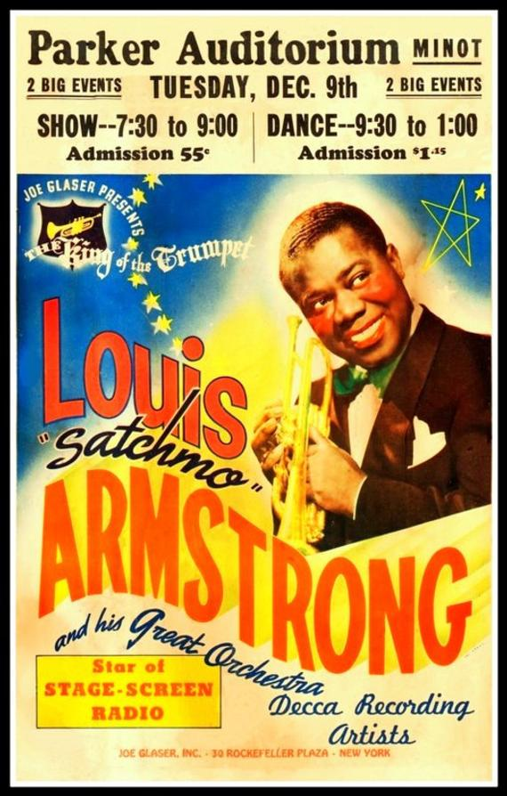
Jazz
Music that originated in African American communities; saxophone, trumpet, & French horn

Slide 20
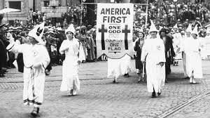
Ku Klux Klan (KKK)
White supremacist group with a focus on eugenics; also anti-Jew, Catholic, and foreigners

Slide 21
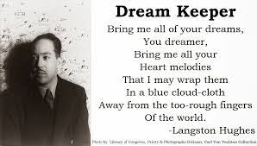
Langston Hughes
Literature from the Harlem Renaissance embraced pride in the African-American culture

Slide 22
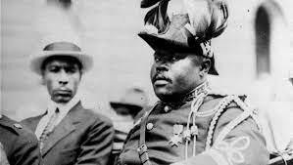
Marcus Garvey
Black nationalism activist who calls for African-Americans to separate from white society

Slide 23
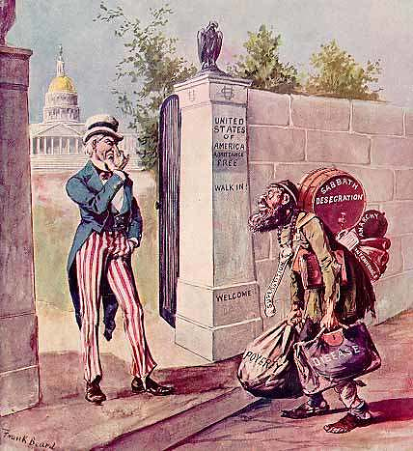
Nativism
Anti-immigration, prejudice or fear by native-born people

Slide 24
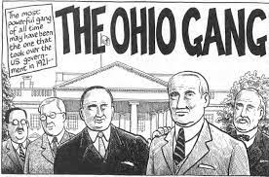
Ohio Gang
President Harding’s cabinet, his friends but not good advisors; very corrupt

Slide 25
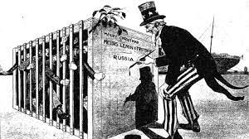
Palmer Raids
U.S. Department of Justice manhunt to locate communists and anarchists

Slide 26
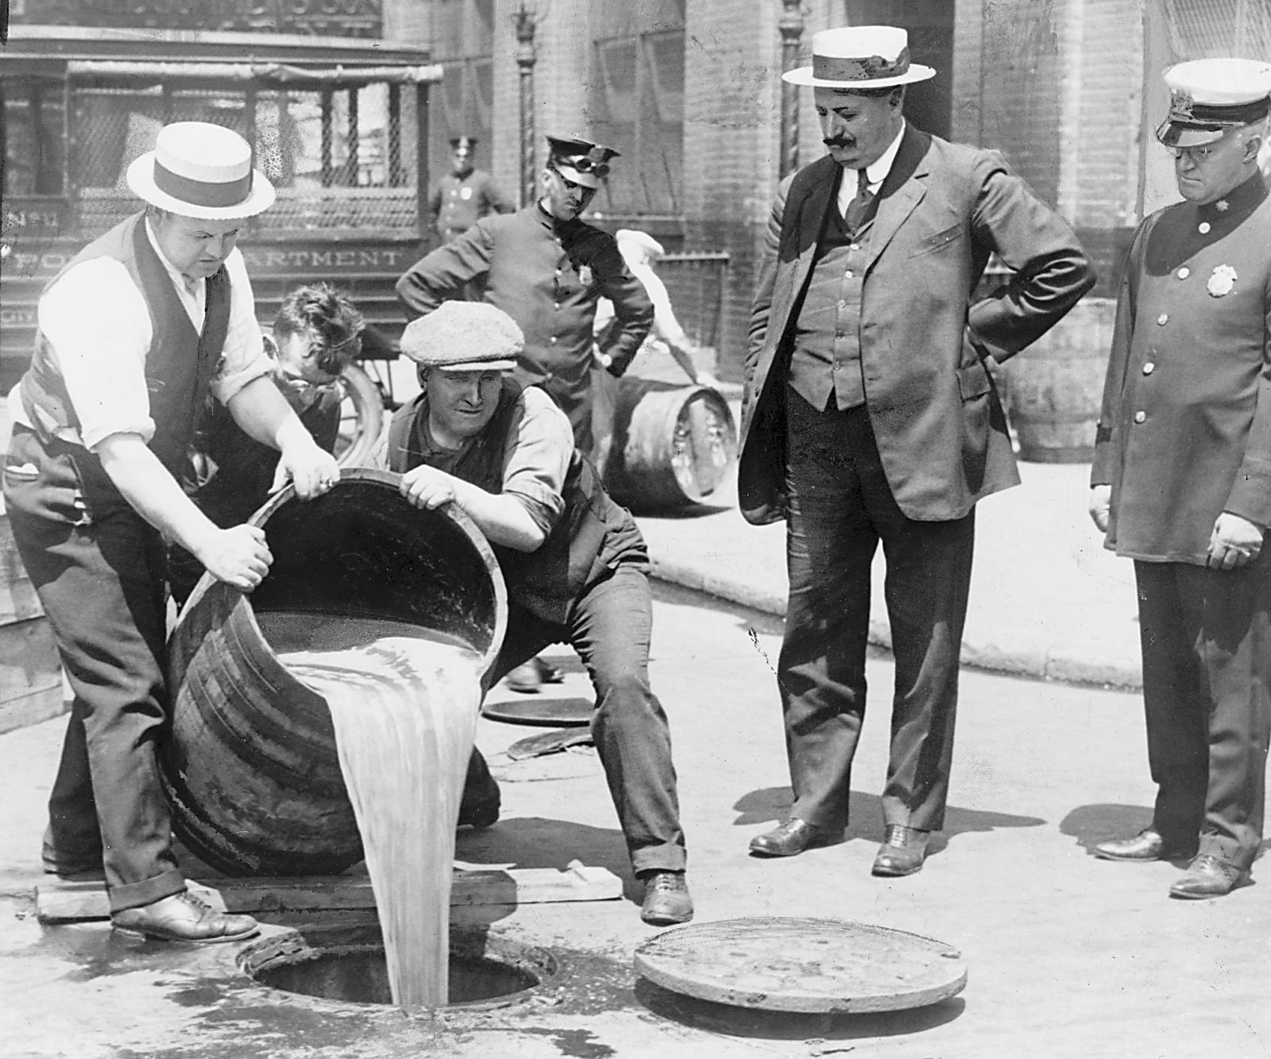
Prohibition (18th Amendment)
Making the manufacturing and selling of alcoholic beverages illegal

Slide 27
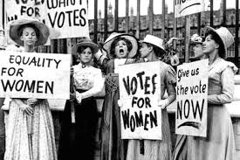
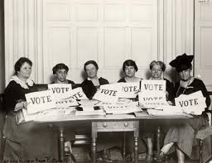
19th Amendment
Women’s suffrage; right to vote

Slide 28
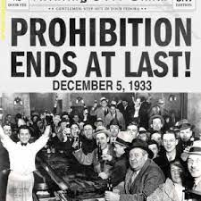
21st Amendment
Repealed the 18th Amendment; legalized alcohol

Slide 29
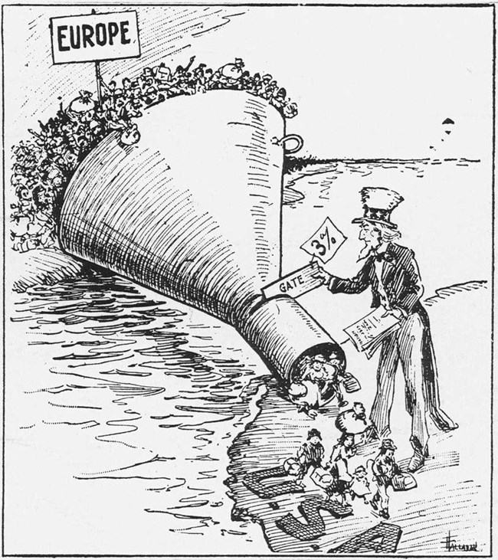
Quota System
Established a maximum number of people who were allowed to enter the U.S.

Slide 30
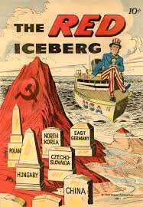
Red Scare
National panic caused by fears that Communism would take over the United States

Slide 31
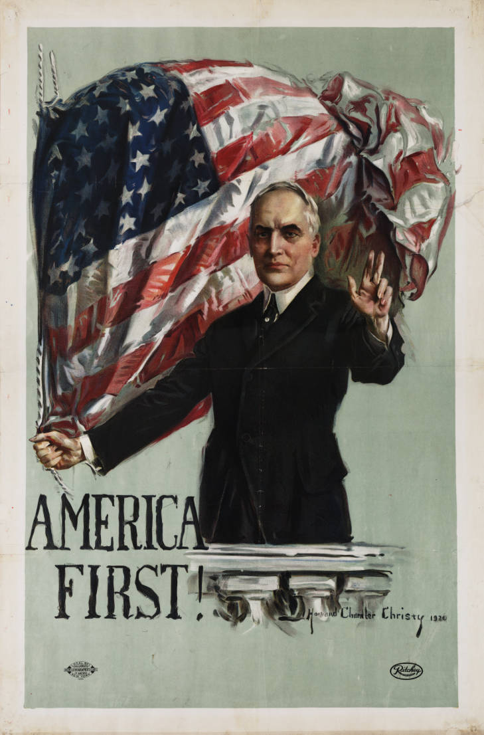
Return to Normalcy
President Warren G. Harding’s campaign promise - he would bring the U.S. back to its “simpler” ways before WWI; corrupt president

Slide 32
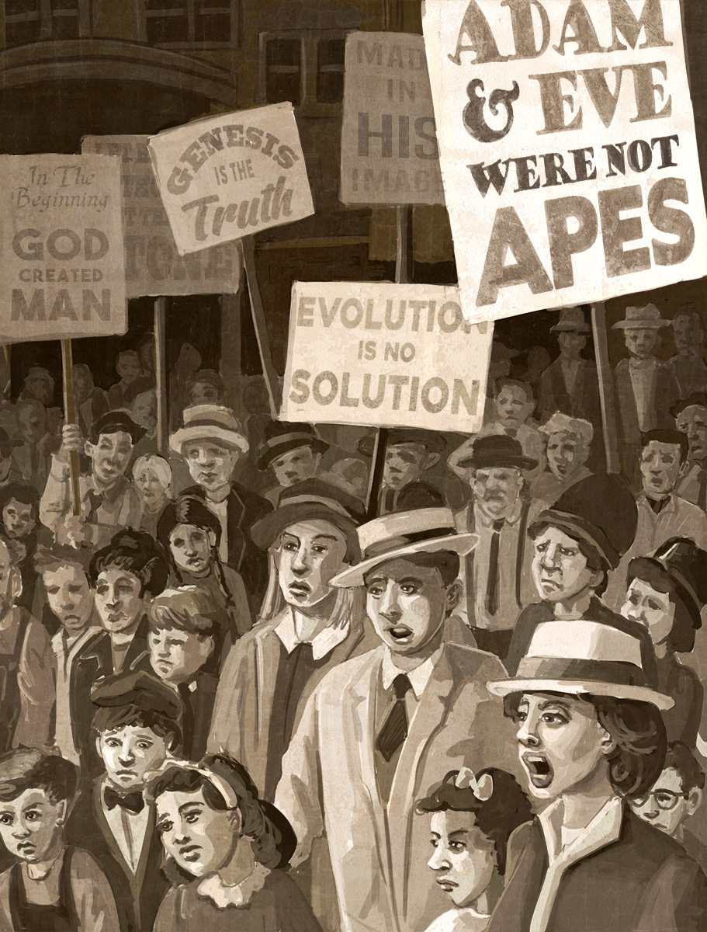
Scopes Monkey Trial
Trial debating if evolution should be legally taught in schools;
WJ Bryan (prosecutor) and Charles Darrow (defense attorney)

Slide 33
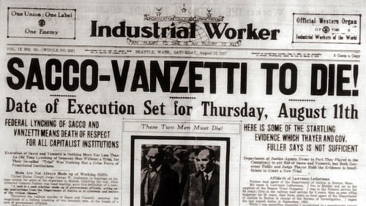
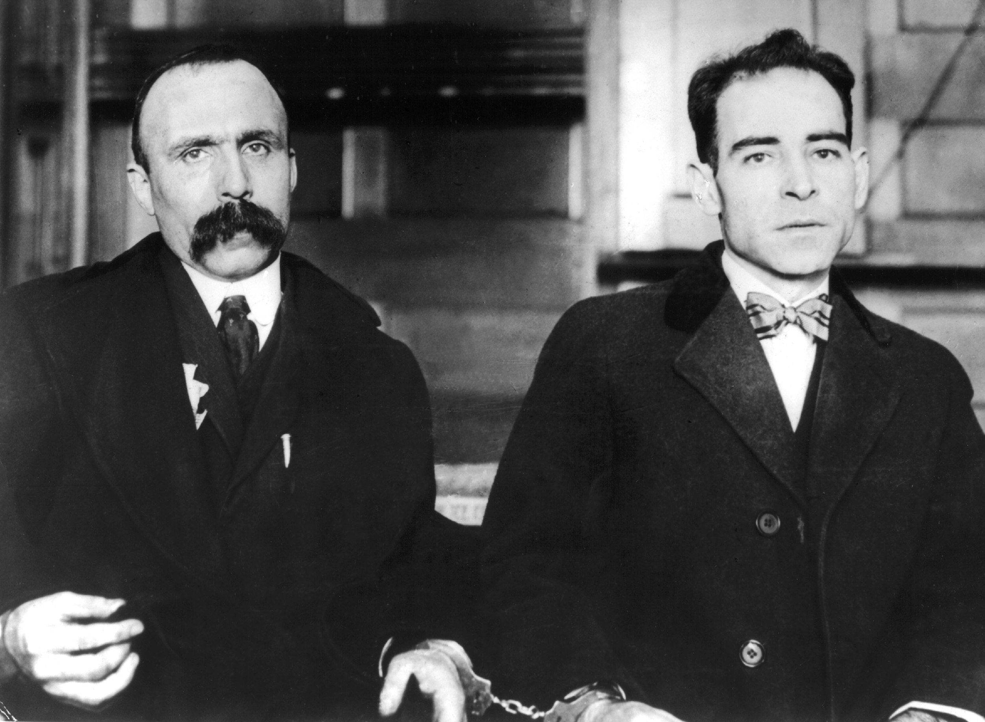
Sacco-Vanzetti
Two immigrants and supposed anarchists who were tried and executed for a murder in an unfair trial due to nativist ideals

Slide 34
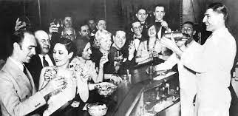
Speakeasy
Establishment that illegally sells alcoholic beverages

Slide 35
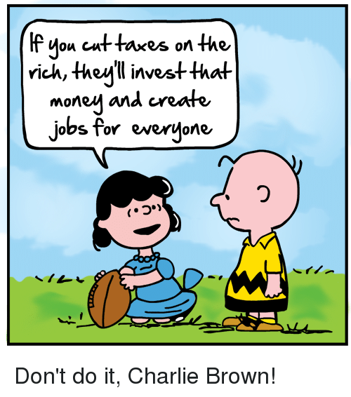
Supply Side Economics
Consumers will benefit from a greater supply of goods and services at lower prices

Slide 36
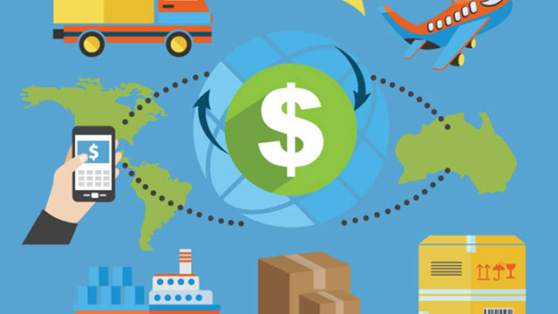
Tariff
A tax placed on foreign goods to help domestic businesses

Slide 37
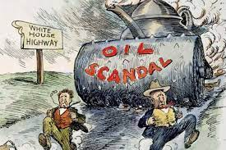
Teapot Dome Scandal
A political scandal during the presidency of Warren G. Harding, in which one of his cabinet-members took bribes from oil companies

Slide 38
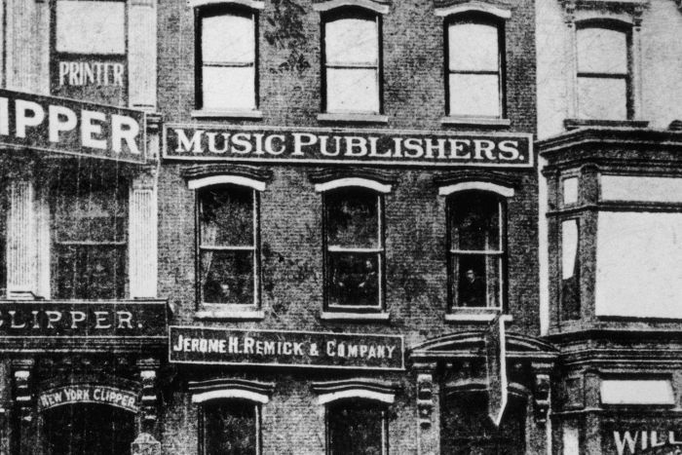
Tin Pan Alley
New York City music published and songwriters who dominated the popular music

Slide 39
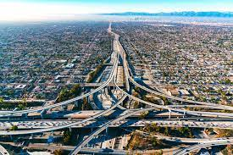
Urban Sprawl
Cities spreading out in all directions

