Slide 1
Atlantic Ocean
This is the 2nd largest of the earth’s 5 oceans.
It’s also the most heavily traveled ocean.
It forms the eastern border of Canada.
It’s a major shipping route to Europe & Africa.

Slide 2
Pacific Ocean
Largest & deepest of the world’s 5 oceans
Covers 1/3 of the earth’s surface!
Western border of Canada
Major shipping route to Asia

Slide 3
British Columbia Video
At the bottom of your notes list 4 things you might like to do if you could go to British Columbia

Slide 4
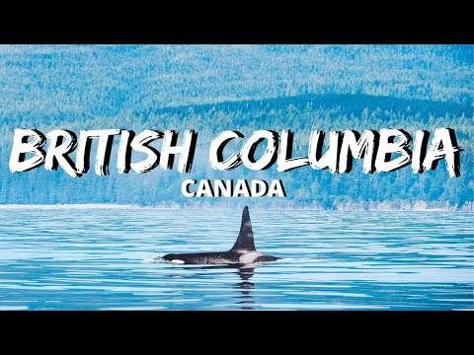

Slide 5
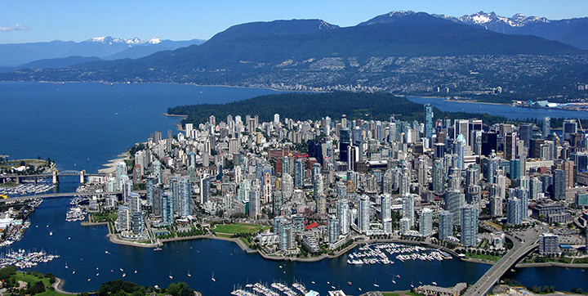

Slide 6
Canadian Shield
Stretches from Great Lakes to Arctic Ocean; covers half of Canada!
Region home to thousands of lakes
Major source of natural resources:
Region is sparsely populated.

Slide 7
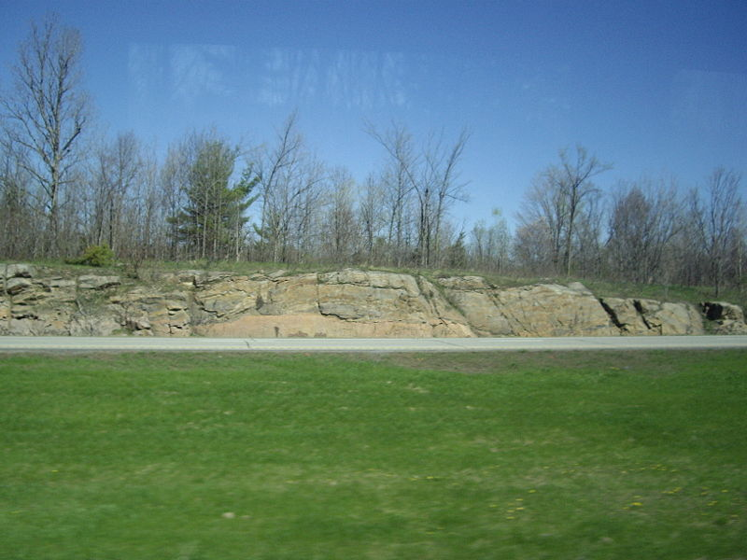

Slide 8
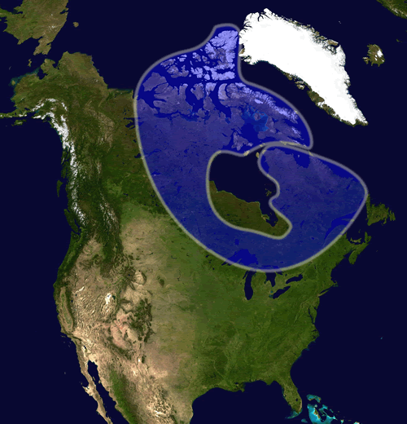

Slide 9
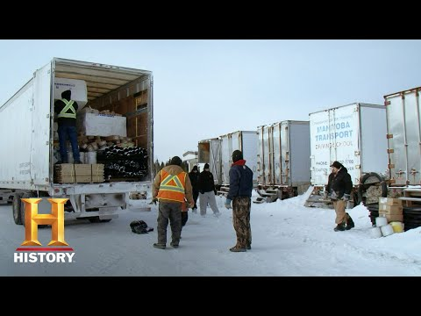
Ice Road Truckers

Slide 10
Rocky Mountains
Mountains located in Western Canada
Stretch a distance of 2,000 miles!
Mining is the biggest industry in the region
Major minerals include: iron ore, copper, coal, gold.
Sparsely populated

Slide 11
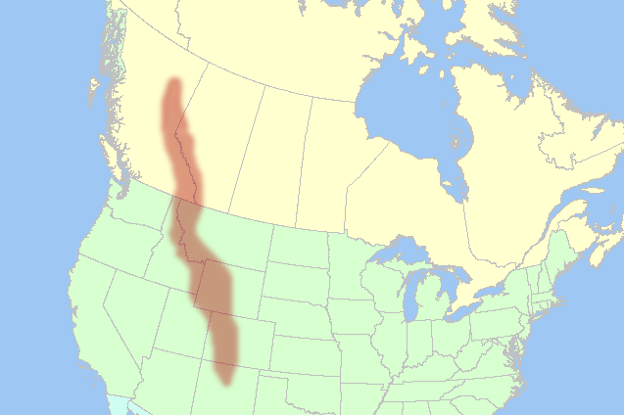

Slide 12
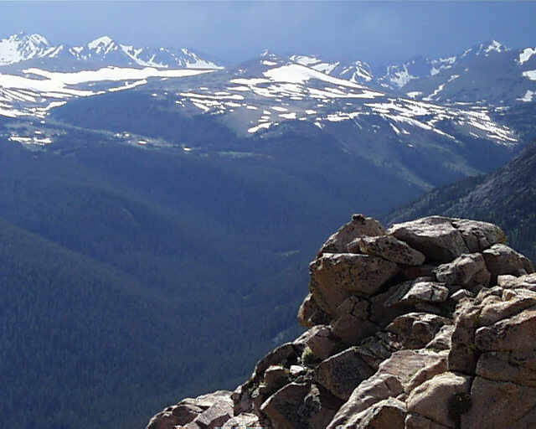

Slide 13
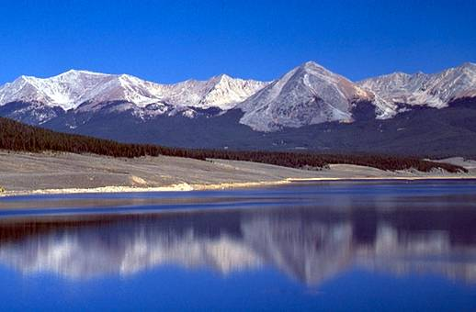

Slide 14
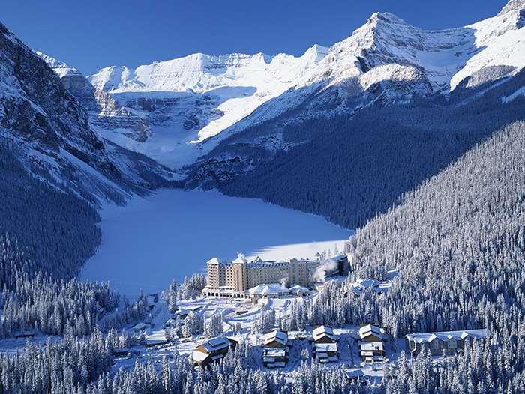
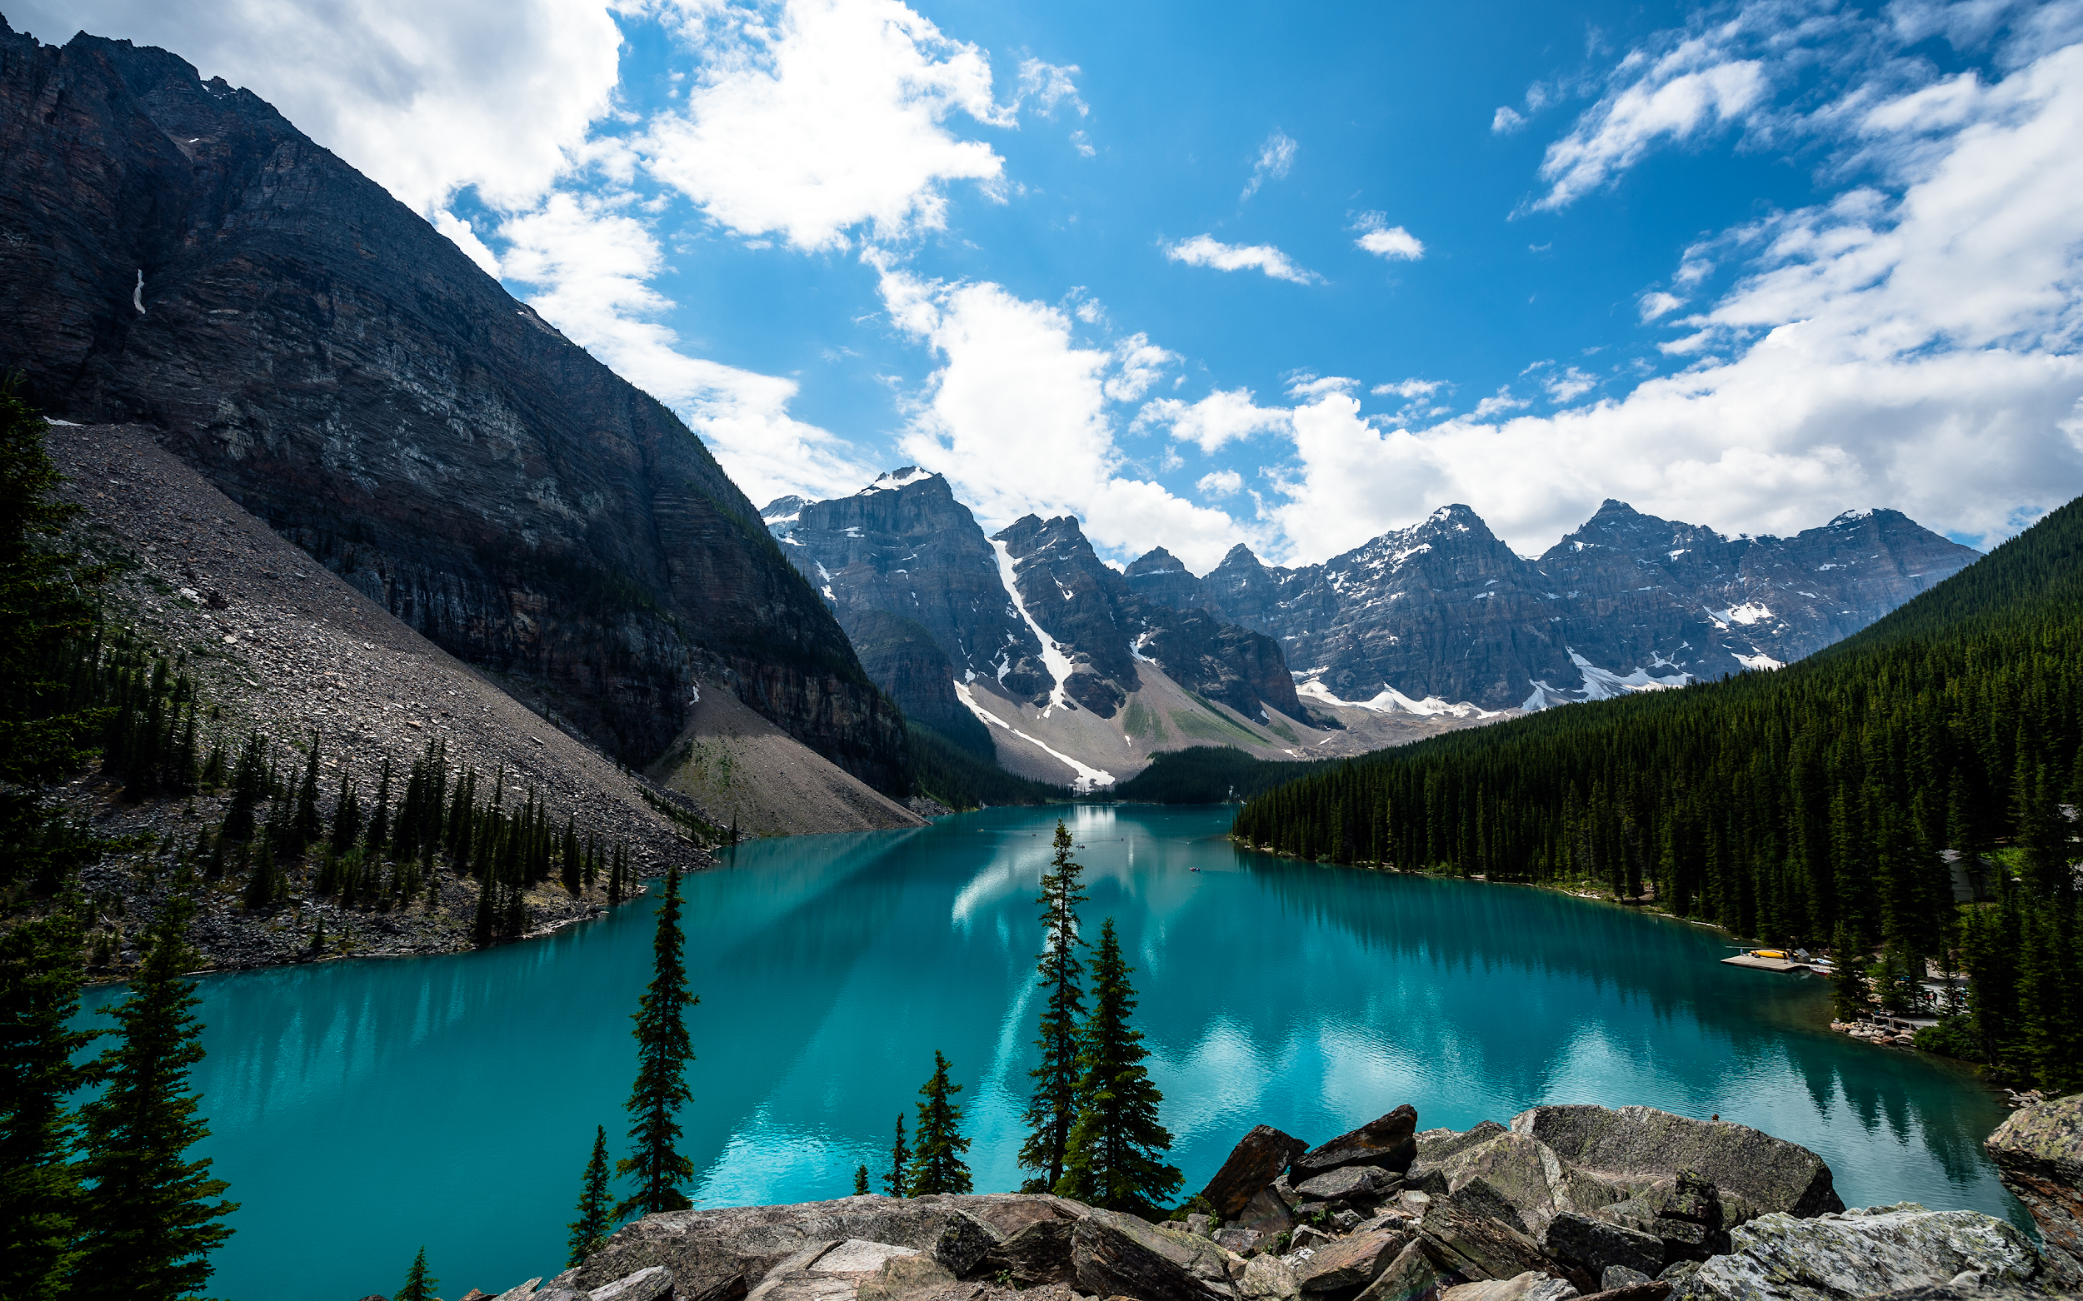
Canadian Rockies: Banff National Park Film
How large is the park?
How many people visit the park each year?
What lake is called the Jewel of the Canadian Rockies?
List 4 activities you can do in the park?

Slide 15
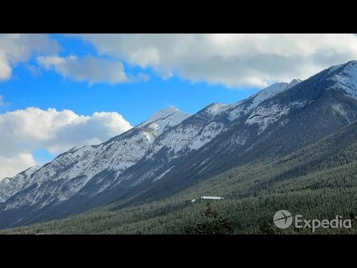
Banff Film

Slide 16
Be the Thing…
Your Task:
Choose 1 of the physical features
Fold your paper “hamburger style” to make a desk tent
On the front : Imagine that you are one of the features. Write 5 facts about yourself.
On the back: draw an illustration of the feature
We will walk around and try to guess the features!

Slide 17
Example:
Brrrrr! I am always so cold!! It’s chilly up here in northern Canada. I am so tired of everybody always picking on me. Dig, dig, dig all day long. I wish I had some pretty trees to look at…All that I can see is scraggly trees and flat, rocky land. It’s so lonely. No one lives near me.

Slide 18
Canadian Shield!

