Slide 1
Geography
of Canada
Physical Features, Where People Live, & How They Trade

Slide 2
Teachers
Print off the following slide for each student. They should complete the chart while discussing the presentation.

Slide 4
Physical
Features

Slide 5
Great Lakes
5 large freshwater lakes
HOMES (Huron, Ontario, Michigan, Erie, Superior)
Serve as the “industrial heartland” of the continent
One of the world’s busiest shipping areas
Most of Canada’s population lives in this region

Slide 8
Great Lakes

Slide 9
St Lawrence River
Major source of overseas and US/Canada shipping & trade
Shortcut that connects the Great Lakes to the Atlantic Ocean
Huge producer of hydroelectricity

Slide 10
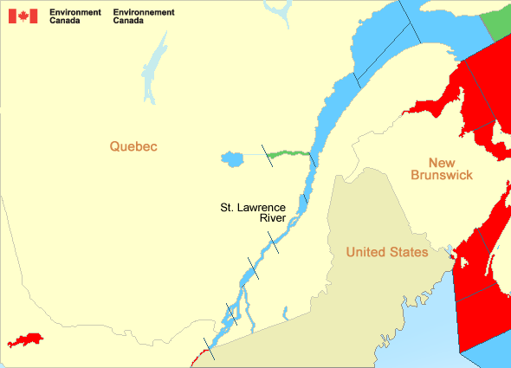

Slide 11
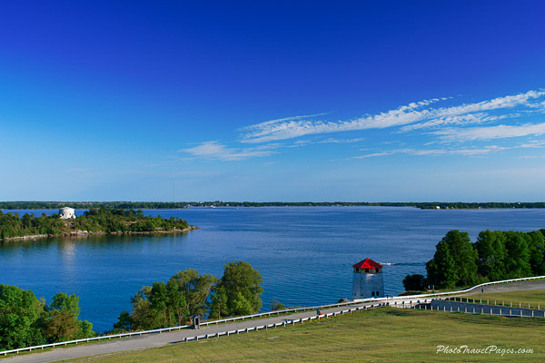

Slide 12
St Lawrence Seaway
A canal completed in 1959
Connects the Great Lakes with the St. Lawrence River
Major source of overseas trade
Closed from November to April (frozen)

Slide 13
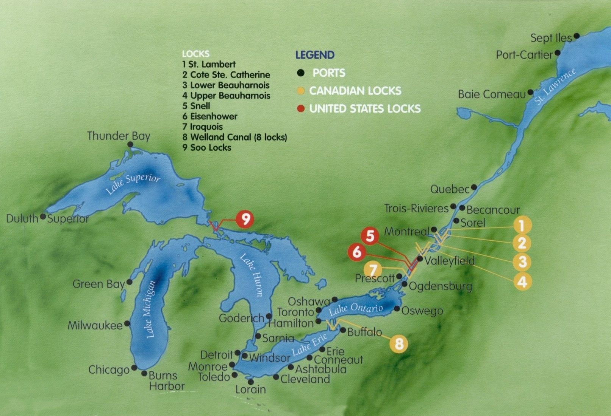

Slide 14
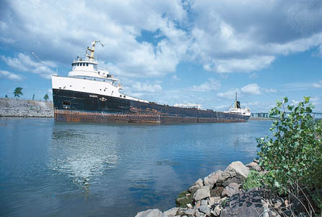

Slide 15
St Lawrence Seaway Film

Slide 16
Hudson Bay
HUGE inland sea in east central Canada
“an arm” of the Atlantic Ocean
Only navigable from July to October

Slide 17
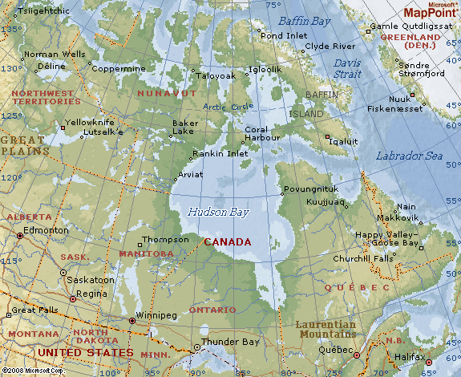

Slide 18
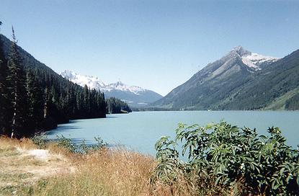

Slide 19
Churchill Canada Polar Bears

