Slide 1
Market Structures
Markets & Businesses

Slide 2
Essential Question
How are markets structured?

Slide 3
Warm Up
Use the space in your notes to respond to the prompts below. Please write in complete sentences.
What is a market?
What role does competition play in a market for a good or service?
How would the market for tomatoes look similar or different to the market for laptops?

Slide 4
Market Structures
What is a market?
It’s where buyers and sellers do business
How are markets structured?
Markets generally fall into 4 main categories: perfect competition, monopolistic competition, oligopoly, & monopoly
These markets are defined mainly by the level of competition
To identify each type of market we need to know:
Number of producers (level of competition)
Similarity of products in the market
Ease of entry into the market (high or low barriers)
Control over price

Slide 5
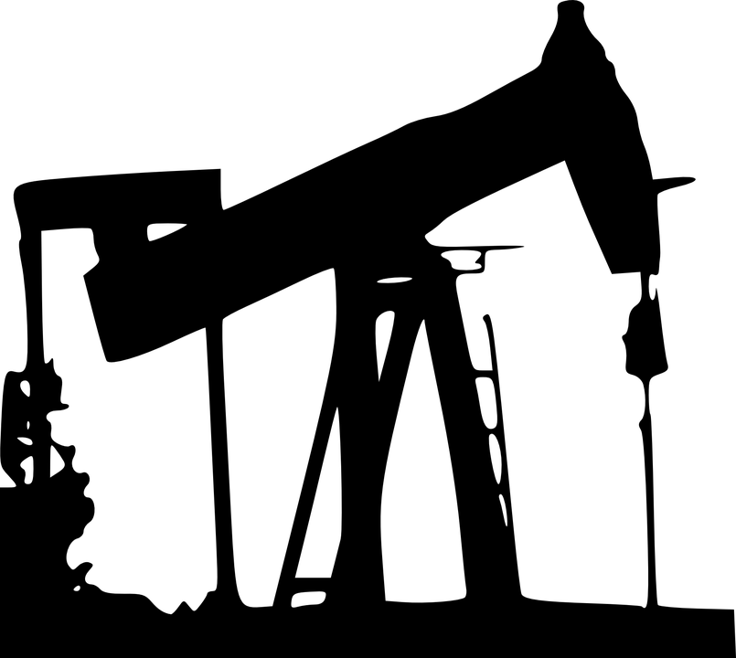
Perfect Competition
What is perfect competition?
It’s the most efficient market structure because there are many firms competing
The price is determined by equilibrium in a perfectly competitive market
Consumers have easy access to information, such as comparing prices
Examples: cotton, grains, crude oil
What are the characteristics?
Many producers
Identical products (also known as commodities)
Easy to enter the market (few restrictions)
No control over price (also known as “price takers”)

Slide 6
Think-Pair-Share
What are some examples of perfectly competitive markets based on this definition?
Why would economists like this market structure best in a market-based economy?

Slide 7
Monopolistic Competition
What is monopolistic competition?
It’s a competitive market structure where the product is differentiated but there are many sellers
Since consumers usually develop “brand loyalty” to certain companies, these brands can develop more market power and can charge more
Examples: shoes, restaurants, hotels, gas stations
What are the characteristics?
Many producers
Varied yet similar products that can be substitutes
for one another
Few barriers to entry
Some control over price

Slide 8
Think About It
Why would building a brand be important to these companies? How would they “build” a brand?

Slide 9
Oligopoly
What is an oligopoly?
It’s a less competitive market where a few companies dominate the market
Examples: soft drinks, automobile, light bulbs, cell phone service providers, cartels like OPEC (illegal in the US)
What are the characteristics?
Few producers (top 4 producers supply a combined 60%+ of total market output)
Similar products
High barriers to entry due to high start up costs
Some control over price (more than monopolistic comp.)

Slide 10
Think About It
Why do you think cartels (oligopolies who work together to set prices for the market) are illegal in the US?

Slide 11
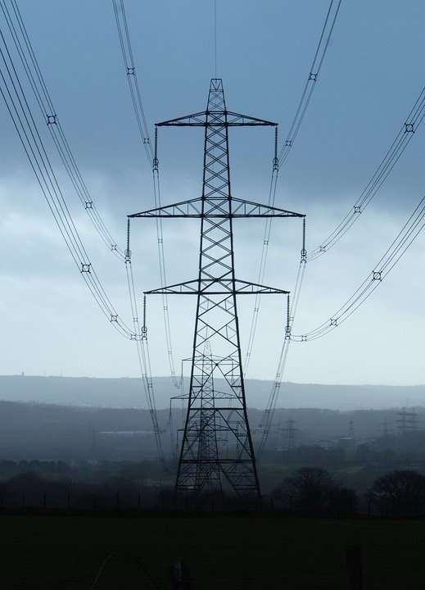
Monopoly
What is a monopoly?
There is no competition because one company controls the market
Due to anti-trust laws, they are not common in the US today
3 types of legal monopolies: resource (one person owns all of a natural resource), government-instituted (like patents), natural (where it only makes sense for one company to provide the service such as electricity)
What are the characteristics?
One producer
Unique Product
High barriers to entry
High control over prices (also known as “price setters”)

Slide 12
Think-Pair-Share
Why do you think the government made most monopolies illegal?
Who or what controls how markets are structured?

