Slide 1
QUESTION OF THE DAY
Managing Credit
Q:
What is the average credit card debt among those carrying a balance?
View blog post
ngpf.org 4/27/22

Slide 2
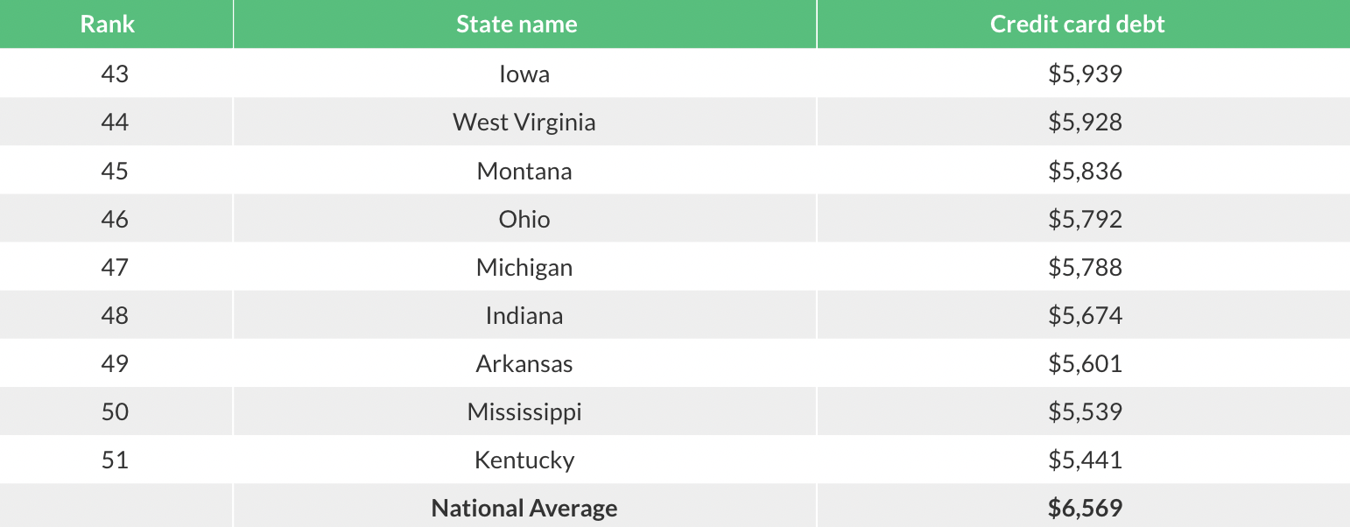
QUESTION OF THE DAY
Managing Credit
A:
$6,569
Source: Lending Tree

Slide 3
FOLLOW-UP QUESTIONS
Are you surprised by the amount of credit card debt people carry? Why or why not?
What negative consequences can you think of for carrying a credit card balance from month to month?
What are some strategies you plan to use to make sure you pay your credit card bill every month (if you plan to use one)?

