Slide 1
INTRODUCTION TO THE PROGRESSIVE ERA & WOMEN REFORMERS
U.S. History
Unit 3: Progressive Era #1

Slide 2
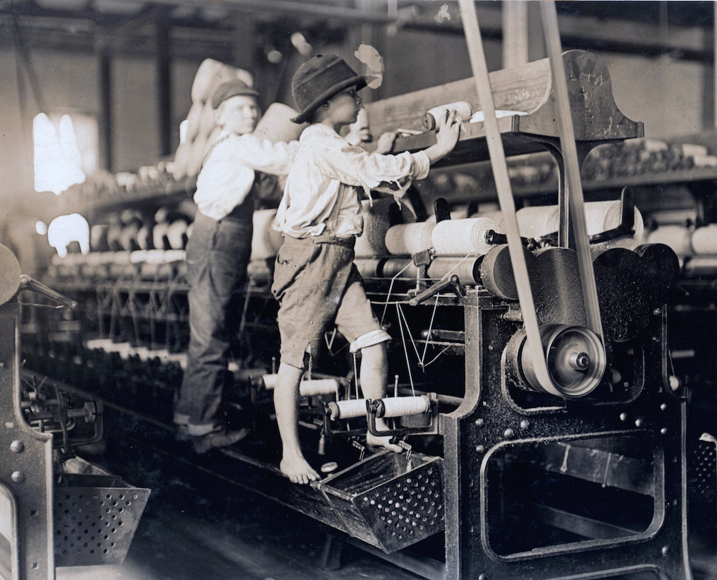
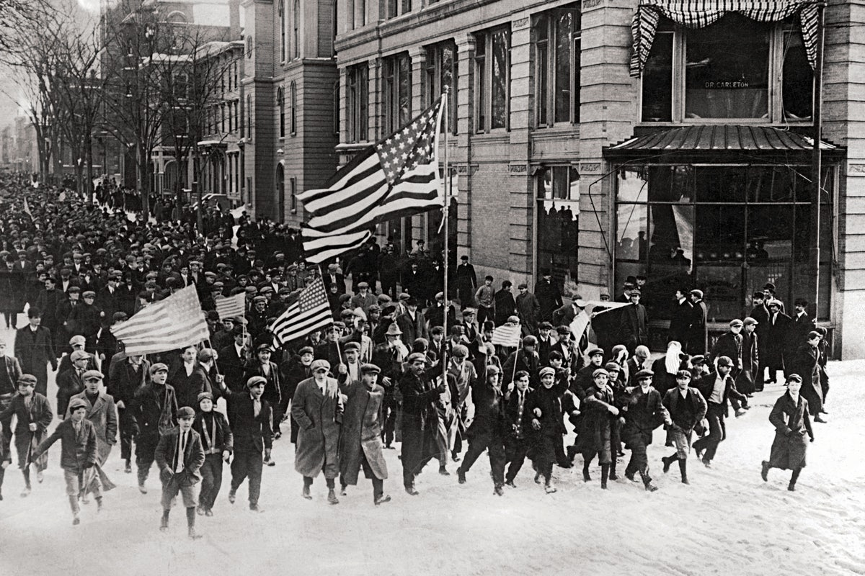
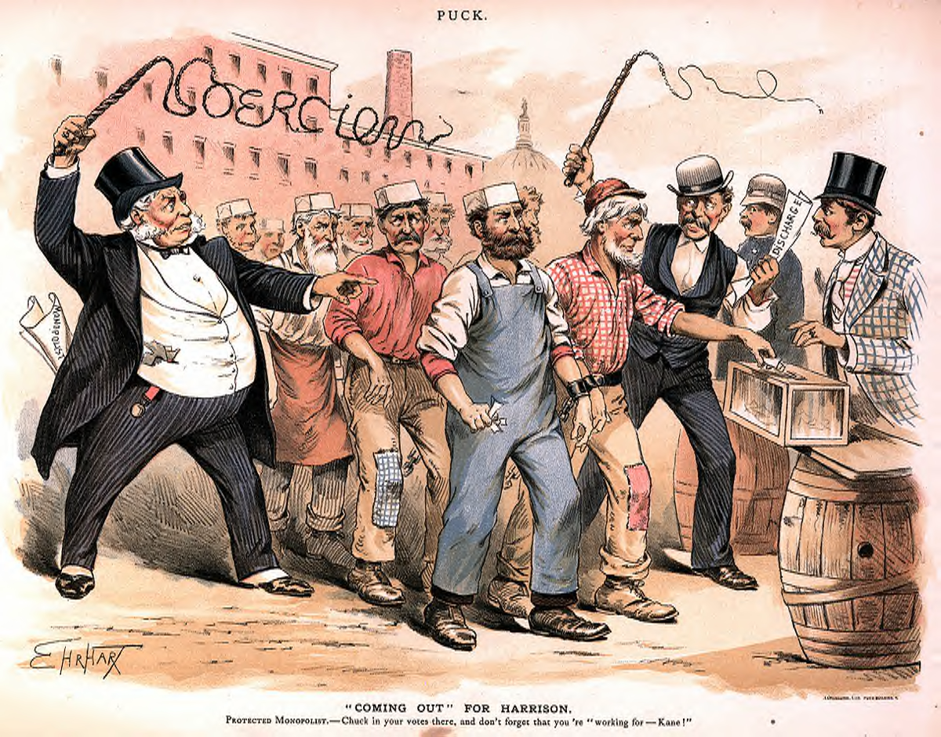
THE PROGRESSIVE MOVEMENT & THE PROGRESSIVES
Tried to correct the problems of industrialization and urbanization and return power to the people
Known as the Progressives:
These are the people who tried to fix the problems of the eastern cities

Slide 3
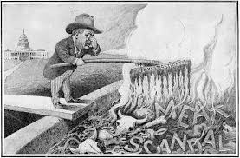
MUCKRAKERS
Writers who exposed the problems of the Gilded Age that resulted from rapid industrialization

Slide 4
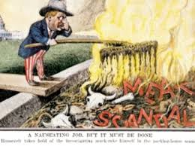
UPTON SINCLAIR
Problem: corrupt and unsanitary food (meat)
Method: investigated meat-packing plants and wrote “The Jungle”
It should be a “sin” to have bad meat
Result: Teddy issued the following two laws:
Food & Drug Act
Meat Inspection Act

Slide 5
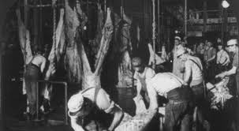
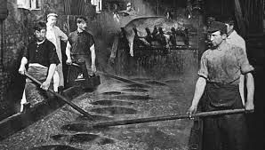
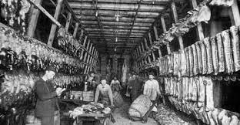
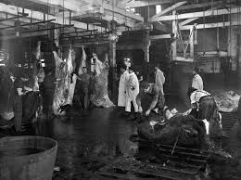
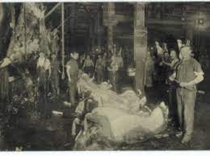
THE JUNGLE
“There would be meat that had tumbled out on the floor, in the dirt and sawdust, where the workers had tramped and spit uncounted billions of consumption germs. There would be meat stored in great piles in rooms; and the water from leaky roofs would drip over it, and thousands of rats would race about on it.” – Upton Sinclair

Slide 6
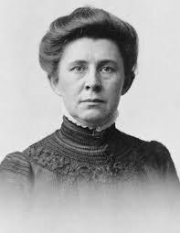
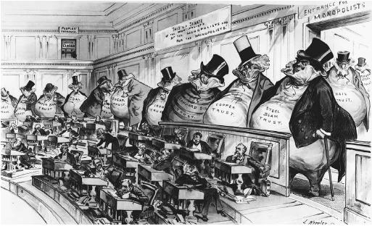
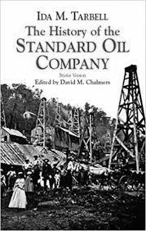
IDA TARBELL
Problem: unfair monopolies and trusts
Method: wrote a book about Rockefeller and the Standard Oil Company
Result: Sherman Antitrust Act & Clayton Antitrust Act

Slide 7
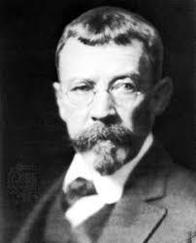
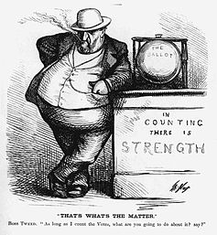
LINCOLN STEFFENS
Problem: exposed local government corruption
Method: wrote “The Shame of the Cities”
Result: people sought more direct power; questioned their government

Slide 8
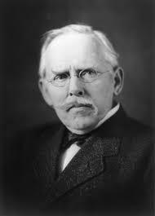
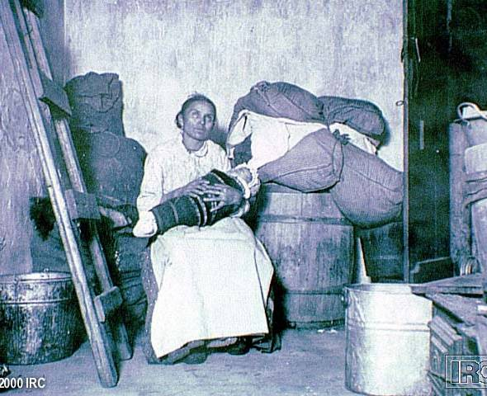
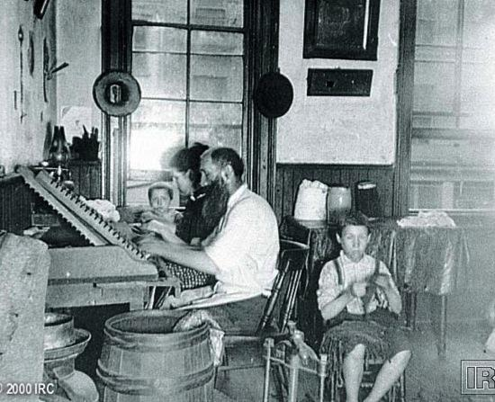
JACOB RIIS
Problem: poor living conditions and slums for immigrants, children, and the poor
Method: wrote “How the Other Half Lives” & photography
Result: laws & ordinances to improve living conditions
Re-see the slums = RIIS

Slide 9
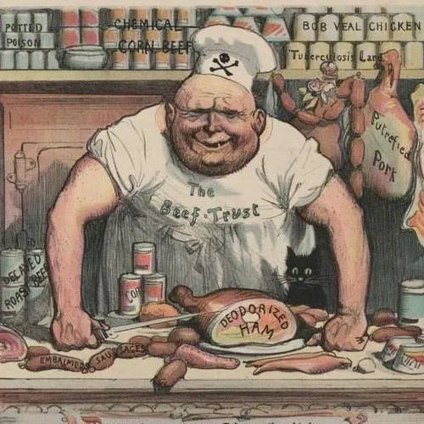
WHICH MUCKRAKER WOULD THIS FIT?
A. Jacob Riis
B. Ida Tarbell
C. Lincoln Steffens
D. Upton Sinclair

Slide 10
WOMEN REFORMERS

Slide 11
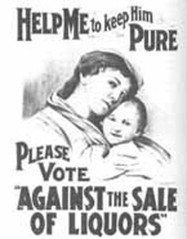
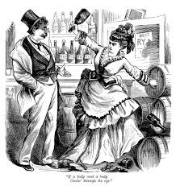
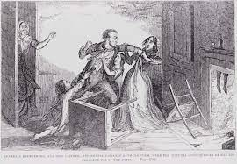
TEMPERANCE MOVEMENT
Temperance = NOT drinking alcohol
Thought it would end corruption and abuse
Alcohol was thought to destroy the family
Led to the 18th Amendment
Goals:
Prevent spousal abuse
Prevent job loss and family suffering
Prevent poverty
Ban the sale of alcohol

Slide 12
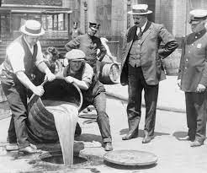
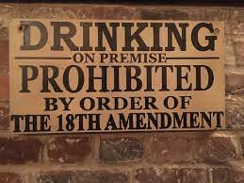
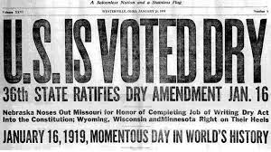
18TH AMENDMENT
Prohibition (the act or practice of forbidding something by law)
Banned the manufacture and sale of alcohol in the U.S.
Frances Willard organized the Prohibition Party in 1882
Created enough influence to get states to ratify the amendment
Many Americans believe Prohibition wrongly tried to force one group’s moral beliefs on others

Slide 13
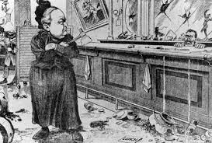
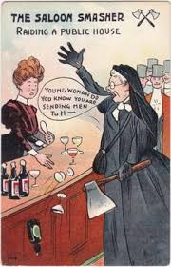
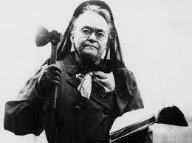
CARRIE NATION
(CRAZY CARRIE)
Leading member of the Temperance Movement
Carrie Nation was considered very radical
She would go into bars and bust up the place with a hatchet

Slide 14
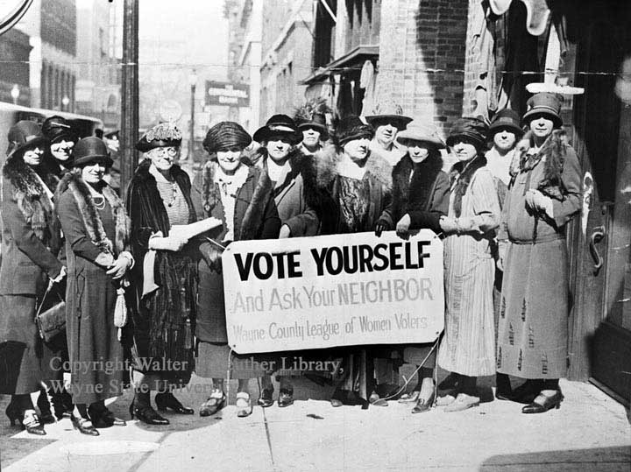
SUFFRAGE
Women’s suffrage: the right of women to vote
Universal suffrage: the right of all citizens to vote
Temperance → Suffrage
Both wanted women to have more power
Success of the 18th Amendment made women want to keep trying for more

Slide 15
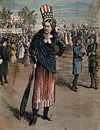
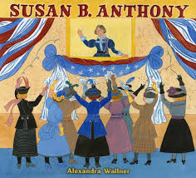
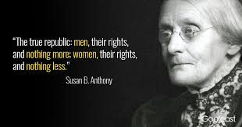
SUSAN B. ANTHONY
American social reformer and women’s right activist who played a pivotal role in the women’s suffrage movement
1872 voted in Rochester, New York
Arrested → Convicted → Fined
“There will never be complete equality until women themselves help to make laws and elect lawmakers.” - Susan B. Anthony

Slide 16
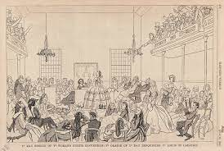
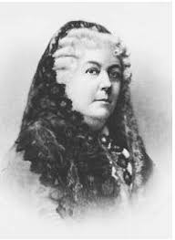
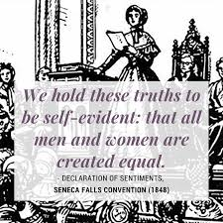
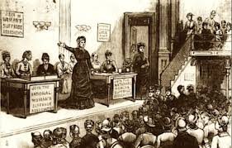
SENECA FALLS CONVENTION & ELIZABETH CADY STANTON
Seneca Falls Convention (1848) in New York
Led by Elizabeth Cady Stanton
First women's rights convention in U.S.; meeting launched the women’s suffrage movement
Wanted to create a Constitutional Amendment granting universal suffrage
Stanton co-authored the Declaration of Sentiments (modeled on the Declaration of Independence)

Slide 17
DEBATE OVER WOMEN’S SUFFRAGE
Arguments FOR Suffrage:
Women are equal in ability to men
Women raise men
Women understand the needs of the home better
Women are half of the population - WITHOUT a voice
Arguments AGAINST Suffrage:
Should stay out of politics
Changed gender roles
Men will lose jobs if gender roles change
Men will end up staying at home with kids

Slide 18
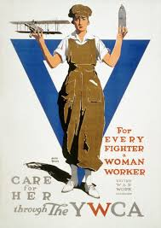
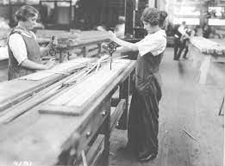
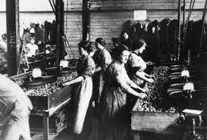
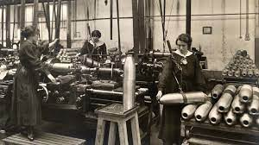
A NEW GENERATION
Women and the Suffrage Movement gained respect and support during WWI
Women worked jobs once reserved for men - while the men went off to war to fight

Slide 19
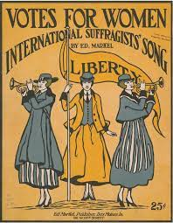
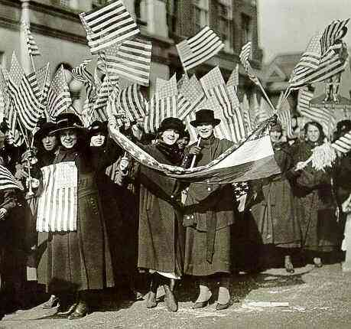
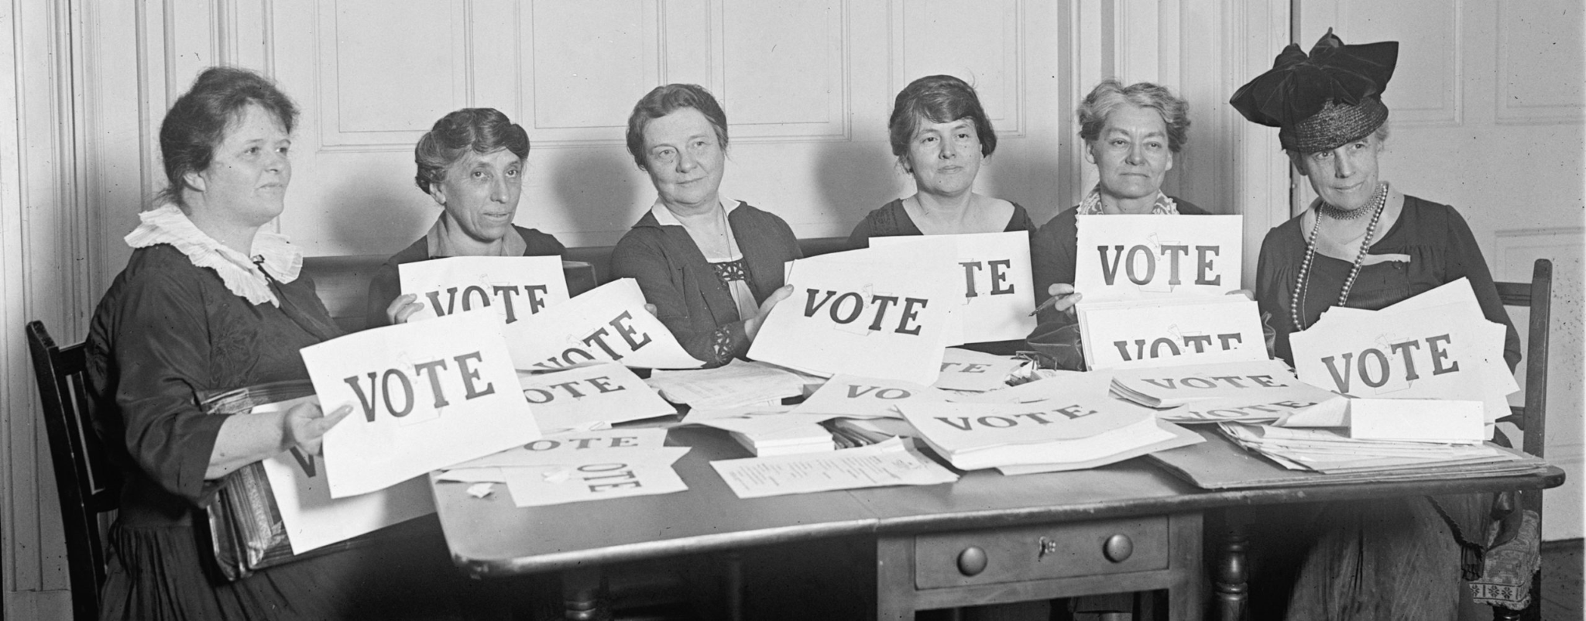
19TH AMENDMENT
Right to vote cannot be denied based on sex/gender
Women gain right to vote

Slide 20
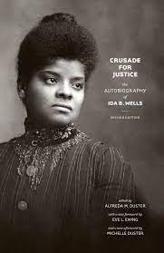
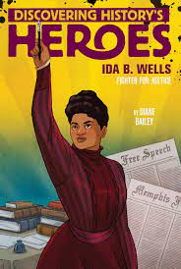
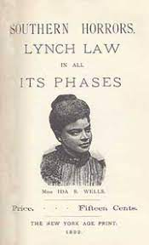
IDA B. WELLS
An African-American journalist, women’s right advocate, and suffragist
Speaker & muckraker
Exposed the horrors of lynching to the American people
Founding member of the NAACP

Slide 21
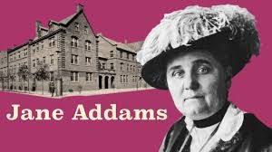
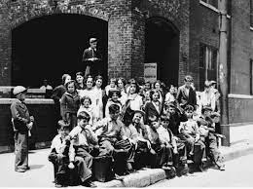
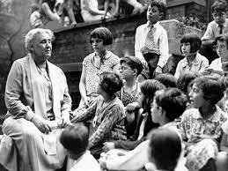
JANE ADDAMS & SETTLEMENT HOUSE
Jane Addams - founder of the Hull House (settlement house)
Homes in immigrant neighborhoods ran by middle class social workers
Provided services to the people
Volunteers lived on site

Slide 22
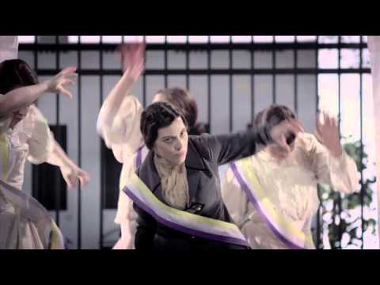

Slide 23
CREATE YOUR OWN T-SHIRT
Topics to choose from:
Temperance
Suffrage
Settlement Houses
Meatpacking Industry
Slums & Poor Living Conditions
Any Muckraker Reform
Needs:
Topic
Slogan
Picture (think graphic t-shirt)
Colorful

