Slide 1
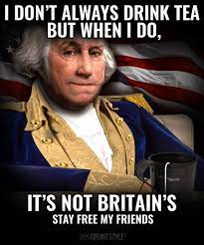
Please put phones and headphones away with the bell.
Game: How much do you know about US History?

Slide 2
How much do you know about US History?
*Without looking up the answers*

Slide 3
What country attacked the US in Hawaii?
A
B
Japan
Germany
D
C
Italy
China
Notes:
A

Slide 4
Which Amendment gives freedom of speech?
A
B
6th
4th
C
D
10th
1st
Notes:
D

Slide 5
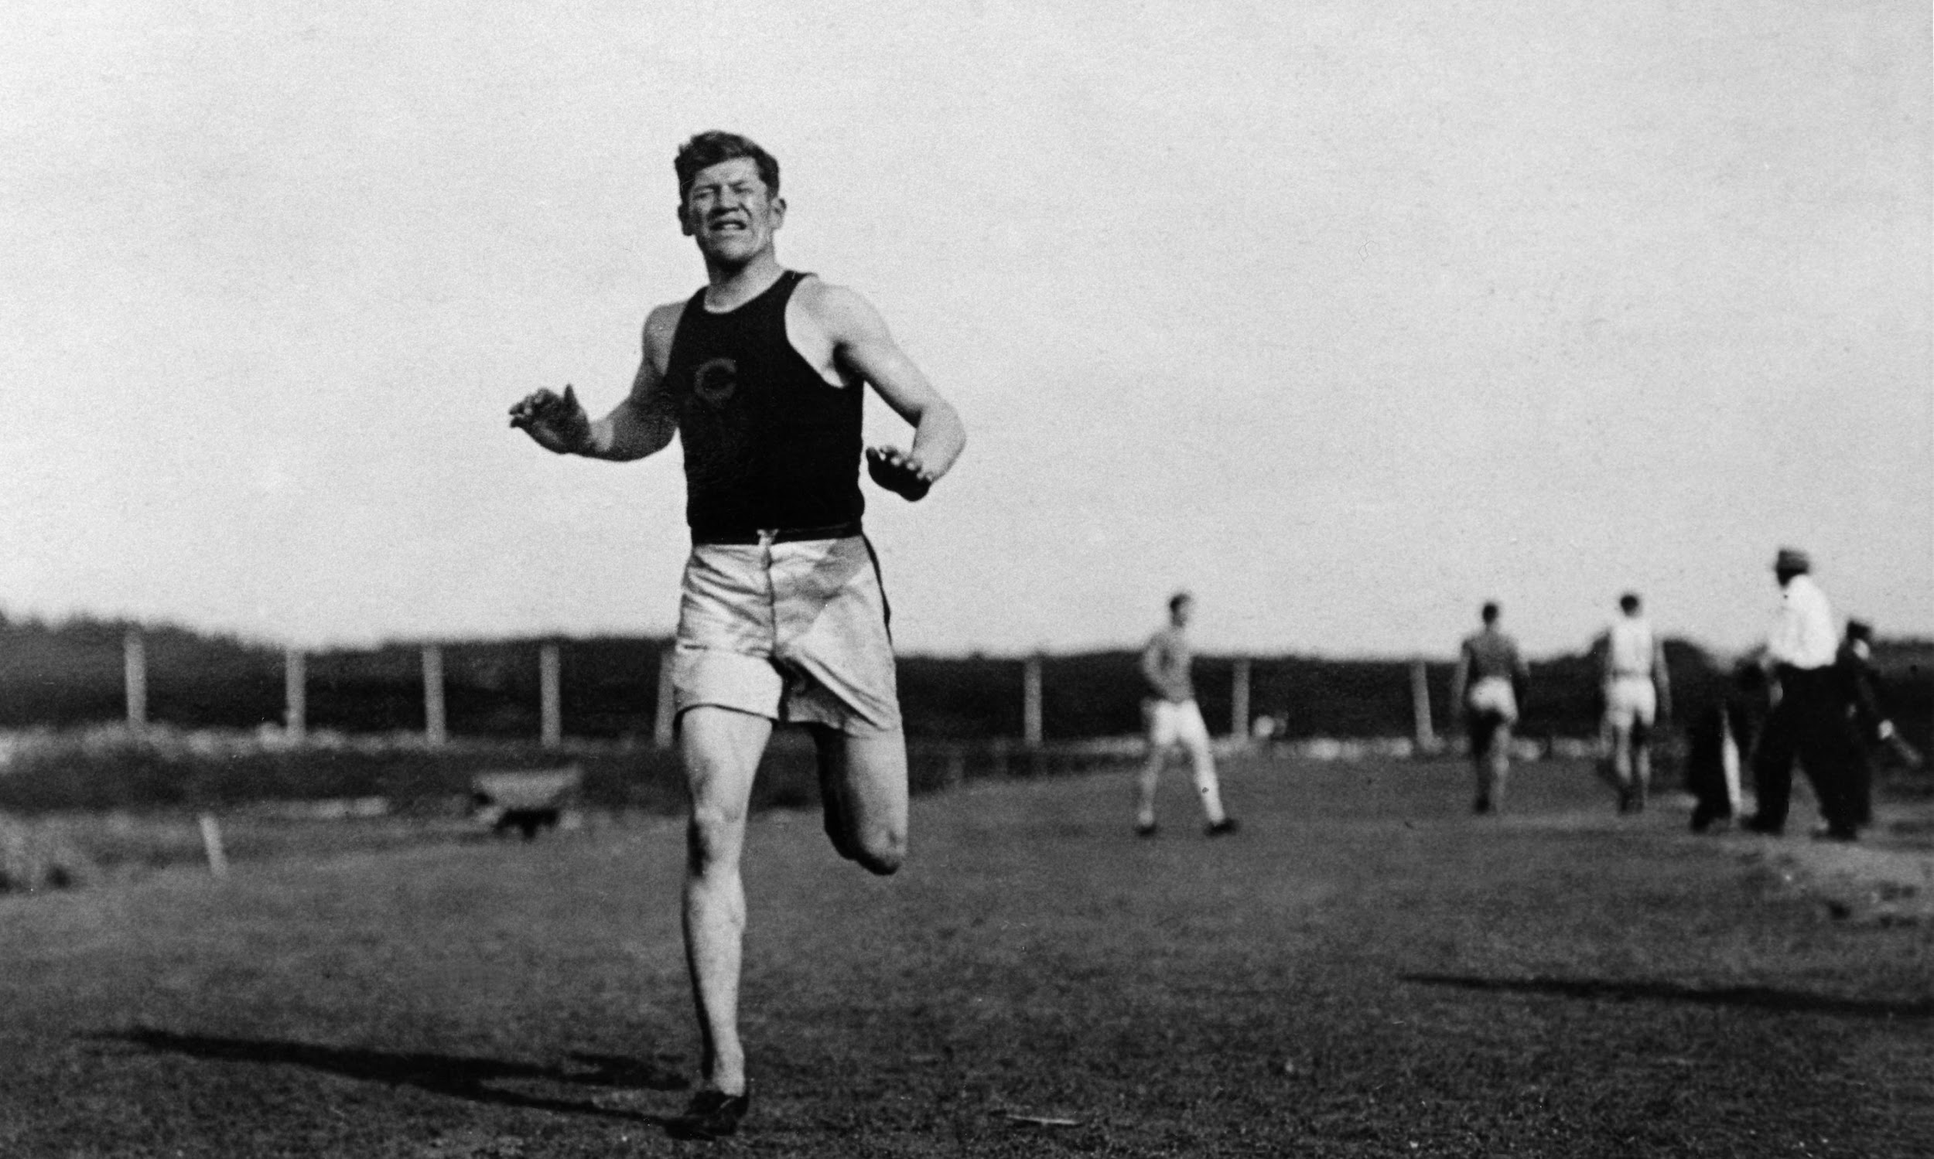
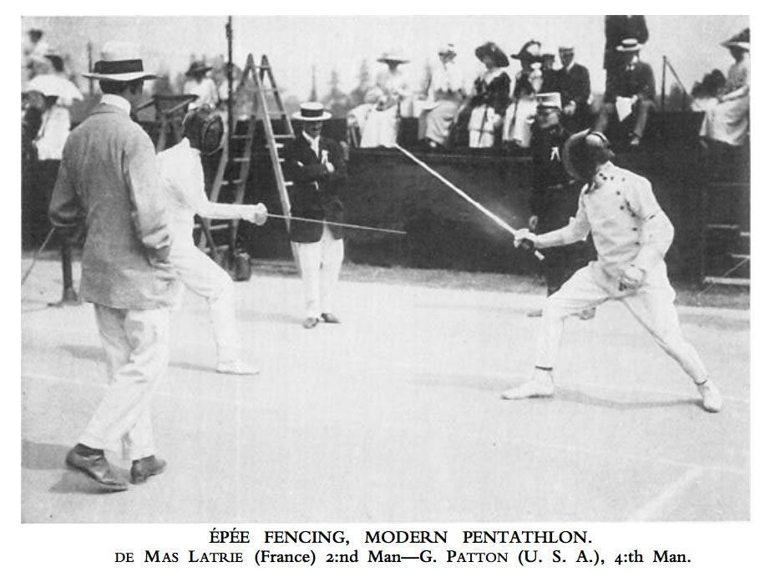
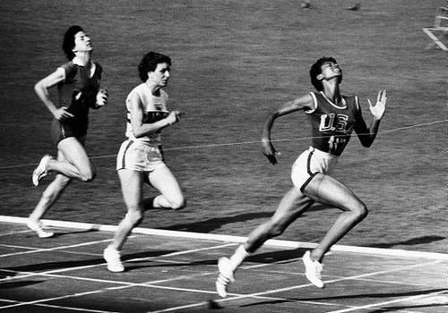
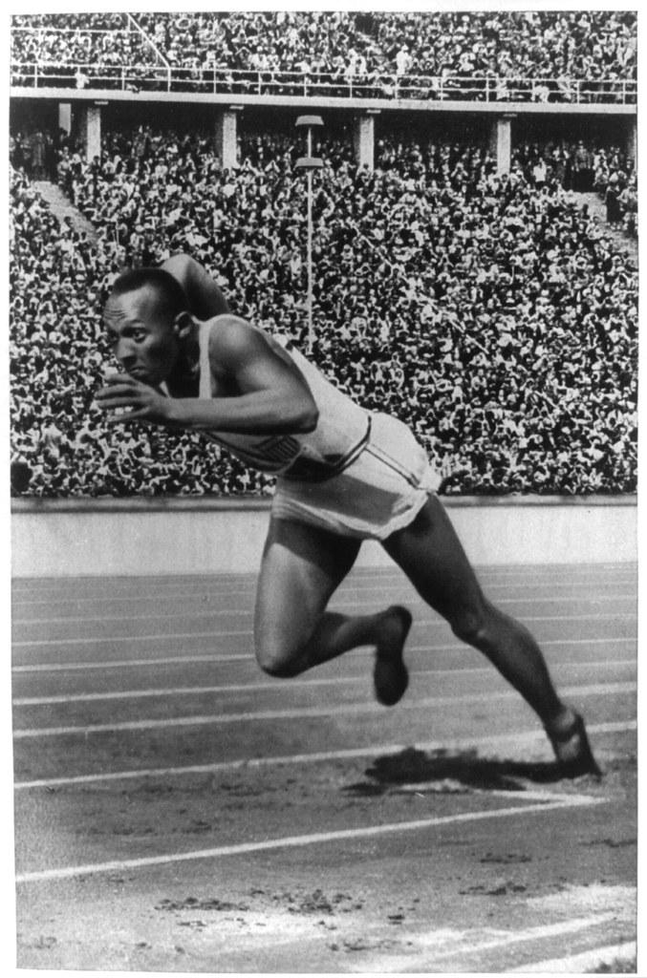
What athlete crushed Hitler’s dreams in the 1936 Berlin Olympics?
B
A
Jim Thorpe
George S Patton
D
C
Jesse Owens
Wilma Rudolph
Notes:
D

Slide 6
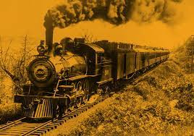
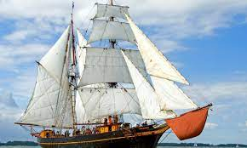
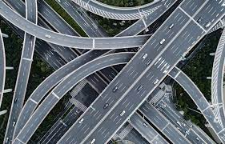
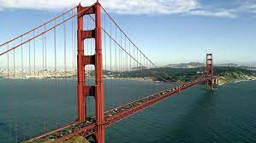
What helped connect the United States in the 1800s?
A
B
Transcontinental Railroad
Ships
D
C
Interstates
Bridges
Notes:
A

Slide 7
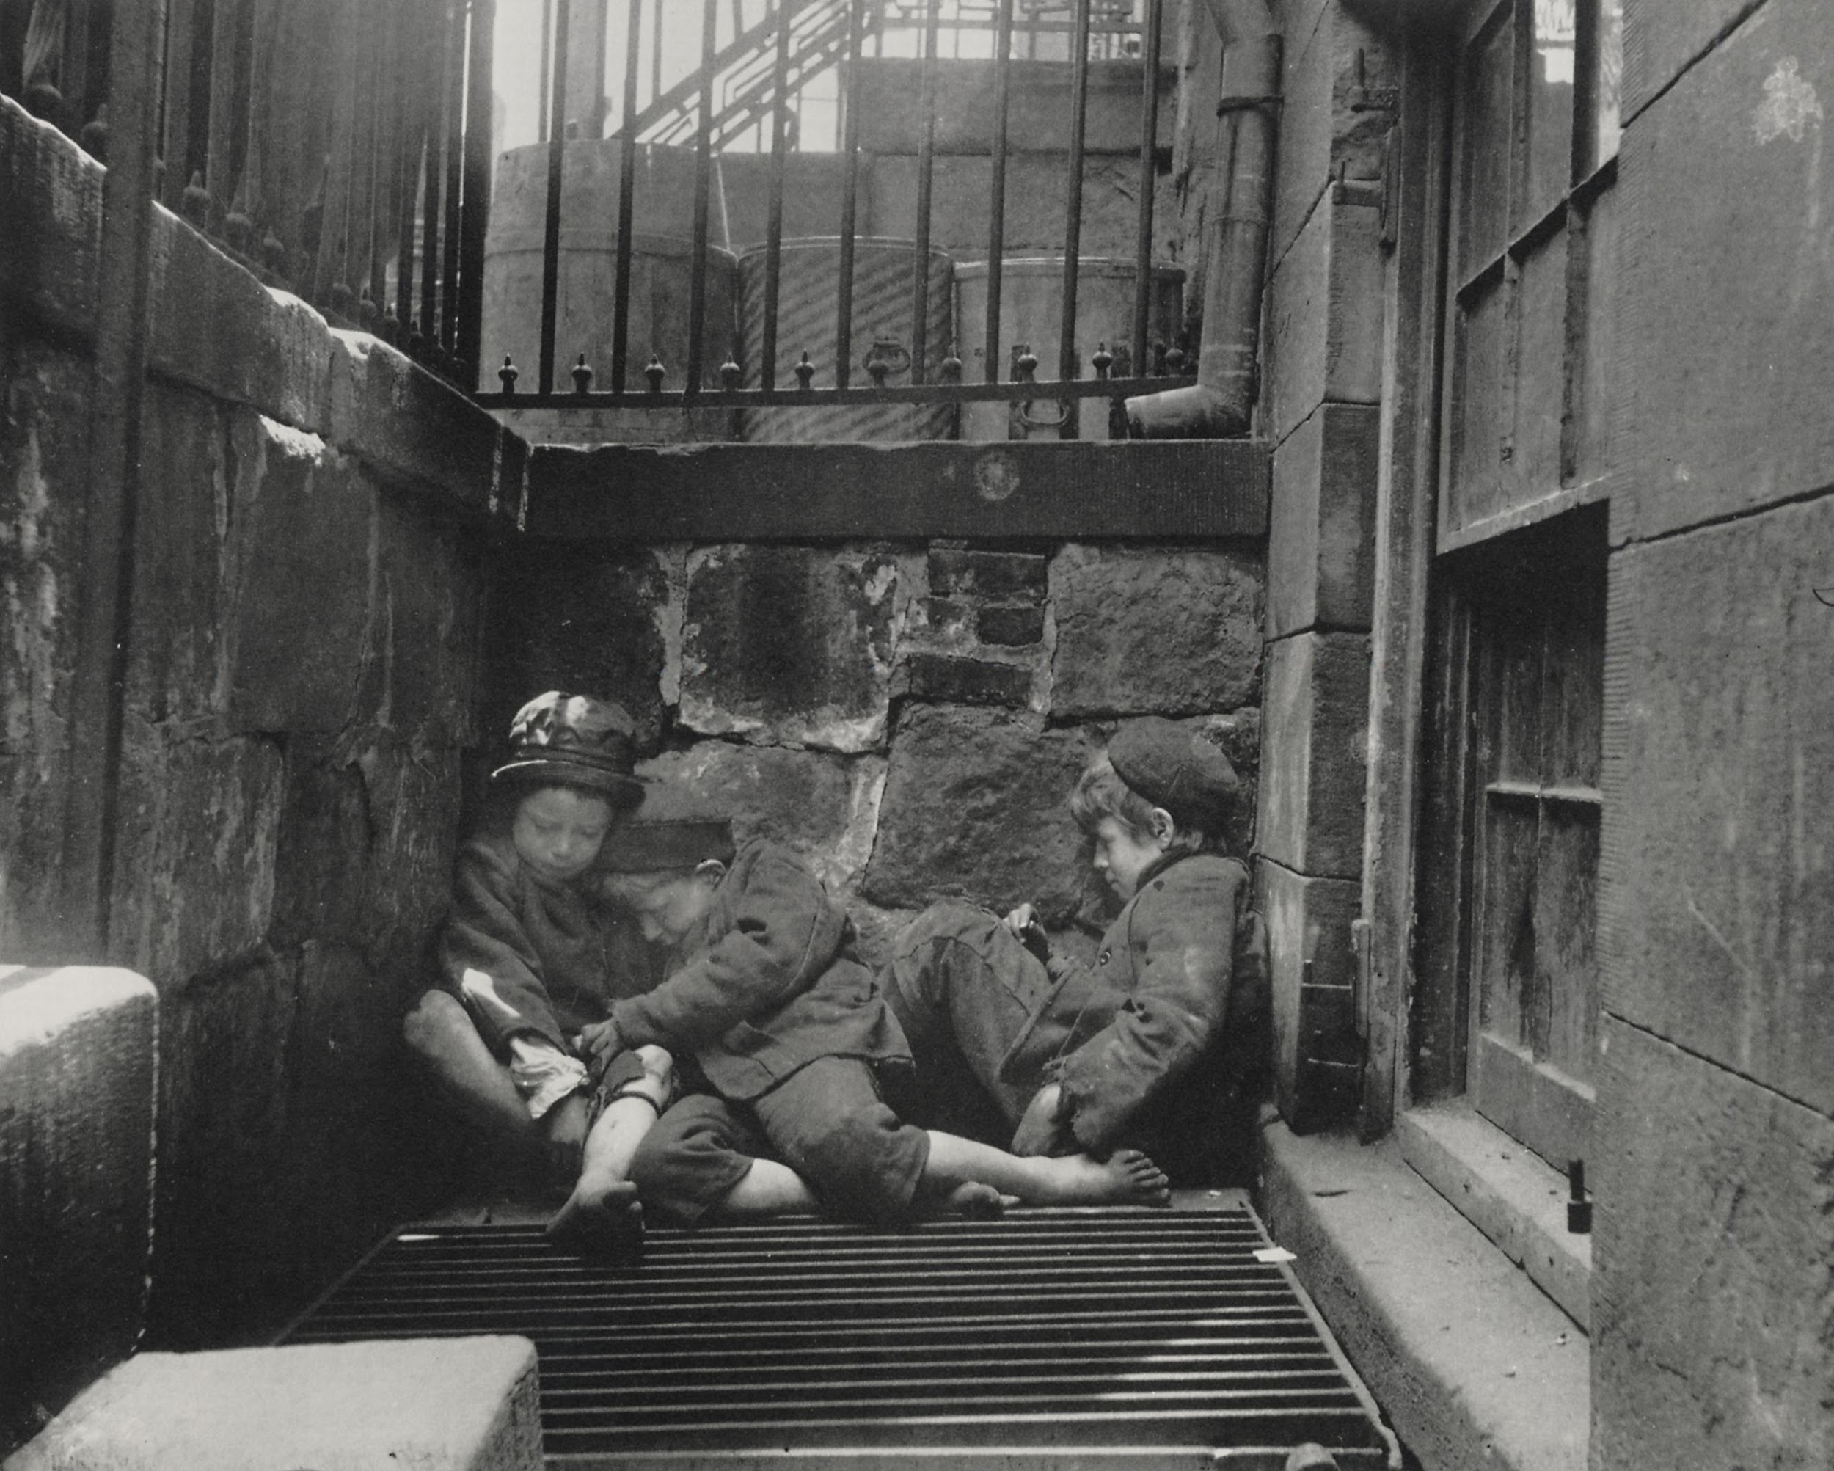
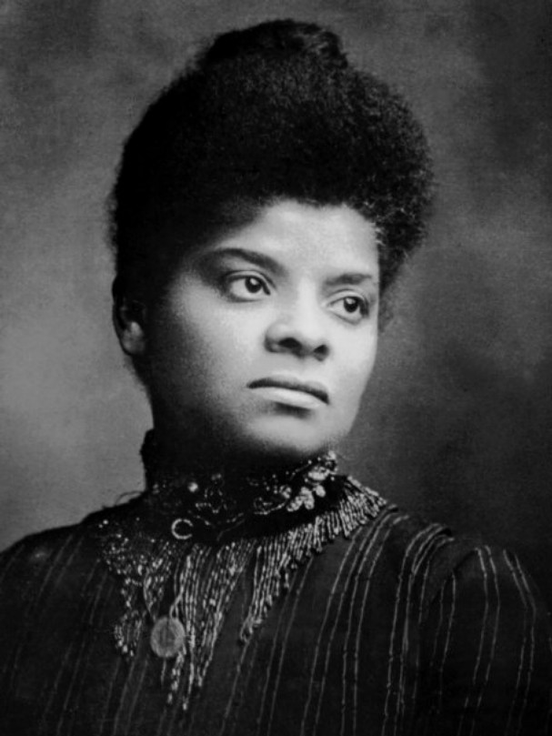
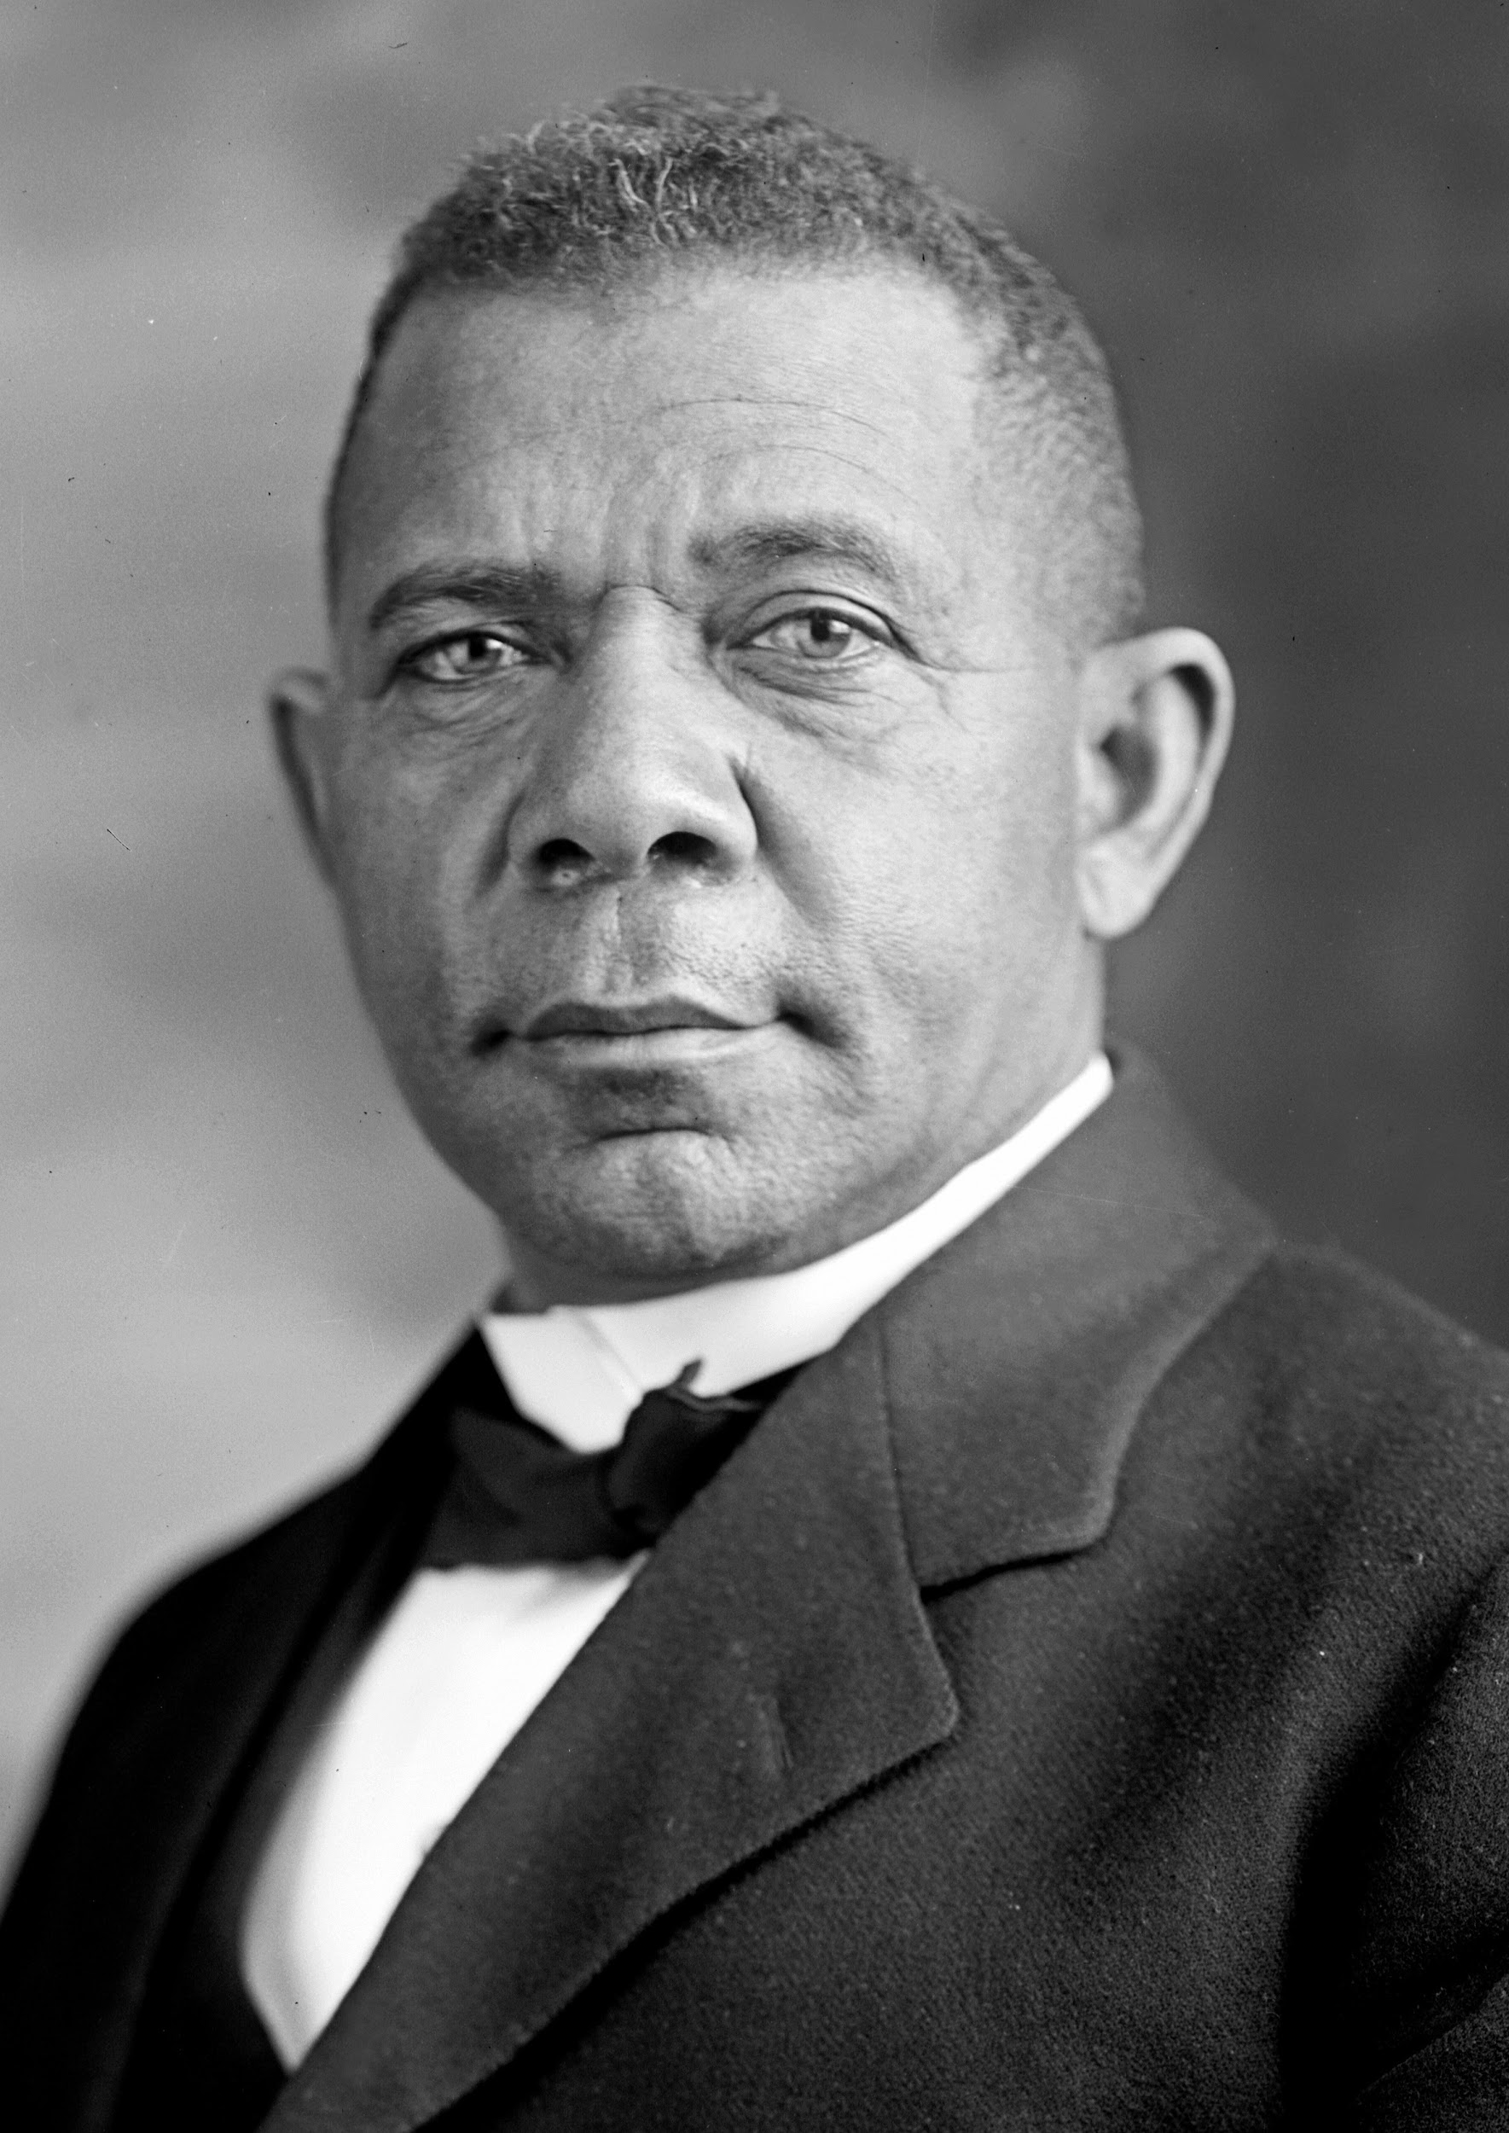
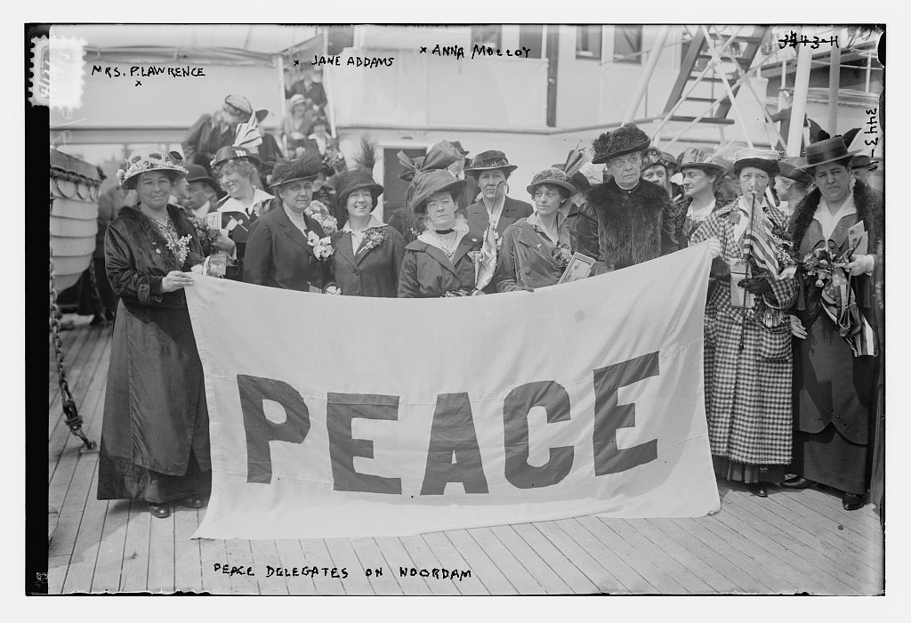
Muckraker that exposed the horrors of lynching
B
A
Jacob Riis
Ida B Wells
C
D
Booker T Washington
Jane Addams
Notes:
B

Slide 8
Which Amendment made drinking alcohol legal again?
A
B
18th
19th
C
D
17th
21st
Notes:
D

Slide 9
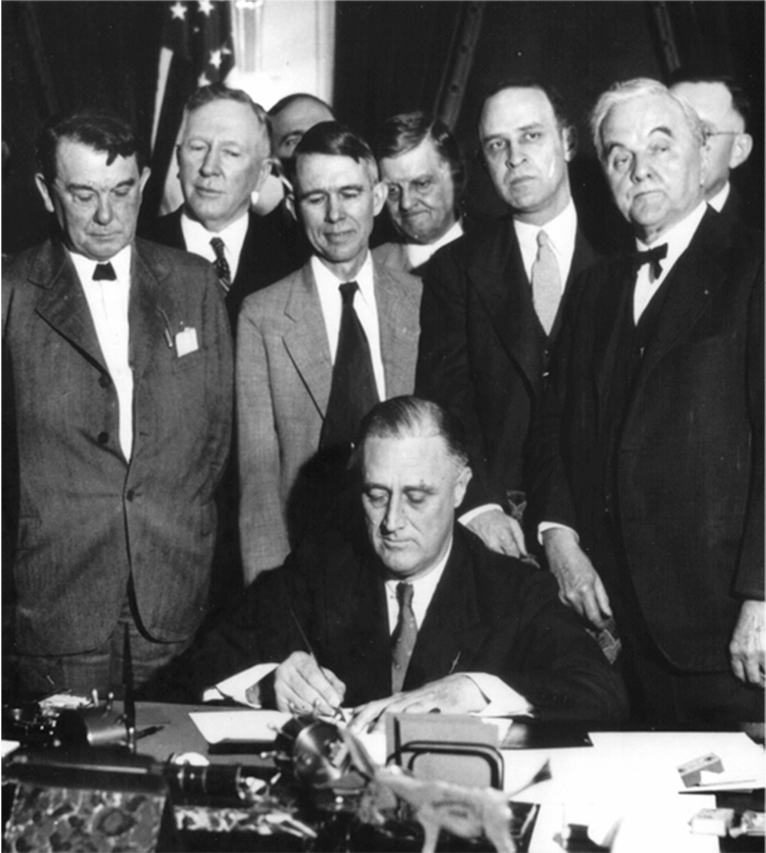
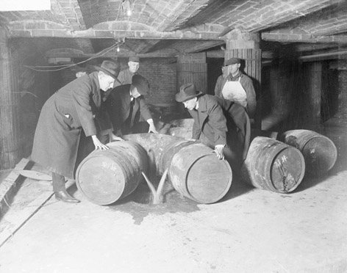
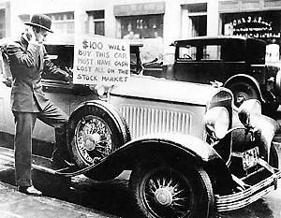
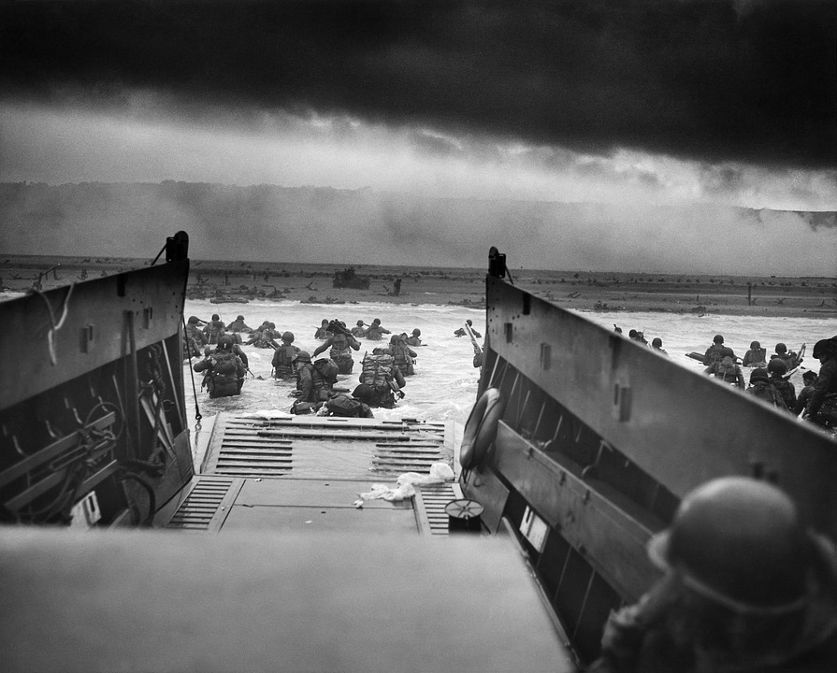
What ended the Great Depression?
B
A
New Deal
Prohibition
D
C
World War II
Stock market crash
Notes:
D

Slide 10
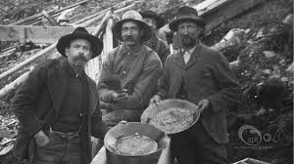
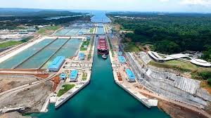
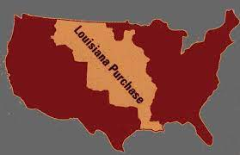
Symbolized U.S. technological prowess and economic power in 1914
B
A
Panama Canal
Gold Rush
D
C
World War II
Louisiana Purchase
Notes:
A

Slide 11
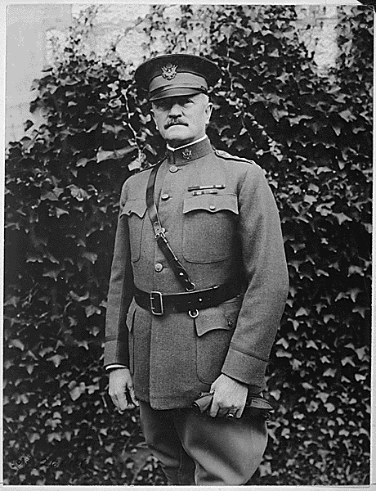
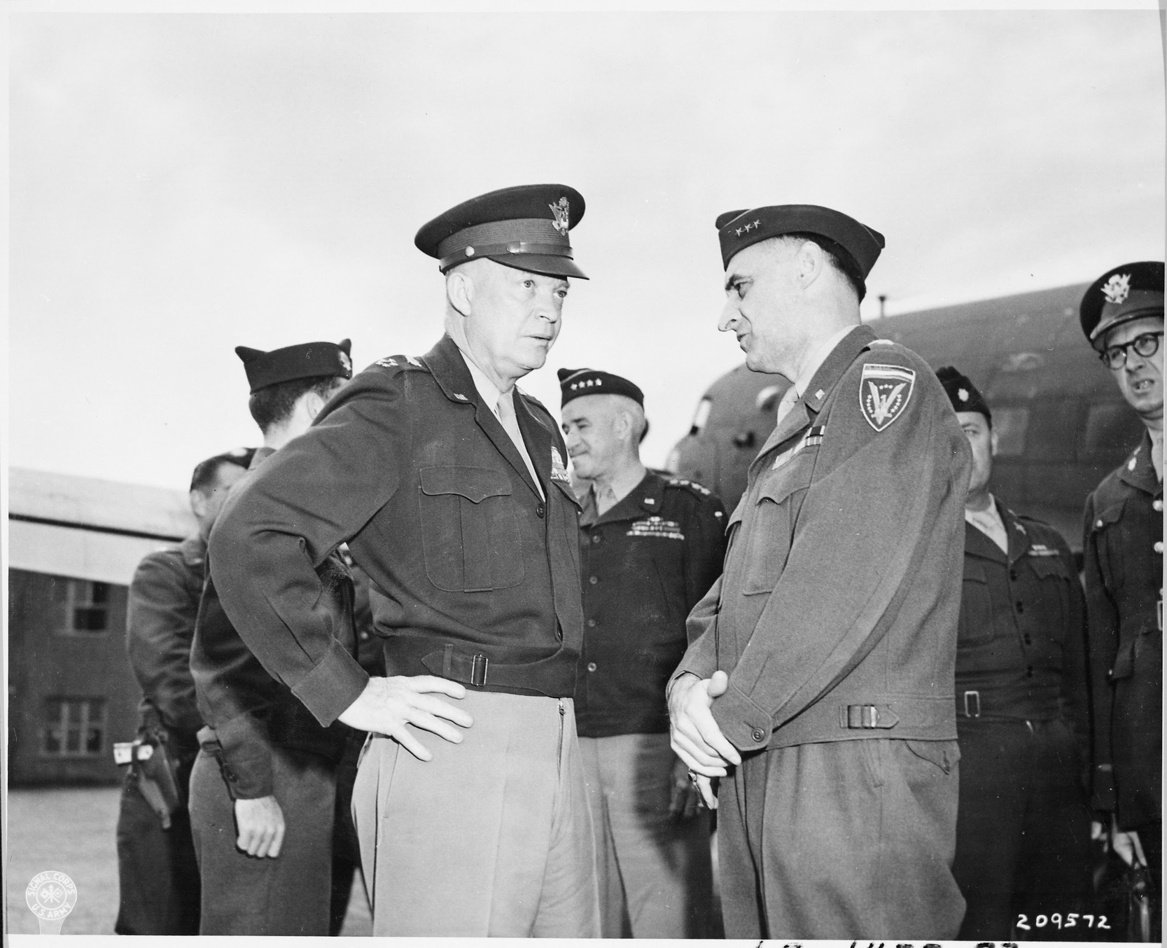
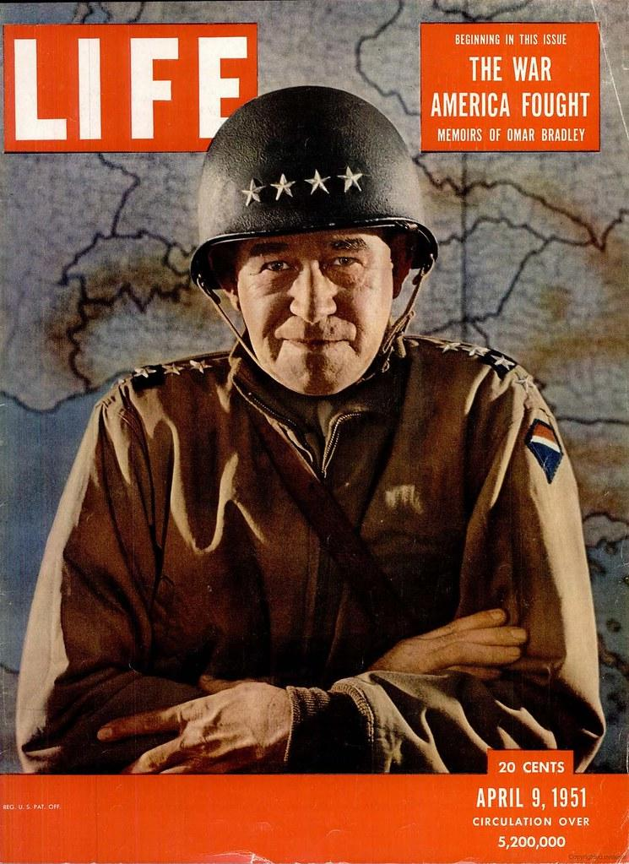
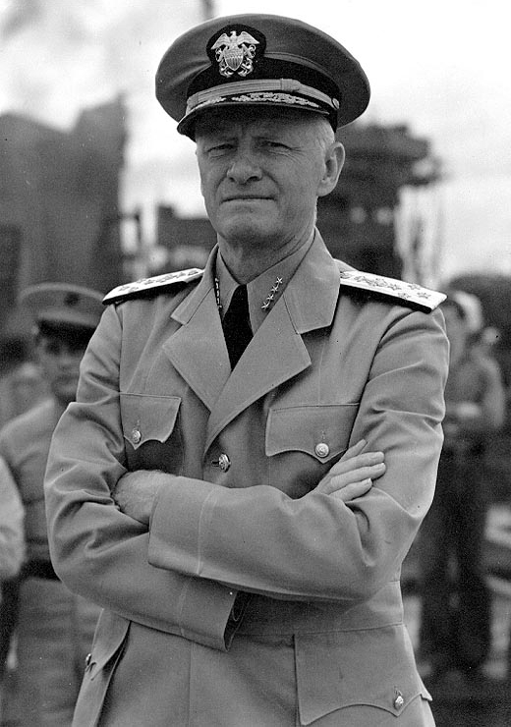
Which former military leader became President?
B
A
General John J Pershing
General Dwight D Eisenhower
Admiral Chester Nimitz
D
C
General Omar Bradley
Notes:
B

Slide 12
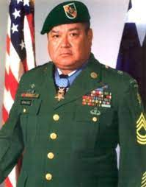
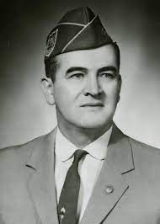
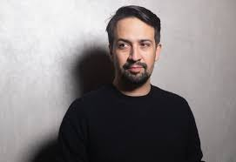
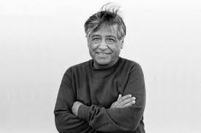
Who was a Civil Rights Activist?
C. Roy Benavidez
D. Lin-Manuel Miranda
Hector P Garcia
Cesar Chavez
Notes:
B….but you could also include A…he fought for Hispanic Veterans

Slide 13
TRUE OR FALSE

Slide 14
The 10th amendment is about State’s rights?
Notes:
TRUE

Slide 15
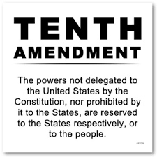

Slide 16
TRUE OR FALSE?

Slide 17
You can not vote until you turn 21
Notes:
FALSE

Slide 18
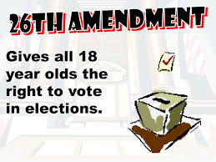
Notes:
Passed in 1971

Slide 19
TRUE OR FALSE?

Slide 20
We’re a tested subject???

