Slide 1
Warm-up
Why was the Constitution written?
Answer
The United States Constitution was written to protect citizens and also the states. It ensures rights, prevents the federal government from infringing on these rights, and creates laws. The fundamental rights and civil liberties for individuals are set out in the constitution.

Slide 2
Westward Expansion & the Railroad

Slide 3
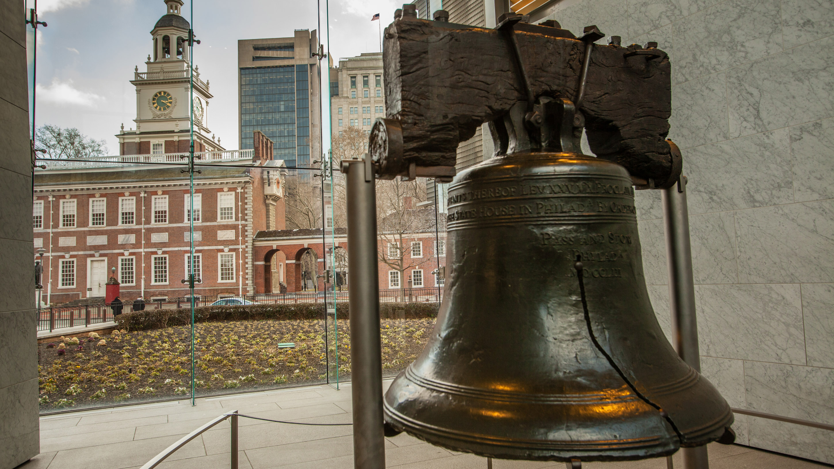
Please pick up Westward Expansion notes!
Put phones and headphones away.
AGENDA:
Finish Notes from Tuesday!
Quiz over Foundations
Begin Westward Expansion notes.
Introduce Activity (if time permits)

Slide 4
QUIZ
Please log onto Canvas and take the 5 question quiz over the notes we covered in class. You may use your notes. *not the person next to you*

Slide 5
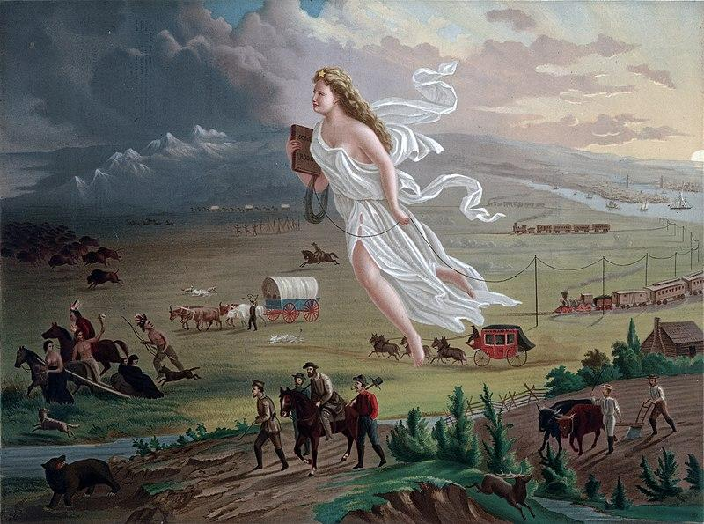
On your notes, describe what you see here. What do you think is happening, where do you think they are going? Write at least 2 sentences.

Slide 6
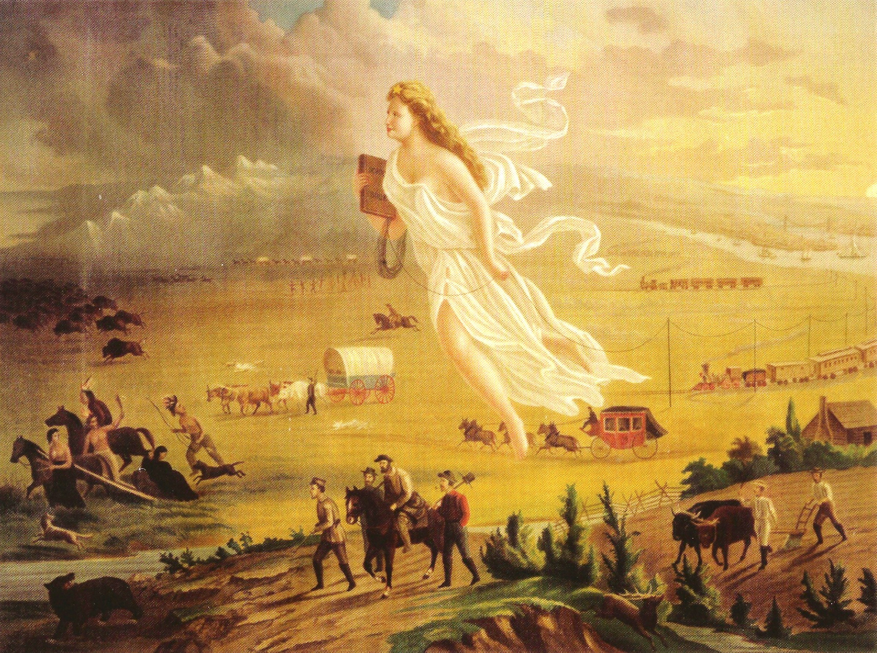
“American Progress”
WESTWARD EXPANSION

Slide 7
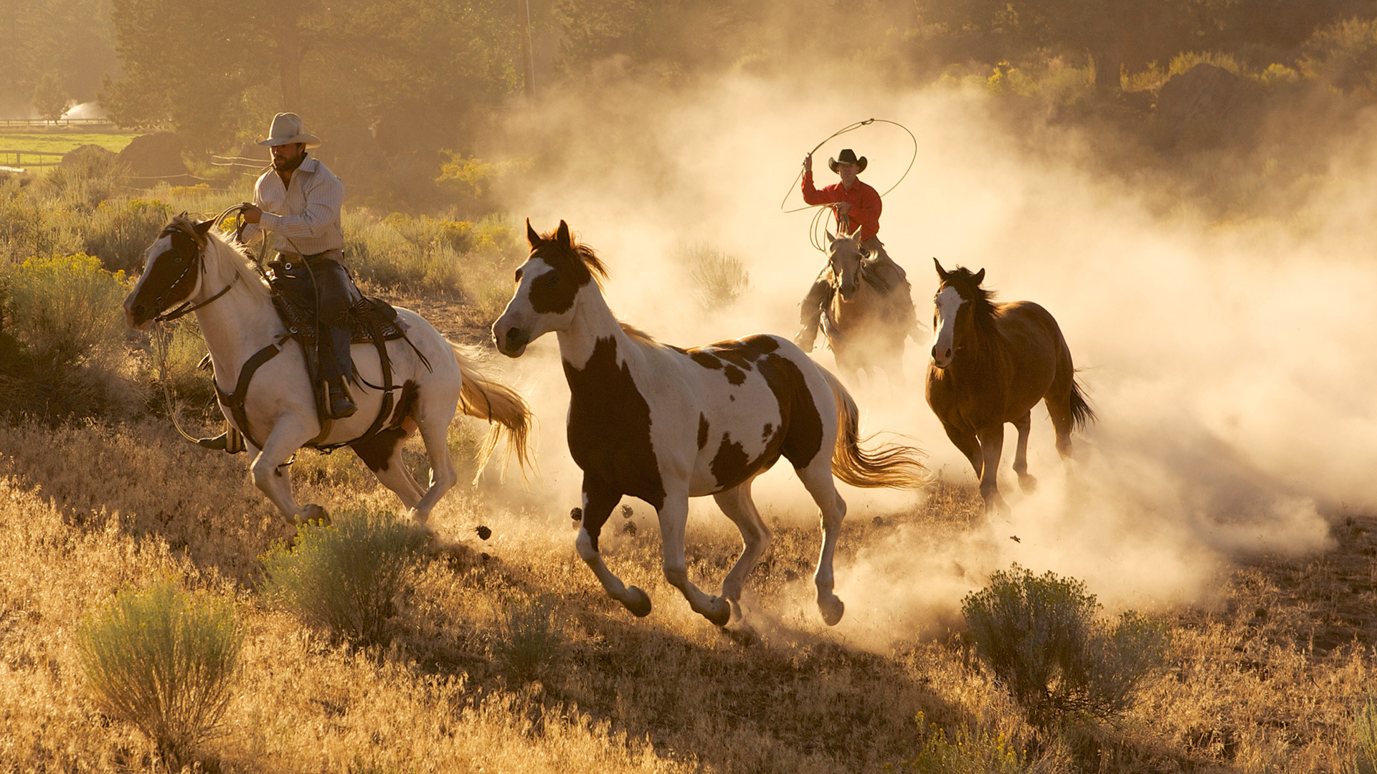
The West
Lots of open land
Good places for farming and cattle ranching

Slide 8
Why did we expand West?
Result of the idea of Manifest Destiny
It was the United States’ destiny to:
expand Westward
and claim new lands
**God meant for Americans to move west across the continent​

Slide 10
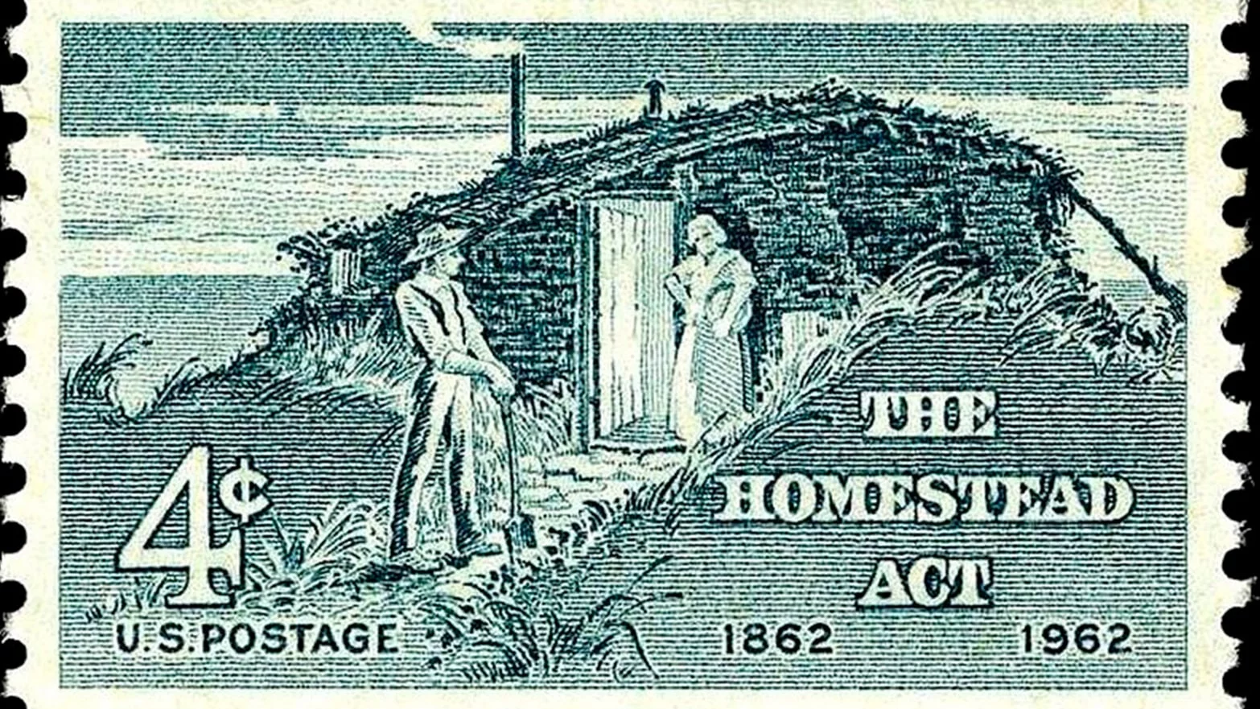
What made people move West?
The Homestead Act (1862)
Encouraged Westward Migration by offering extremely cheap land to settlers
Work for: 5 years
then pay $8-$15 to register land in your own name

Slide 11
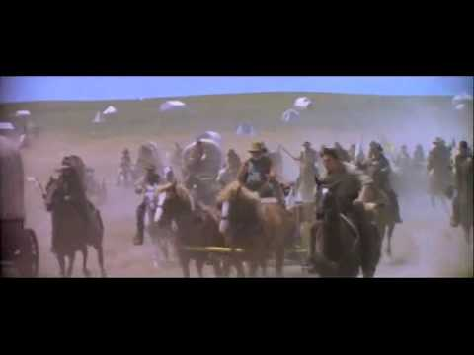

Slide 12
Homestead Act -> Manifest Destiny
The Homestead Act fulfills the idea of Manifest Destiny by making it easy for Americans to afford to move West
The “Opening” of the Plains

Slide 13
Quick Check
The Homestead Act allowed people to settle in the west.
Is this a pull or push factor??

Slide 14
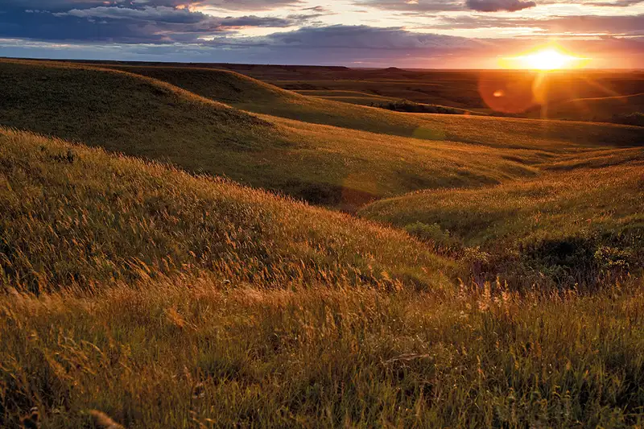
The Great Plains
I want to build a house and stay warm for the winter with a fire.
What building material might I need that you do not see here?

Slide 15
The Great Plains
NO TREES

Slide 16
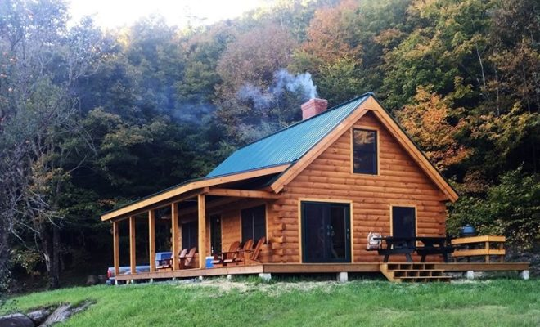
The Great Plains

Slide 17
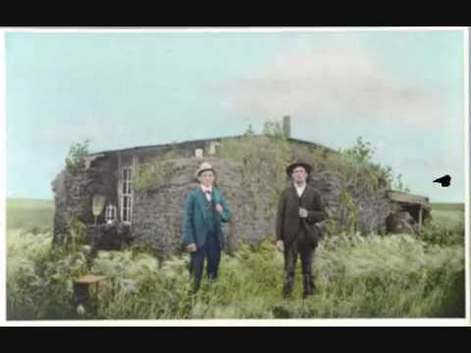

Slide 18
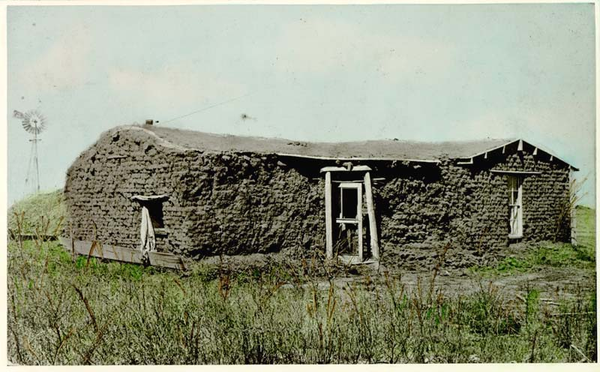
What did they do instead?
Sod houses or soddies: made of mud and grass
Why was this necessary?

Slide 19
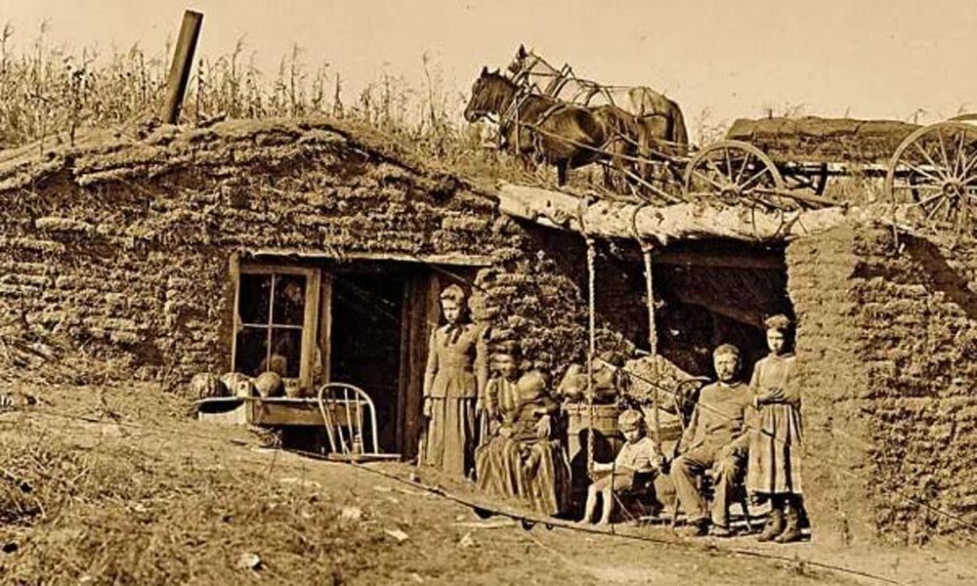
Notes:
THE REALITY

Slide 20
Economic Effects - The Long Drive
Wide open land (no trees) = **GOOD FOR CATTLE DRIVING*** BIG $$$$ for TEXAS
Notes:
Test Question

Slide 21
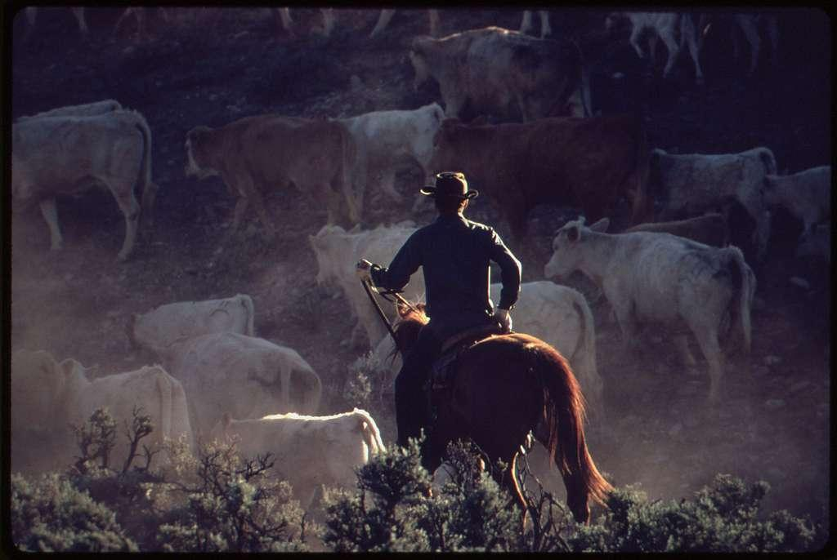
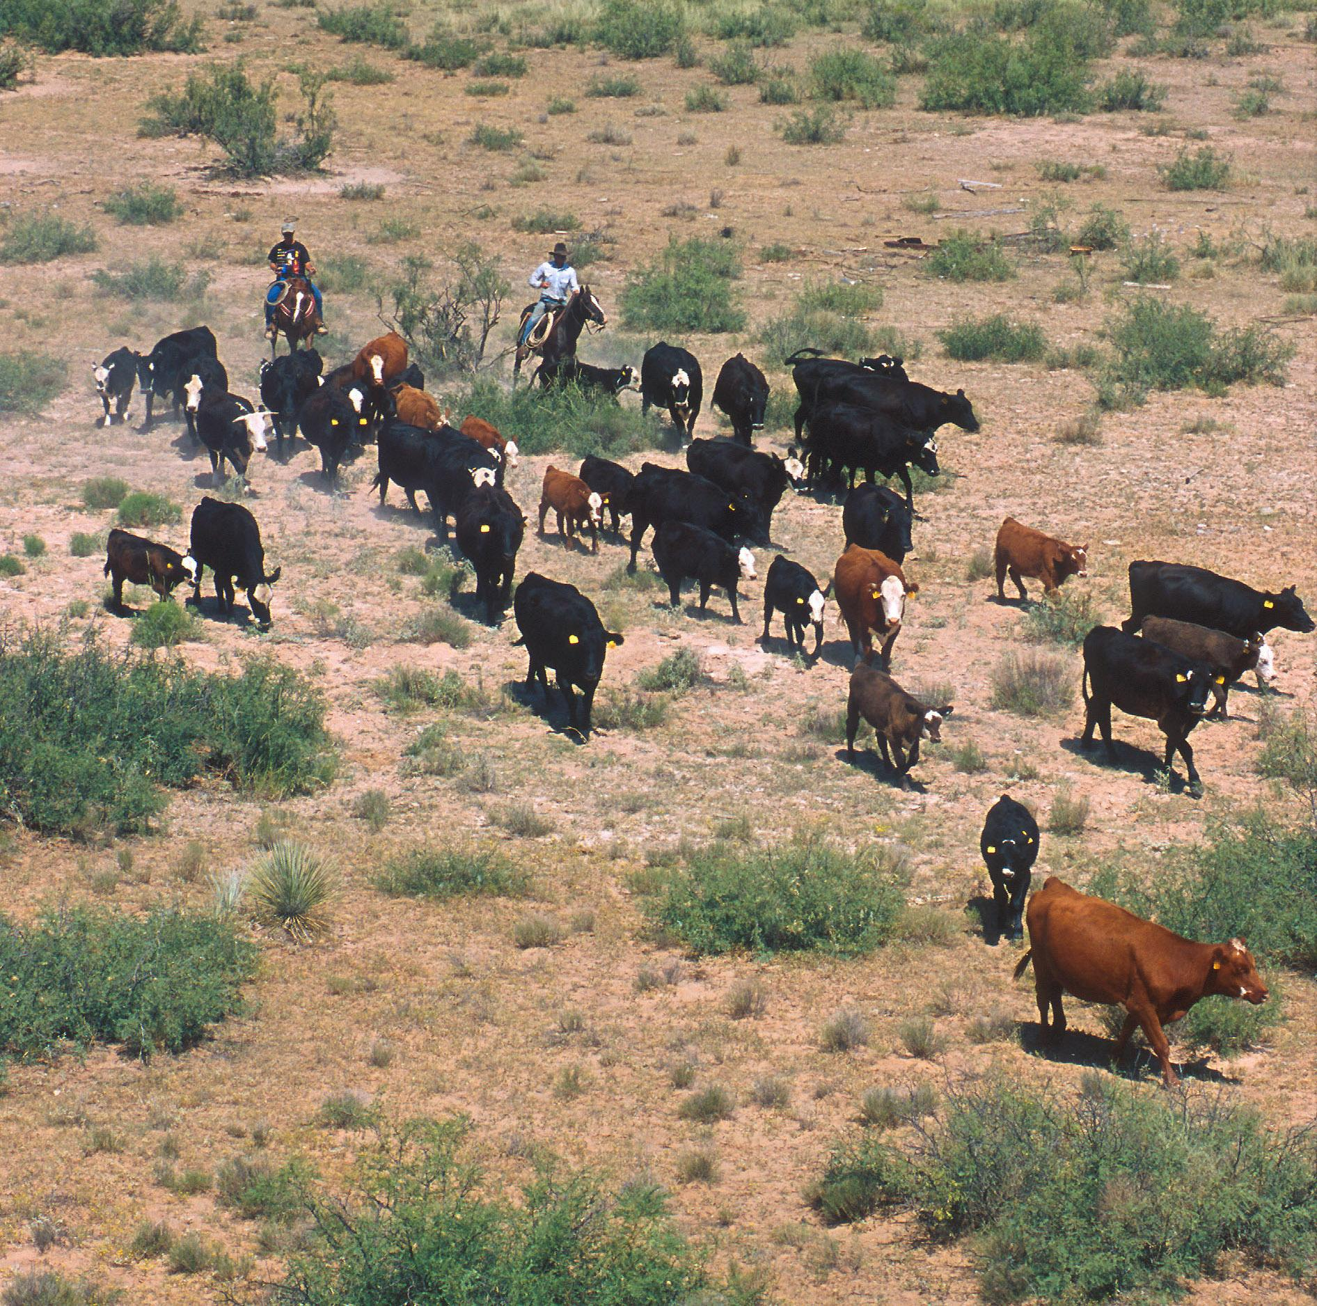
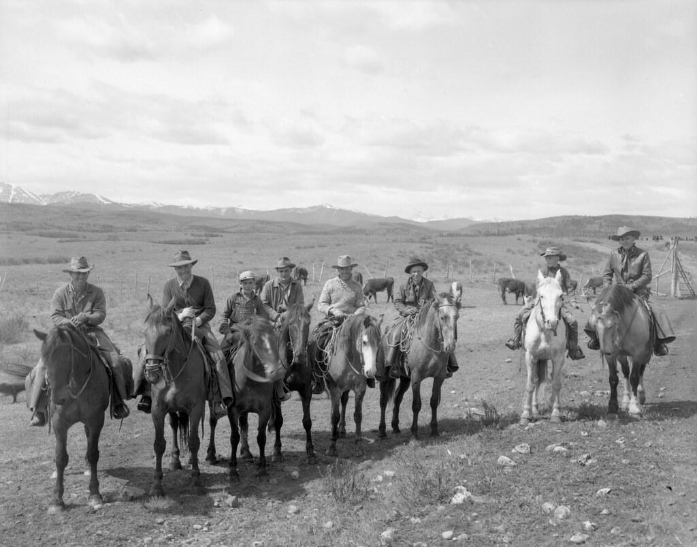

Slide 22
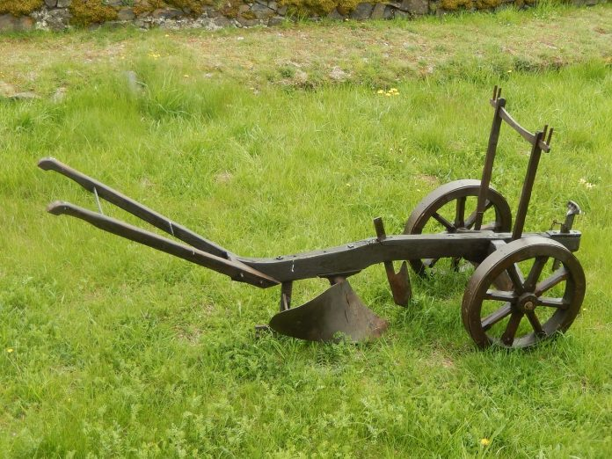
Economic Effects - Increased Agriculture
John Deere Steel Plow - could break through the hard, clay soil of the Plains/West

Slide 23
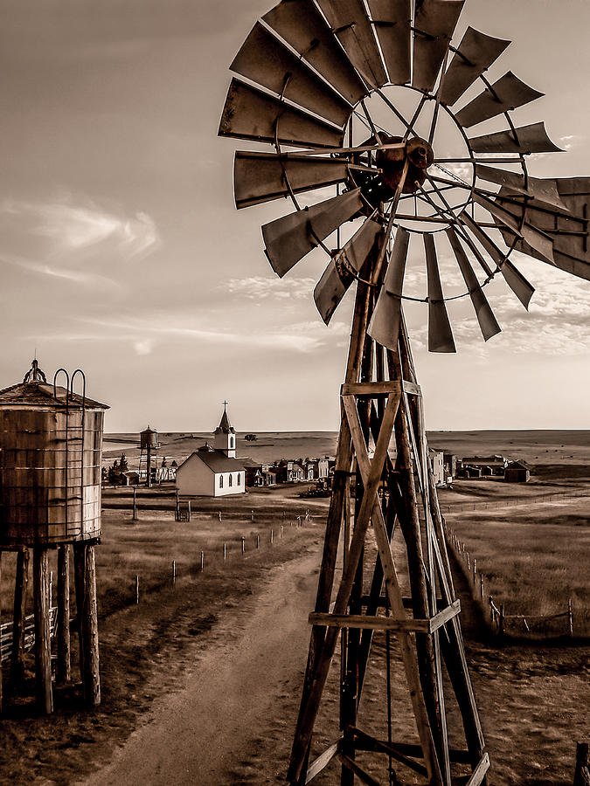
Economic Effects - Settlers altered the environment
The Windmill - used to lift water from underground wells
*Could survive if there was little rain

Slide 24
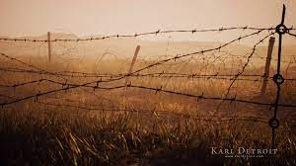
Economic Effects - Settlers altered the environment
BARBED WIRE was another important adaptation to the lack of materials on the Great Plains.
Barbed Wire
Allowed a rancher to keep their cattle secure(safe)
Keep cattle from roaming off their lands.
Notes:
TEST QUESTION

Slide 25
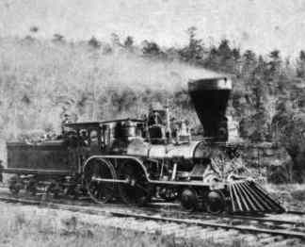
Economic Effects - The Transcontinental Railroad

Slide 26
Quick Check
Would railroads increase or decrease how quickly people could move to the West?
Notes:
Q, triple S, A

Slide 27
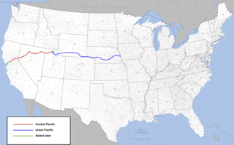
Transcontinental Railroad
Developed a nation-wide transportation network that united the country

Slide 28
How does the Railroad help?
Brainstorm how the transcontinental railroad could have benefited the cattle industry.

Slide 29
Speeding Things Up
The railroads increased social and economic mobility (ex: Cattle could be shipped on train cars faster than grazing across the land)

Slide 30
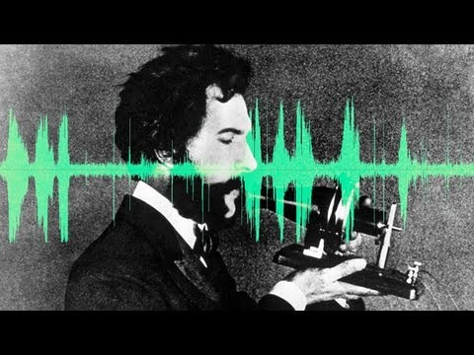
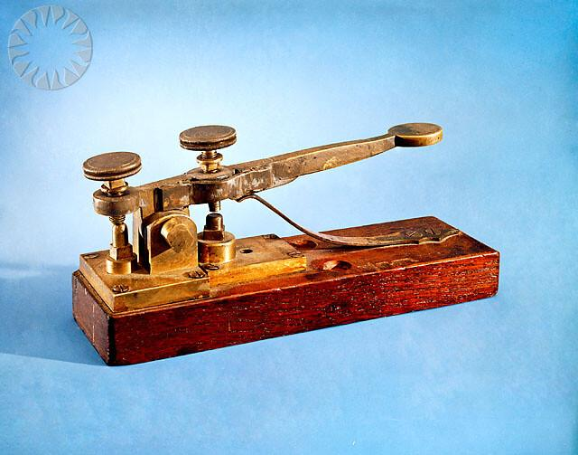
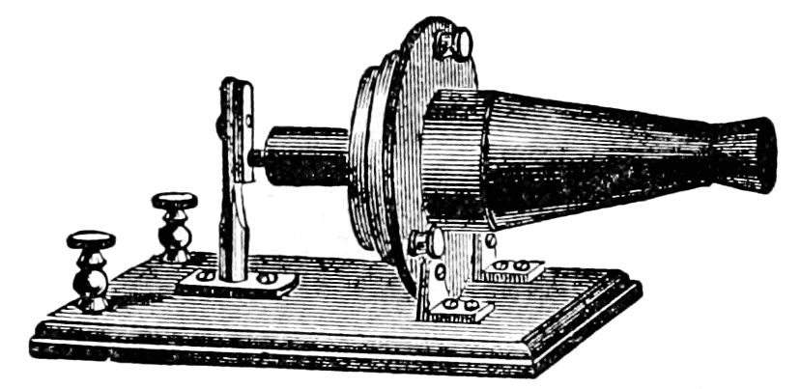
Communication Inventions:
Alexander Bell’s telephone followed the telegraph-would allow instant voice communication.
Easing the frontier from isolation even more.
Living on the Great Plains was isolating (lonely)
The following invention helped remedy that:
The TELEGRAPH invented by Samuel Morse allowed people to send text message across a wire.
Notes:
This is also a form of globalization...think about how the internet changed the way we communicate...and how we communicate now….it started with this invention.

Slide 31
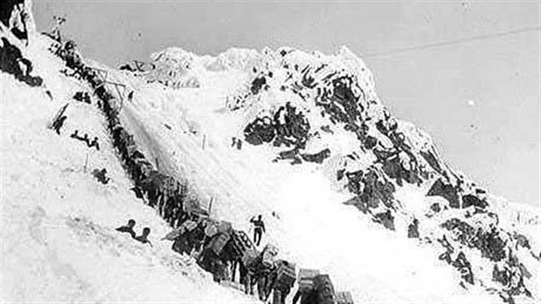
Klondike Gold Rush
Discovery of Gold!
Led to the migration of 100,000 prospectors to Canada, Alaska, and California

Slide 32
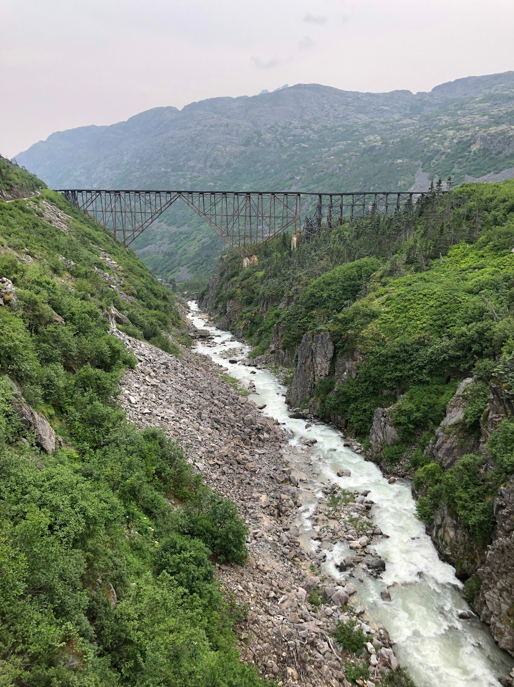
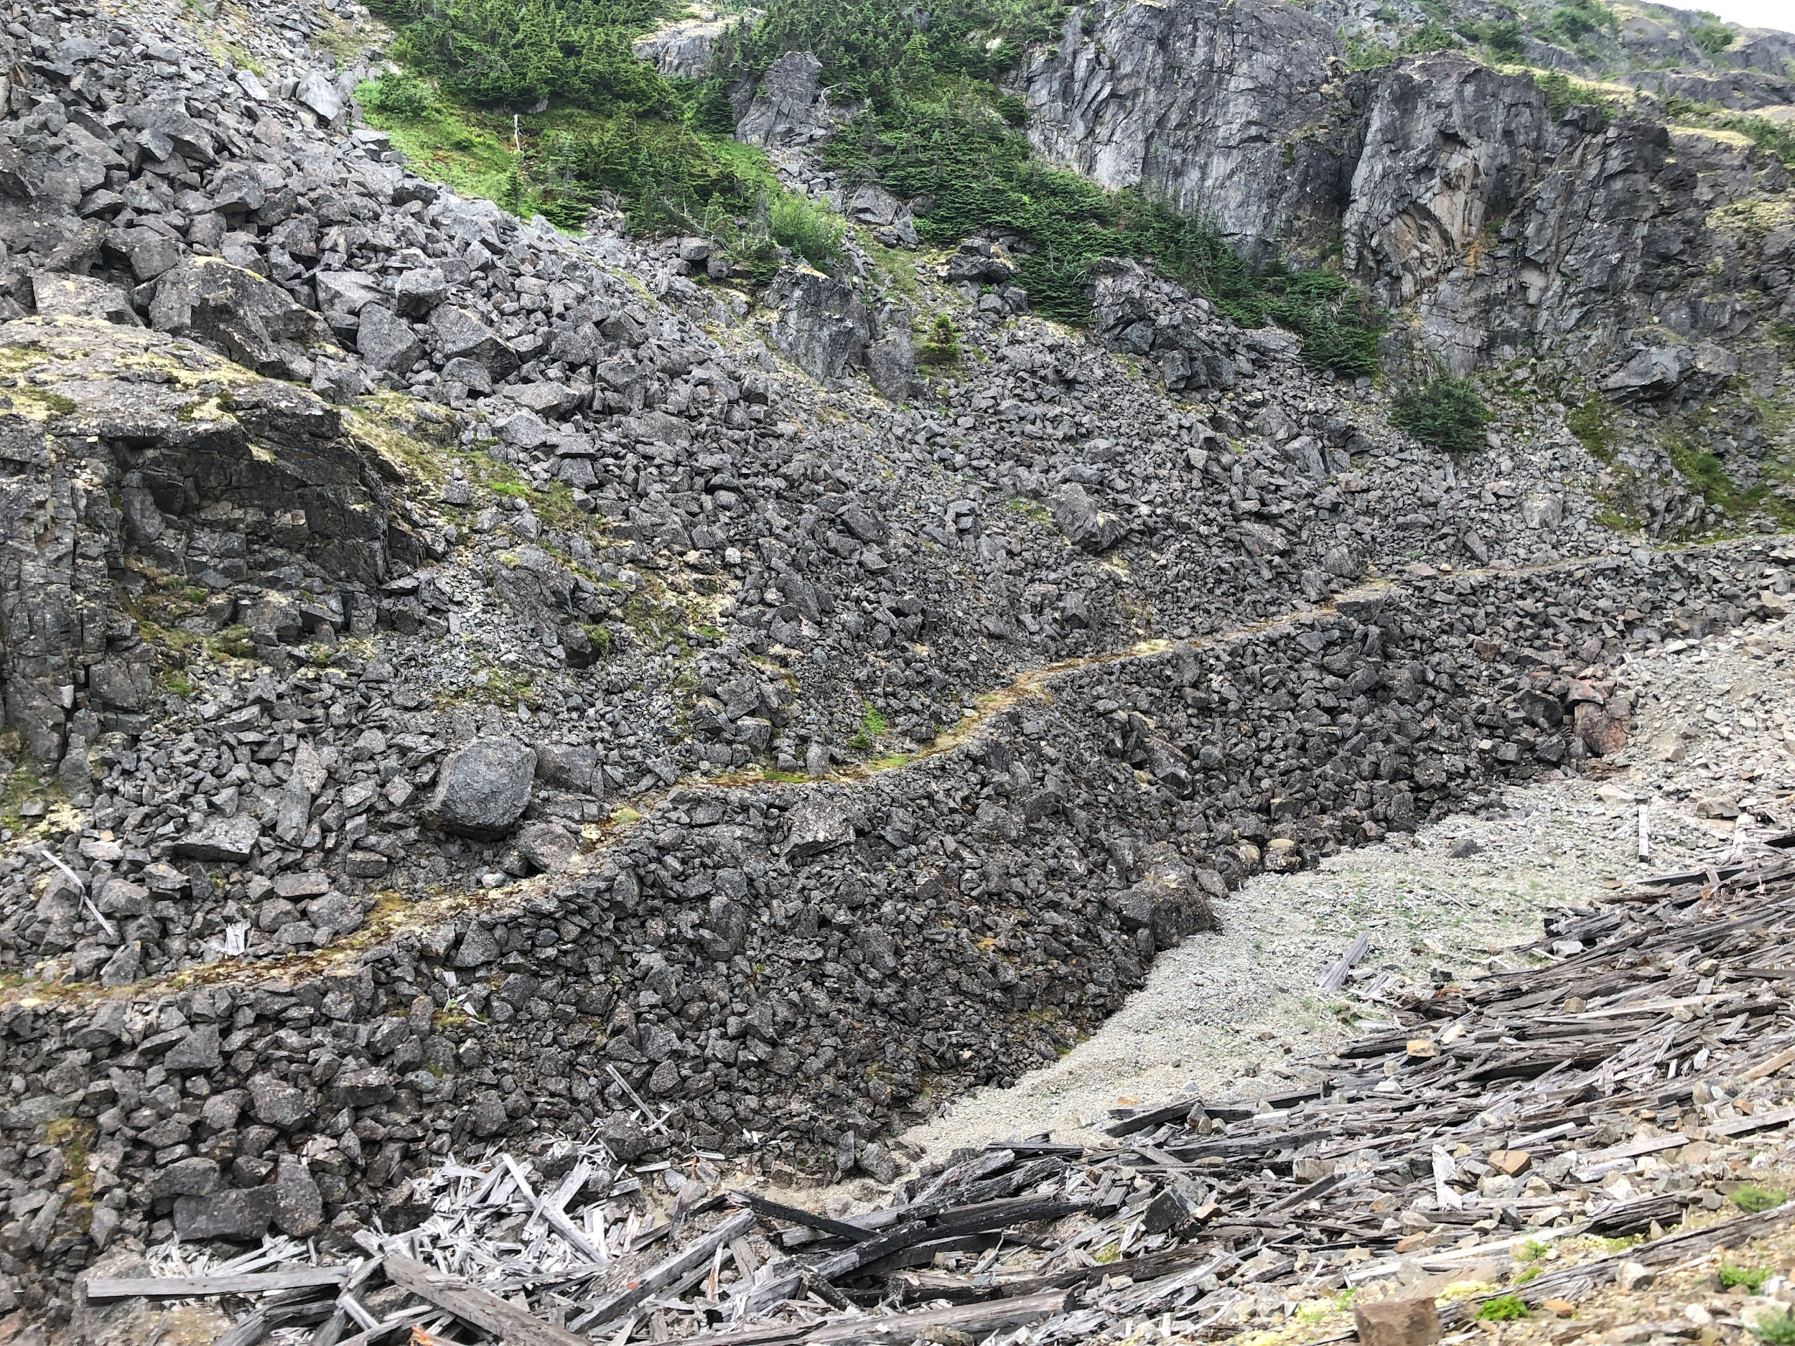

Slide 33
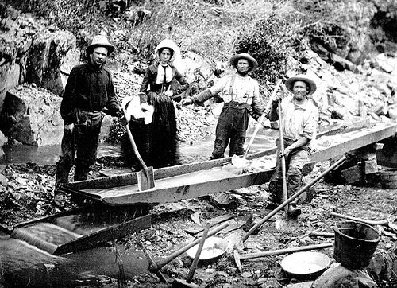

Slide 34
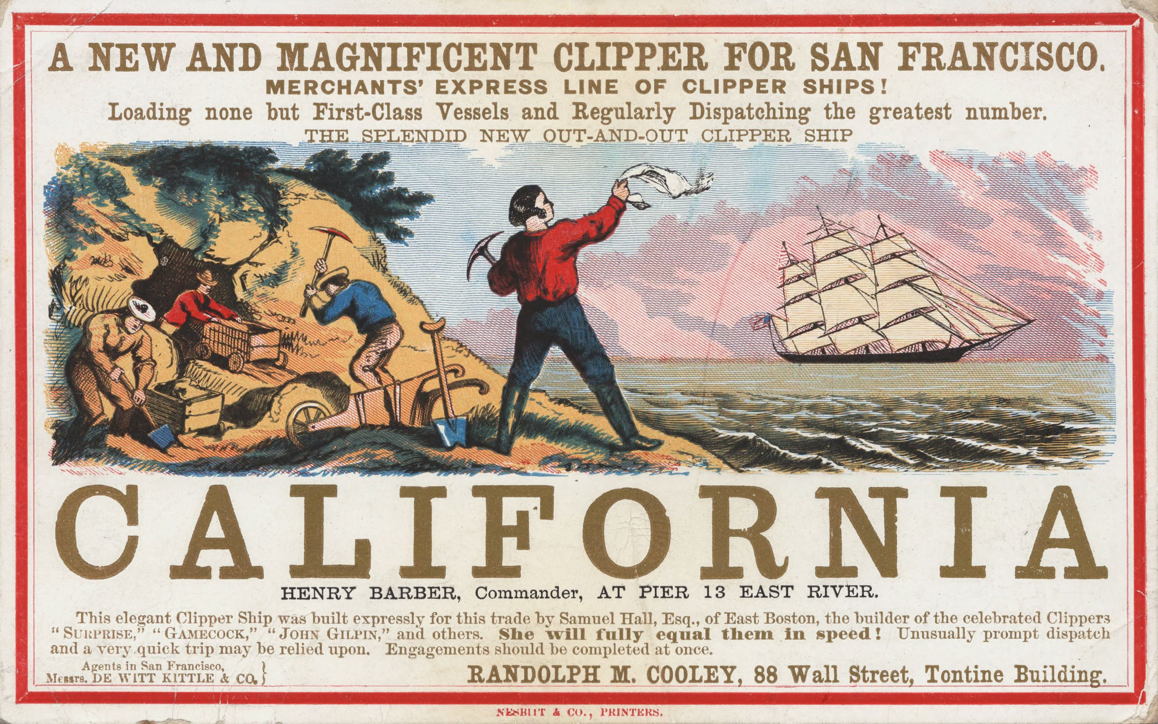
Notes:
Gold was discovered in California in 1848.
The following year (1849), people flocked to California in search of Gold.
Over 300,000 people moved to California looking for gold.

Slide 35
GOLD: PUSH OR PULL FACTOR?

Slide 36
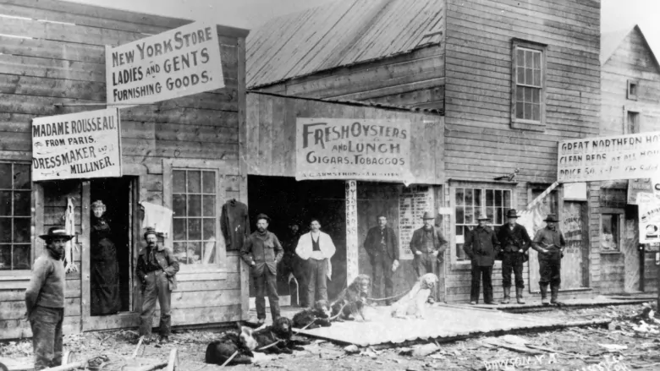
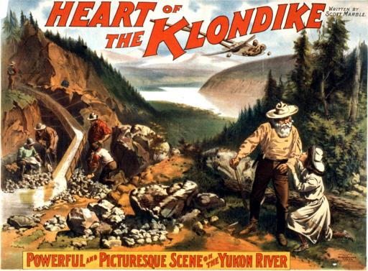
Environmental Impacts
Population increase = New BOOM towns

Slide 37
BOOM TOWNS
Towns grew:
Abilene
Kansas
This became a central market for buyers to meet in one location and BUY CATTLE.
Made possible because:it was a stop on the new railroad lines.

Slide 38
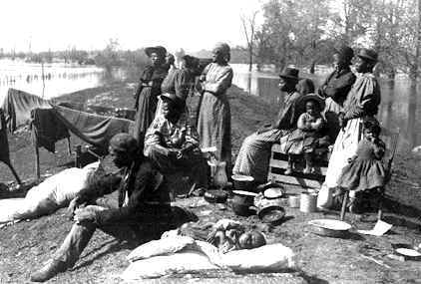
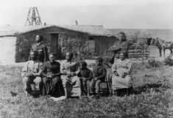
Exoduster
African Americans who migrated north *states along the Mississippi River to Kansas late nineteenth century*
**First migration of African Americans after The Civil War. War
Notes:
People were looking for gold for a better way of life.
African Americans are also going to move to look for a better life
Will impact the 1920s

Slide 39
What will impact (an invention) people being able to move safely to the West???
Notes:
Population growth

Slide 40
BRAIN BREAK

Slide 41
Conflict & Assimilation of Native Americans

Slide 42
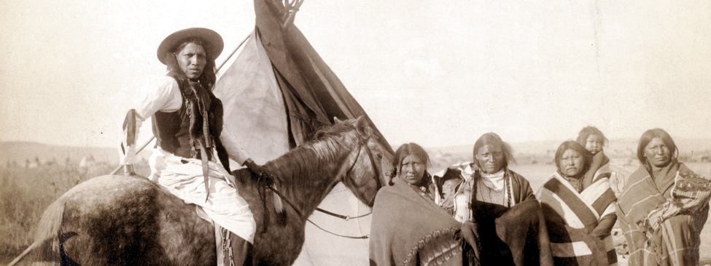
American conflict with theNative Americans on the Plains

Slide 43
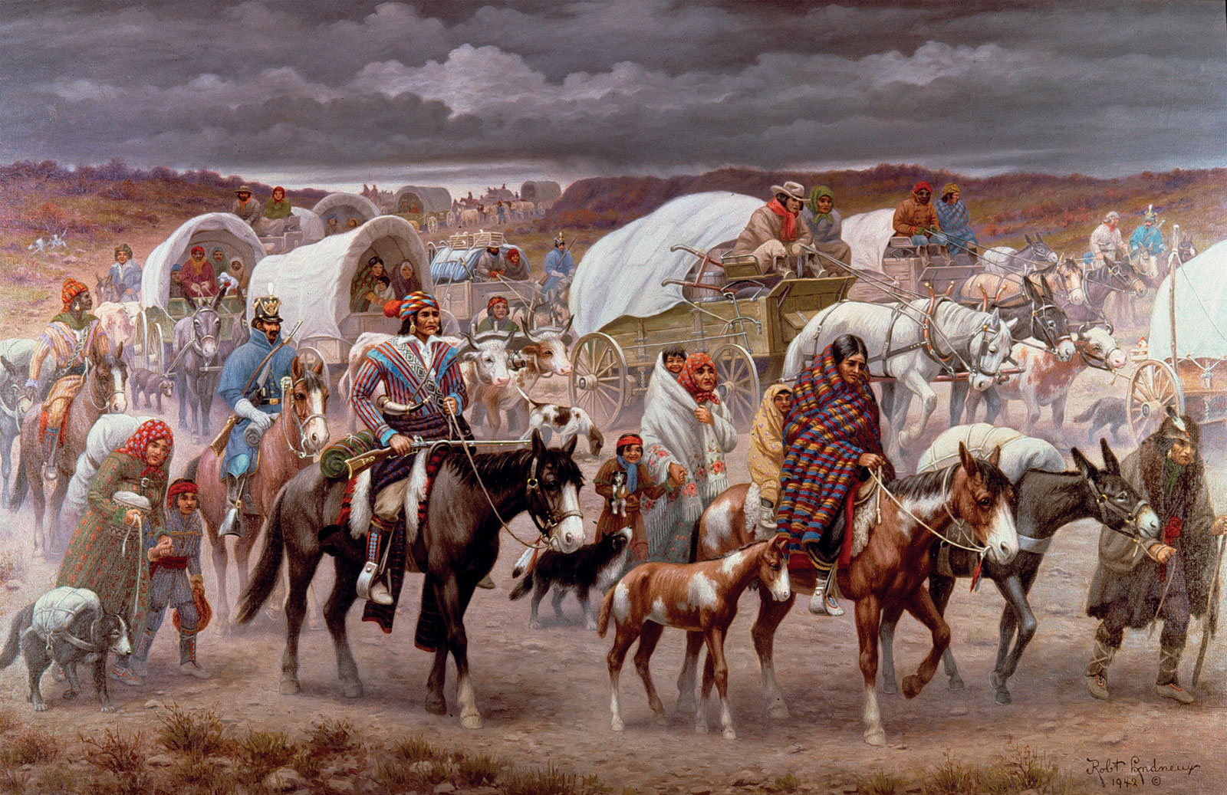
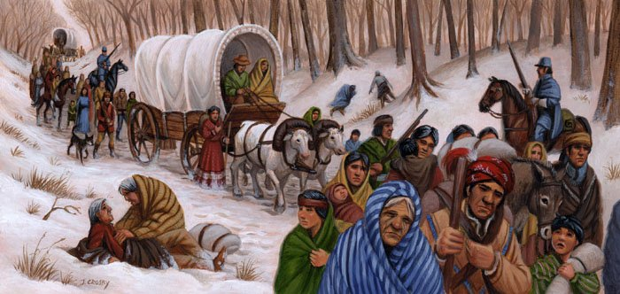
Native American REMOVAL
•Removing Native Americans from their lands was believed to be necessary because
Increases in population --> need for more land
Idea of Manifest Destiny

Slide 44
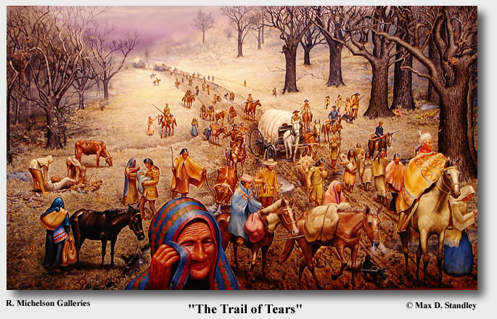
Indian Removal Act (1830)
Forced Indian tribes onto reservations
Included the “Trail of Tears”

Slide 45
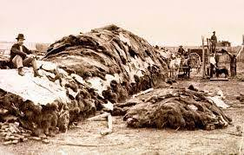
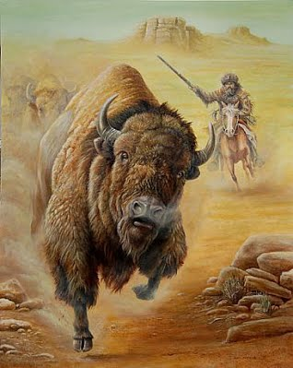
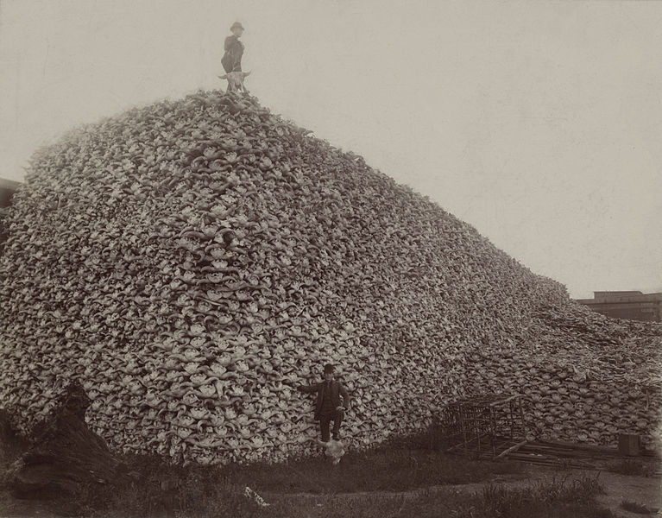
Destruction of the Buffalo
1840 = 25 Million Buffalo
1889 = only 1100 buffalo remained in the US!
Slaughtered for:
Sport
to hurt the Native Americans
Notes:
https://www.theatlantic.com/national/archive/2016/05/the-buffalo-killers/482349/

Slide 46
Why do you think the buffalo were targeted?
*Violent Approach*

Slide 47
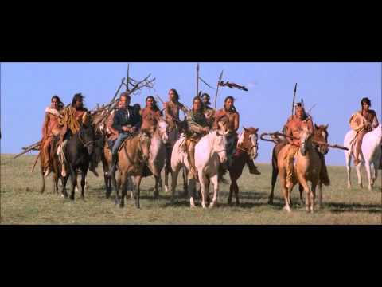
Notes:
This is a sad video...and shows the waste that happened to the Buffalo. This will impact the Native Indians because as on the previous slide it was so important to every aspect of their lives.

Slide 48
What staple food of Native tribes was eliminated to undermine their independence and resistance?

Slide 50
Battle of Little Bighorn-Custer’s Last Stand
June 25–26, 1876
Gold had been discovered on Indian Land; miners(those looking for gold) were on the way.
Notes:
Indians did not move from
the Montana Territory quickly
enough for the US government.

Slide 52
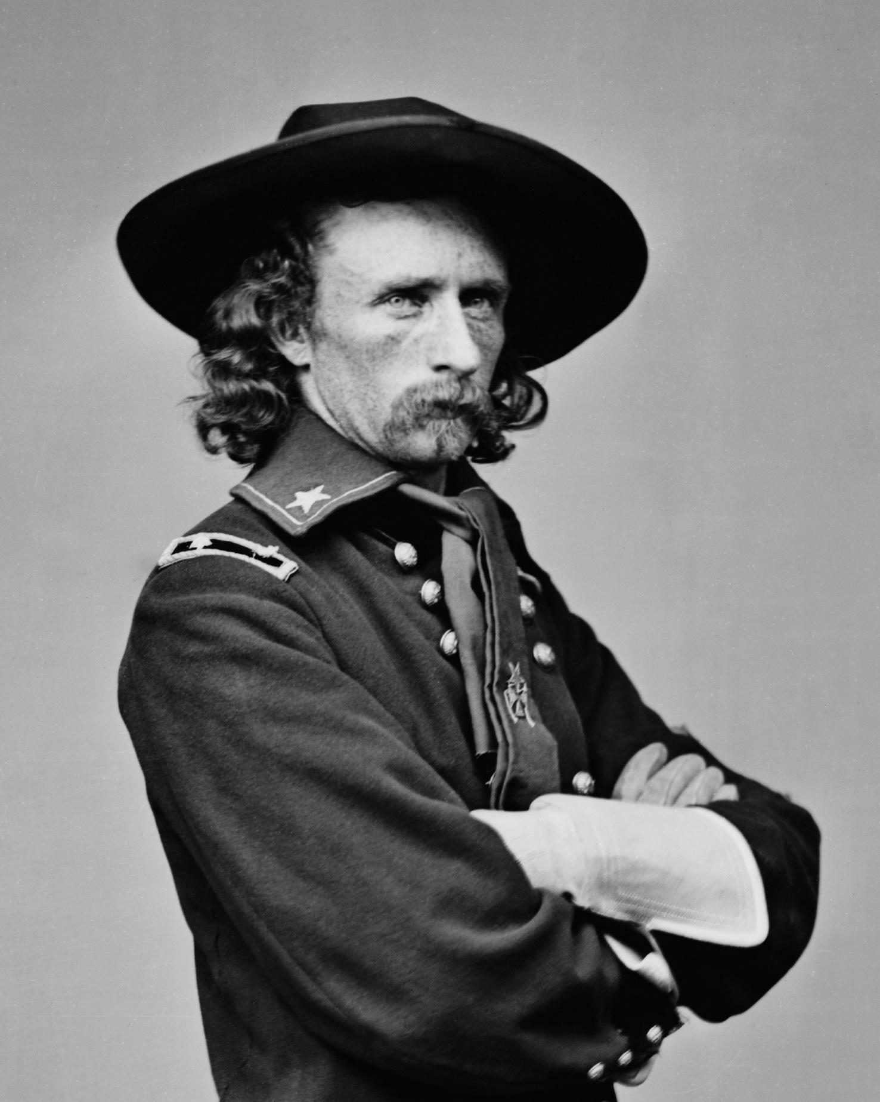
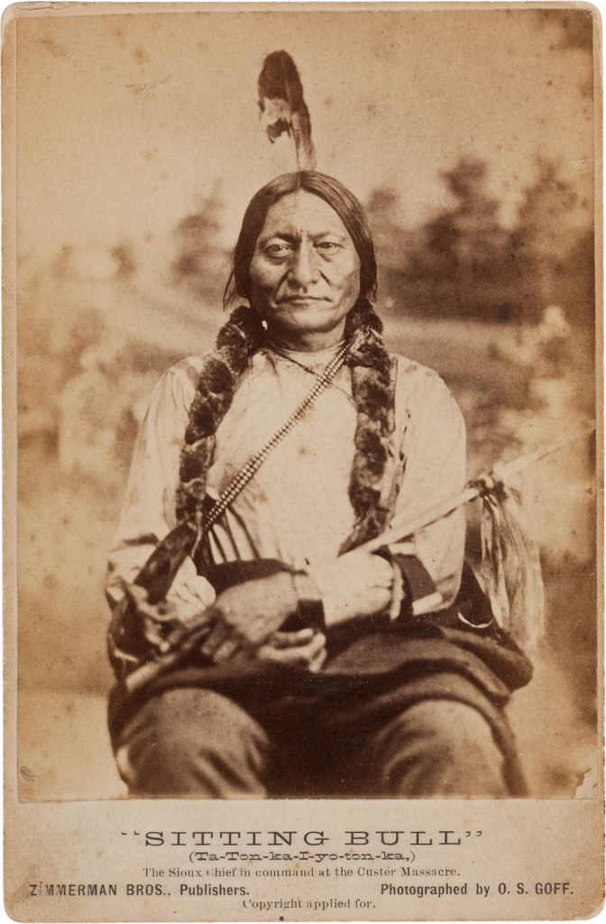
Sitting Bull and Crazy Horse joined forces and defeated US General Custer.
This defeat fueled:the US to remove Indians from the Plains.

Slide 53
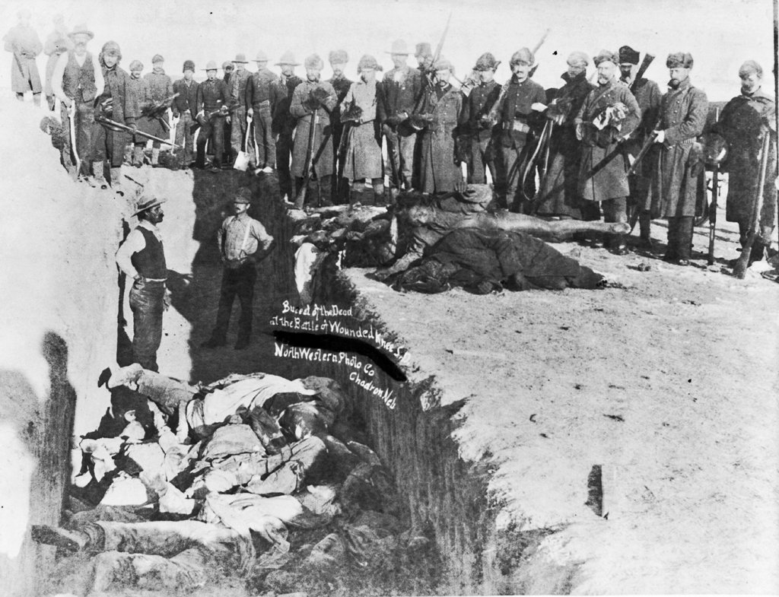
Battle of Wounded Knee
-Indians fought back against tactics of the US government.
-Last violent conflict between Indians and the US (300 Indian men, women, and children killed)

Slide 54
Less Violent Approach

Slide 55
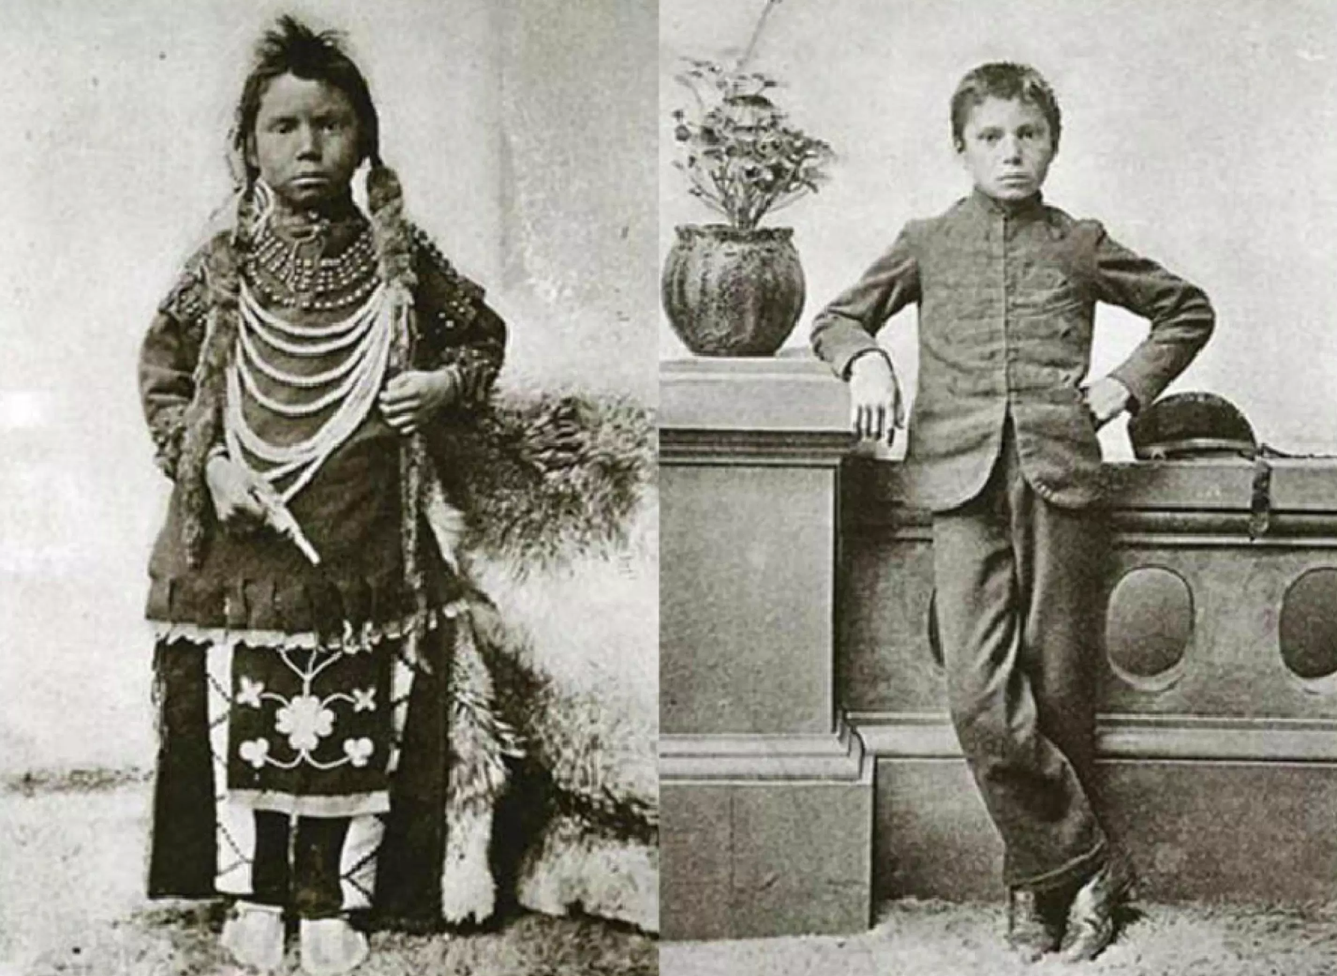
Assimilating
Which of these children do you think is a Native American?
Attempt to “Americanize” the Native Americans.
To force them to adopt Western culture and “civility.”

Slide 56
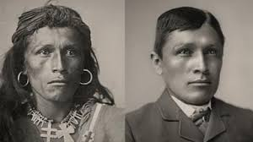

Slide 57
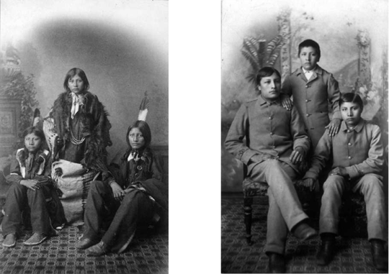
The two images are of the same three Native boys. What term did we learn today can you use to describe the process above?

Slide 58
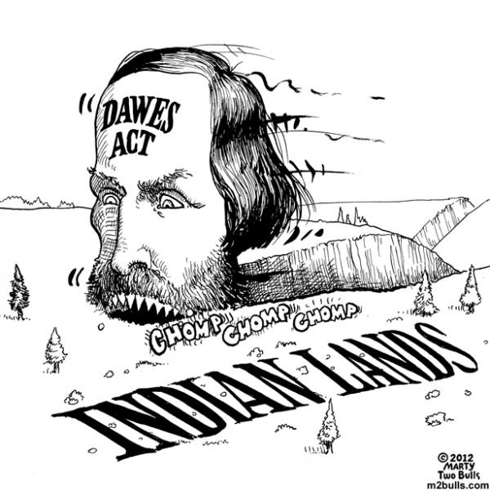
Dawes Act
Broke up reservations into family farms, owned by US.
US gave farms to Indians who agreed to assimilate (house, farm, English, Christianity, children to English school)
Effects: Increase assimilation, destroy tribal authority, make $$$ (sold land to highest white bidder instead of giving it away)

Slide 59
Farmer’s Tough Times
Debt purchasing farm equipment
Couldn't pay off debts because railroads charged so much to ship grain
Formed the Populist Party
Later, will become the People’s Party
Notes:
Populist party gave a voice to the farmers

Slide 60
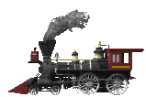
Interstate Commerce Act:
Farmers did have one big success; convinced the government to pass the Interstate Commerce Act;
created rules to make railroad rates fairer to small farmers and businesses;
Created the Interstate Commerce Commission to enforce these new rules. First time the federal government was involved in big business!!!
Notes:
The Interstate Commerce Act was the first time gov’t had regulated private business.

Slide 61
Exit Ticket - Daily Grade
•What were some positive effects of Westward Expansion?
Some positive effects of Westward expansion were….
•What were some negative effects?
Some negative effects were….
The Dawes Act
The Indian Removal Act
The Destruction of the Buffalo
The Transcontinental Railroad
The Homestead Act
Manifest Destiny
Assimilation

