Slide 1
CIVIL RIGHTS MOVEMENT
VOCABULARY

Slide 2
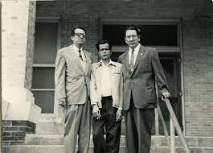
Hernandez v. Texas
Challenged Jim Crow discrimination against Mexican-Americans

Slide 3
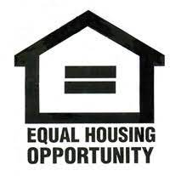
HUD-Dept. of Housing and Urban Development
Enforced housing laws and regulations

Slide 4
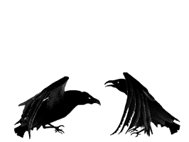
JIM CROW LAWS
Southern state and local governments separated white and black people in public and private facilities.

Slide 5
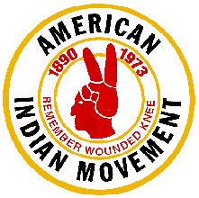
American Indian Movement (AIM)
American Indian militant advocacy group; demanded government honor paste treaty obligations.

Slide 6
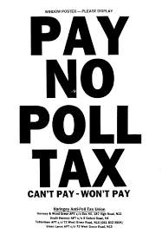
24th Amendment
Prohibited poll tax in elections

Slide 7
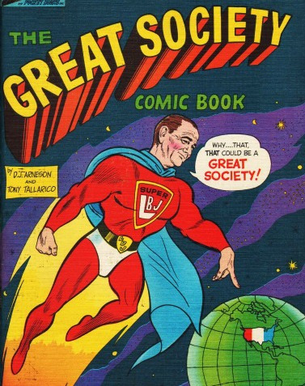
GREAT SOCIETY
Lyndon B. Johnson’s programs to help the poor and end poverty

Slide 8
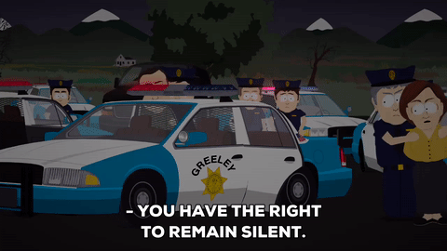
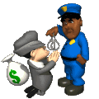
MIRANDA V. ARIZONA
People must be informed of their Constitutional rights if they are accused of a crime

Slide 9
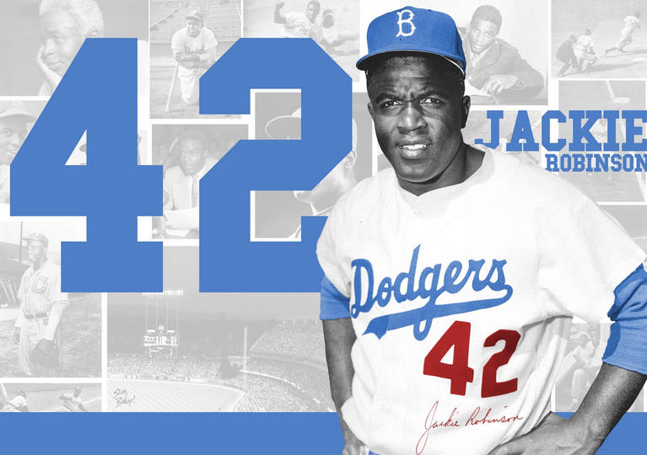
JACKIE ROBINSON
First African American major league baseball player

Slide 10
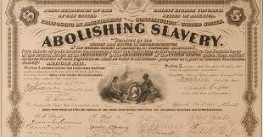
13TH AMENDMENT
1865 abolished slavery

Slide 11
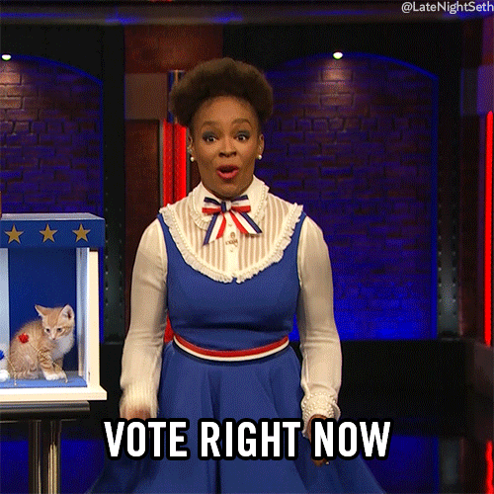
15TH AMENDMENT
1870; prohibits the denial voting rights to people because of their race.

Slide 12
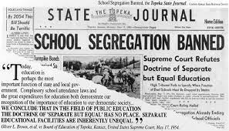
BROWN V. BOARD OF EDUCATION
1954; Supreme Court ruled “separate but equal” unconstitutional.
Overturned Plessy v. Ferguson
School segregation banned

Slide 13
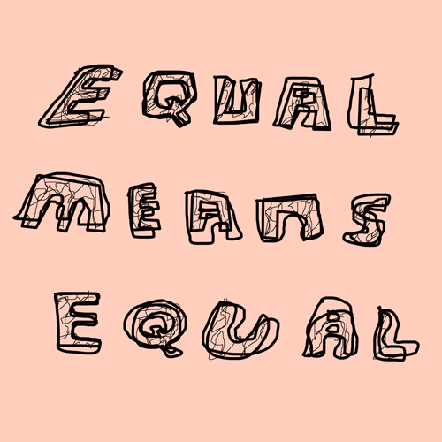
CIVIL RIGHTS ACT OF 1964
Banned discrimination in public places and most workplaces.

Slide 14
VOTING RIGHTS ACT OF 1965
Easier for African Americans to register to vote;
Eliminated literacy tests

Slide 15
C.O.R.E.
Congress of Racial Equality
Organized Freedom Riders from the North to the South.

Slide 16
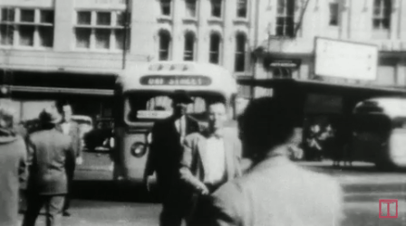
FREEDOM RIDERS
Rode buses into the south to register blacks to vote.
Organized by CORE

Slide 17
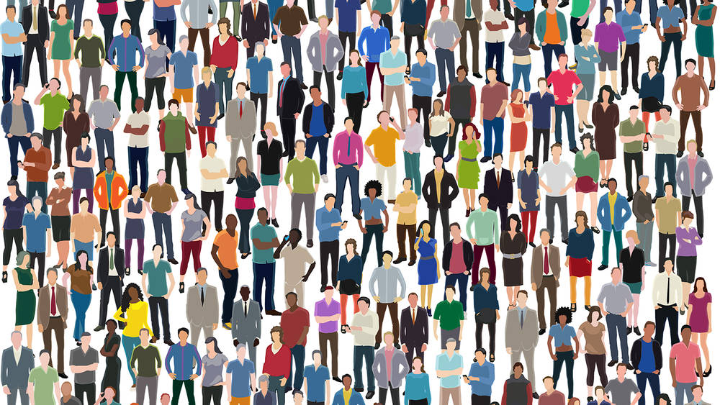
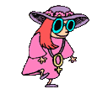
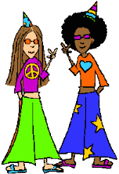
14TH AMENDMENT
1868; persons born/naturalized in US citizens; equal protection

Slide 18
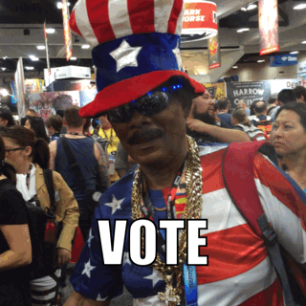
FREEDOM SUMMER
1964; Freedom Riders go to the Mississippi to register blacks to vote
They are attacked and some are killed.

Slide 19
SIT-INS
Non-violent student protest, civil disobedience
Organized by SNCC

Slide 20
SELMA
MLK’s march in Alabama that brought treatment of minorities to the spotlight

Slide 21
S.N.C.C.
Student Nonviolent Coordinating Committee
Sit-ins

Slide 22
MONTGOMERY BUS BOYCOTT
Chain reaction of boycotts throughout the South. In 1956, the Supreme Court voted to end segregated busing.

Slide 23
S.C.L.C.
Civil rights organization led by MLK, Jr.
Southern Christian Leadership Conference
Non violence

Slide 24
SEGREGATION
To separate the races

Slide 25
INTEGRATIONs
Combining or bringing back races together

Slide 26
UNITED FARM WORKERS
Founded by Cezar Chavez, organizes Mexican American agricultural workers

Slide 27
TITLE IX
Prohibits discrimination on the basis of sex in any federally funded schools or sports program

Slide 28
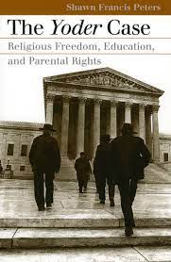
Wisconsin v. Yoder
School attendance was not mandatory due to freedom of religion
Amish did not need education to fulfill Amish society responsibilities

Slide 29
NATIONAL ORGANIZATION FOR WOMEN
N.O.W.
American feminist organization founded in 1966 by Betty Freidan.

Slide 30
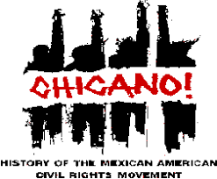
Chicano Movement
Mexican American Civil Rights Movement

Slide 31
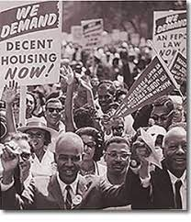
Civil Rights Act 1968
Law that banned discrimination in housing

Slide 32
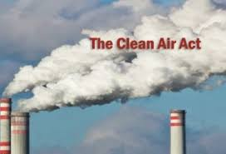
Clean Air Act
Control air pollution on a national level

Slide 33
Equal Rights Amendment
Amendment designed to guarantee equal rights for women. (Equal Pay Act) did not pass

Slide 34
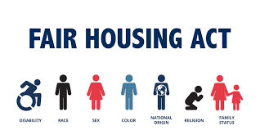
Fair Housing Act
Protected the buyer or renter of a dwelling from seller or landlord discrimination.

Slide 35
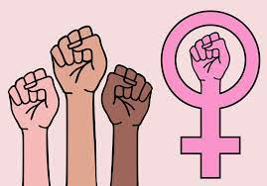
Feminism
Women’s rights on the grounds of political, social, and economic equality to men.

Slide 36
League of United Latin American Citizens
Fought discrimination of Latino citizens, encouraged assimilation and speaking of English

Slide 37
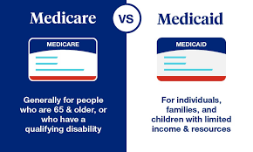
Medicare
Medicaid
Healthcare for the elderly and disabled
Healthcare for the poor

Slide 38
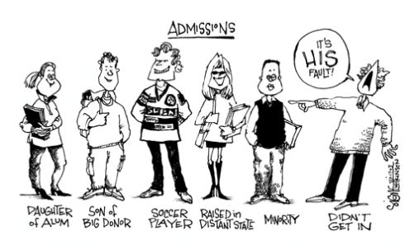
Affirmative Action, 1965
Johnson signed an order requiring employers with federal contracts raise the number of their minority and female employees.
(Equal Employment Opportunity)
Notes:
Martin Luther King was born in Atlanta Georgia to Rev. Martin Luther King Sr. and Alberta Williams King. At Morehouse College, King was mentored by Civil Rights leader Benjamin Mays. King later became minister of the Dexter Ave. Baptist Church. King started his campaign for Civil Rights during the Montgomery Bus Boycott. After the movement, King helped found the SCLC (Southern Christian Leadership Conference.)
Picture: www.kycourts.com
<http://www.kycourts.net/AOC/MinorityAffairs/Martin%20Luther%20King,%20Jr.%20--%203.jpg>

