Slide 1
Chinese Fall & The Korean War
Unit 9: The Cold War

Slide 2
China “Falls” to Communism

Slide 3
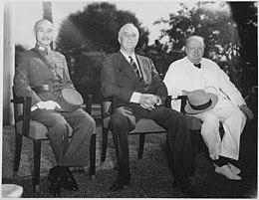
How Did China End Up Falling?
Recap: During WWII, the U.S. supported the efforts of the Chinese rebel leaders fighting the Japanese occupation of China

Slide 4
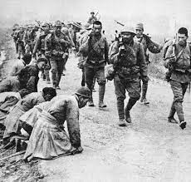

Slide 5
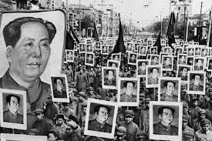
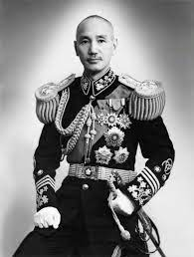
Post-WWII
After the war, the U.S. supported the leader of the Chinese Nationalist Army: Chiang Kai-Shek (Non-Communist)
So, why did the U.S. become involved?
Because the other leader, Mao Zedong, was a Communist

Slide 6
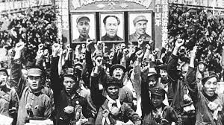

Slide 7
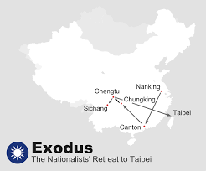
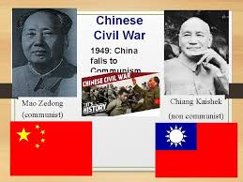
Fighting In China
A civil war between the two sides erupted and in 1948:
Mao Zedong won (the Nationalists fled to what is today, Taiwan)
In 1949, China then became a Communist country, alarming many Americans
All aspects of life will change and be under the direct control of the Chinese Communist Party
President Truman was blamed, even though it had nothing to do with him

Slide 8
Changes in China Under Mao
Peasants | Focused on land reform and the peasantry
Capitalist Class eliminated | Landowners, factory owners, village leaders, and better off peasants are considered the capitalist class The Communists believed they exploited the others At least 1 million will be killed
Reeducation | Communist beliefs became required learning. Extreme censorship
The Family | Family authority replaced be Communist authority Children taught to obey the state over their parents

Slide 9
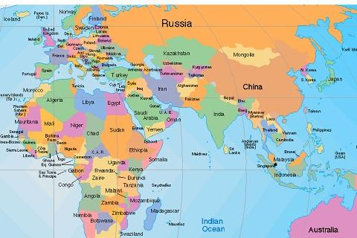
Why would the U.S. be scared of China becoming Communist?

Slide 10
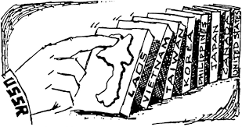
Tensions in the Communist World
1962: border disputes and different forms of Communism led to disagreement between China and the Soviet Union
Mao wanted to launch a new bid for world leadership of the Communist movement
Domino Theory:
U.S. theory that if one nation becomes Communist, the nations around them will fall to Communism too
Like stacked dominos falling over

Slide 11
The Korean War

Slide 12
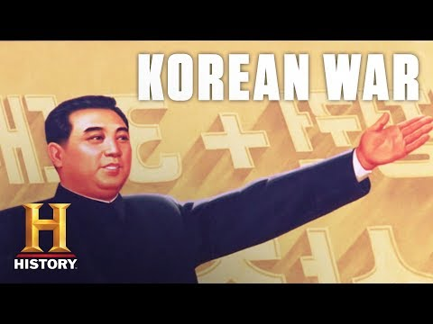

Slide 13
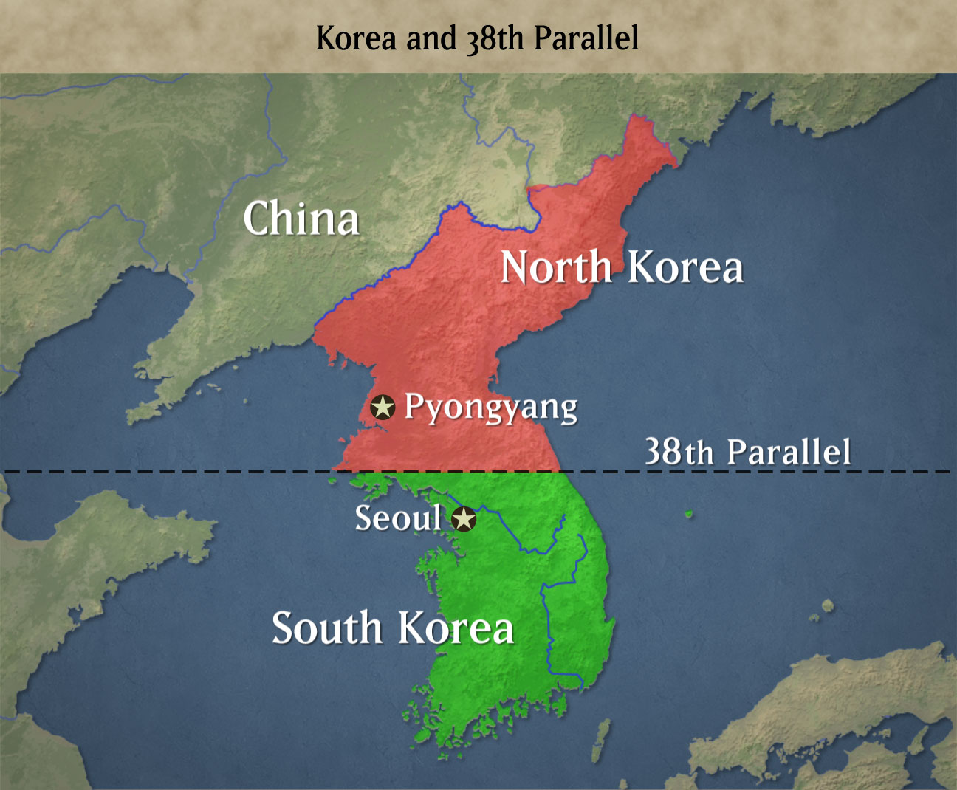
The Divide
Divided between Communist and Non-Communist (like Germany)
After WWII, the Korean peninsula had been divided along the 38th parallel
1950: Communist North Korea will invade non-Communist South Korea in an effort to unite it as a single Communist state

Slide 14
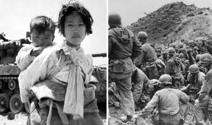
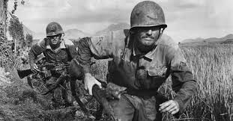
The State of the Cold War
The first Cold War military action:
Soviet Union & China will support North Korea
The U.S. will support South Korea
President Truman and other Western leaders decide to take a stand against Communism and maintain containment

Slide 15
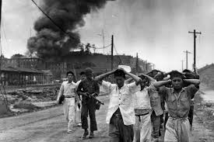

Slide 16
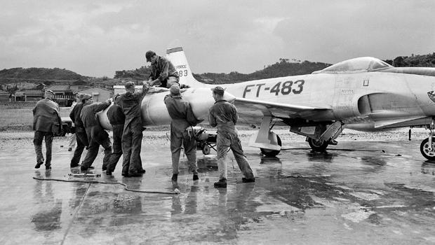
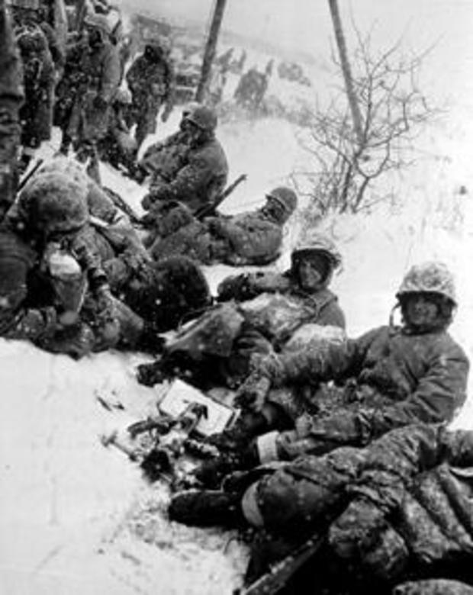
Ground crew men load an auxiliary fuel tank on a U.S. jet plane at a base in Southern Japan for a mission against North Korean troops, June 30, 1950.
A group of Marines fighting its way from the communist encirclement at Chosin to Hungnam, Korea, takes a rest in the snow in December 1950.

Slide 17
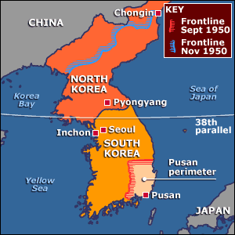
United Nations & The Korean War
The United Nations Security Council will vote unanimously to intervene and protect South Korea
The USSR could have vetoed, but they had been boycotting the UN due to the inclusion of the Council of Taiwan and not China

Slide 18
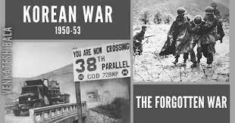
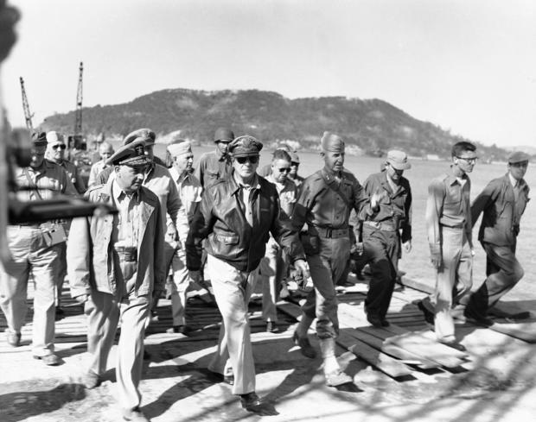
The War
Communists will be forced back to North Korea
China threatened to invade to protect North Korea
U.S. General Douglas MacArthur was put in charge of UN forces
He wanted to use nuclear weapons but lacked the support of President Truman
Truman was worried that China would invade, but MacArthur dismissed him

Slide 19
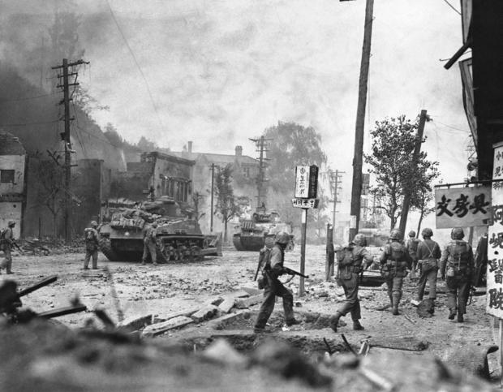
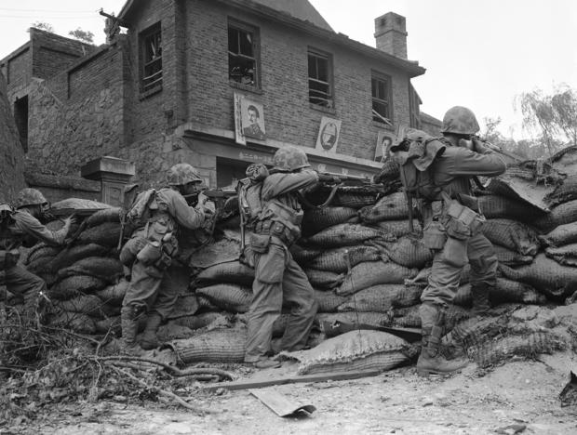

Slide 20
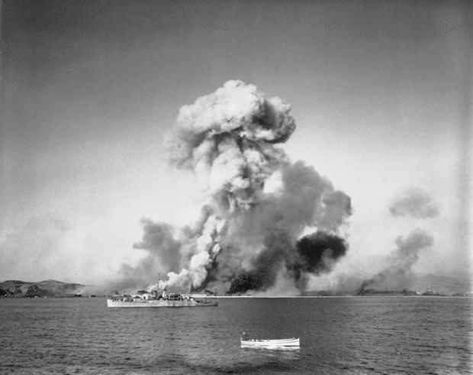
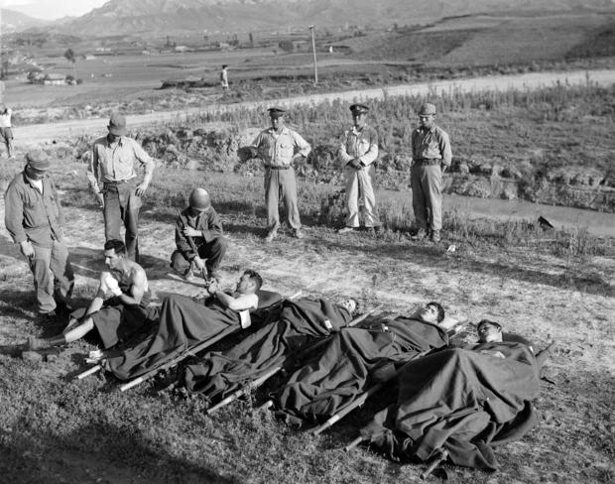

Slide 21
Truman and MacArthur
President Truman will fire General MacArthur (1951) because he violated Truman’s orders, criticized him publicly and threatened to use nuclear weapons and invade China
The Congressional hearing will agree with Truman, but the American people will see MacArthur as a hero and Truman as a wimp or weak

Slide 22
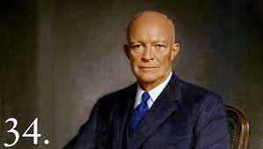
We Like IKE…
In 1952, retired Five-Star General Dwight “Ike” Eisenhower will be elected president
He was cautious about using nuclear weapons and going to war with China
He will continue with Truman’s efforts to end the war by treaty

Slide 23
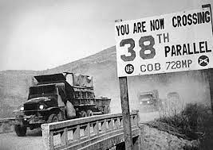
The Stalemate
China invades with over 1 million troops supported by Soviet air support
This creates a long stalemate as UN forces are pushed back
The war will end (July 27, 1951) with an armistice and North & South Korea will remain divided at the 38th parallel as it had been before the conflict began
This area became known as the DMZ - Demilitarized Zone (no fighting can take place in this area)

Slide 24
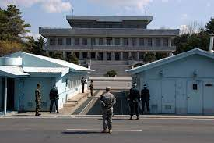

Slide 25
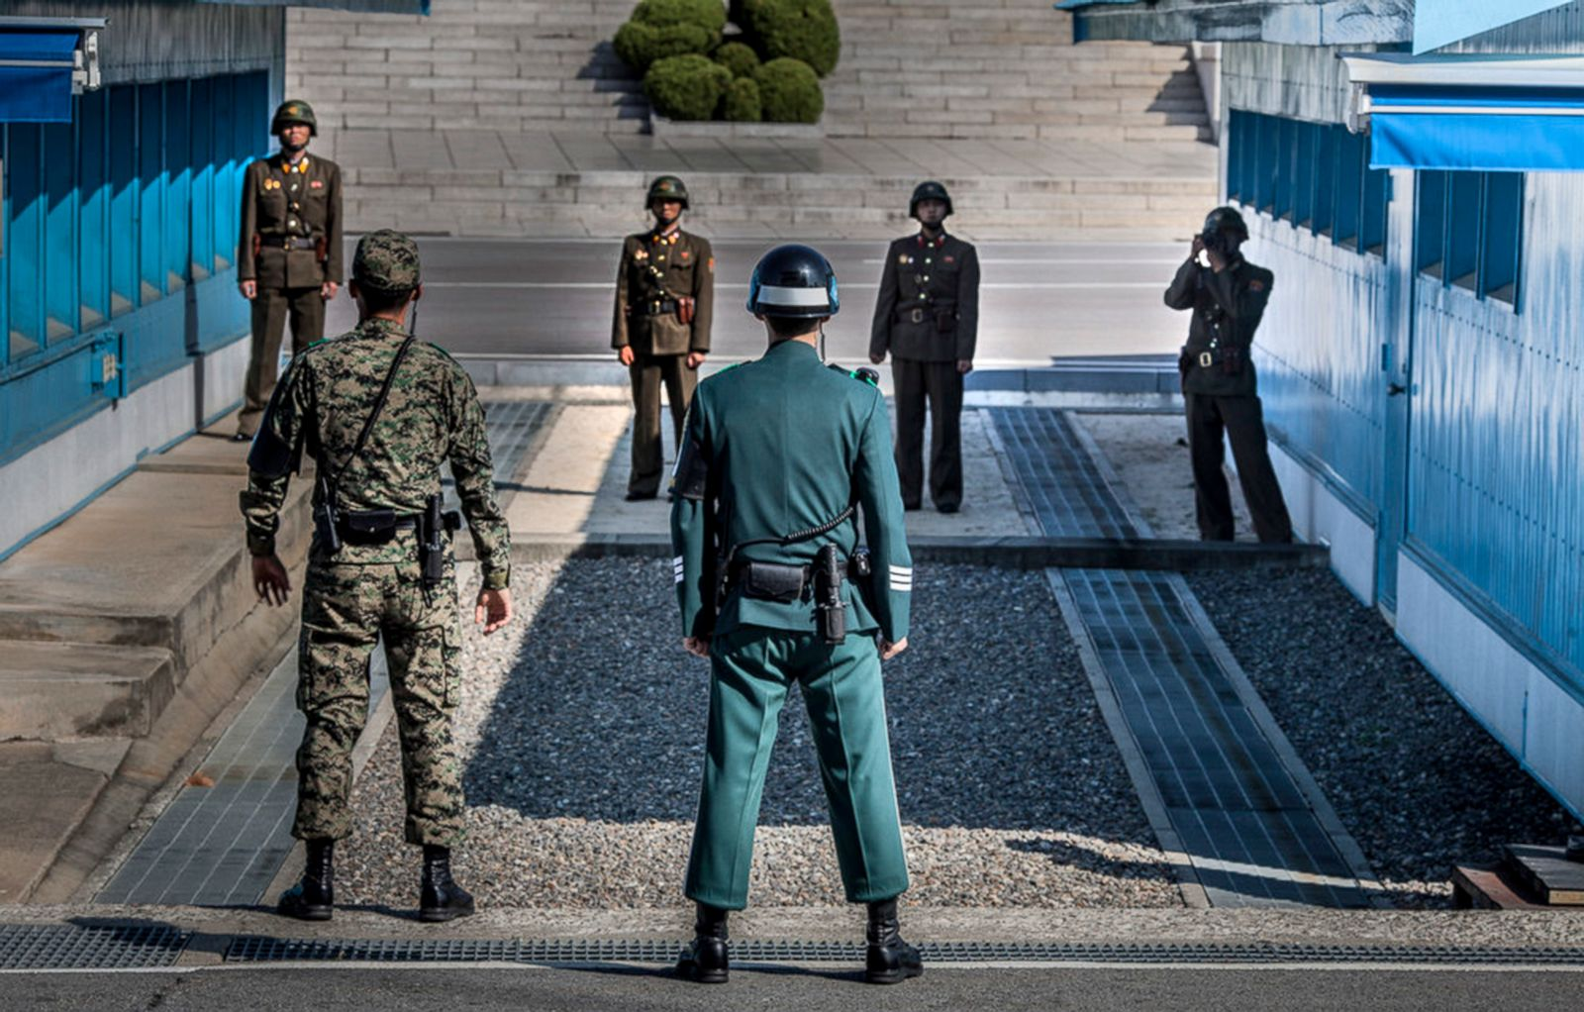

Slide 26
The End of the War
Nearly 5 million people died
More than half of these - about 10% of Korea’s prewar population - were civilians
This rate of civilian casualties was higher than WWII’s & the Vietnam War’s
Almost 40,000 Americans died in action in Korea, and more than 100,000 were wounded

Slide 27
