Slide 1
QUESTION OF THE DAY
Checking
Q:
How many checks does the average American write
each year?
View blog post
ngpf.org 9/11/20

Slide 2
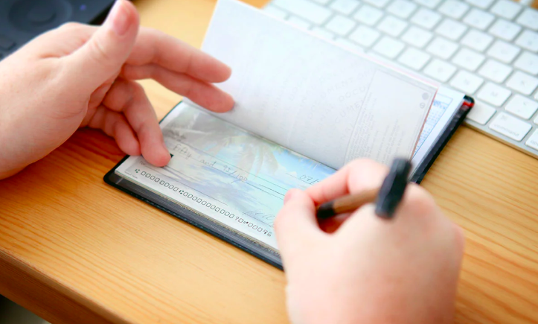
QUESTION OF THE DAY
Checking
A:
36
Click here for more info on this topic

Slide 3
FOLLOW-UP QUESTIONS
If you have a checking account, how many checks have you written in the past month?
What do you think are the most common expenses that people write checks for?
What do you think the answer to the number of checks would be for the average teenager with a bank account?
Do you think the answer to this question will change in the next five years? Explain.

