Slide 1
QUESTION OF THE DAY
Checking
Q:
How quickly do you need to report a stolen debit card to get all your money back?
View blog post
ngpf.org 5/25/21

Slide 2
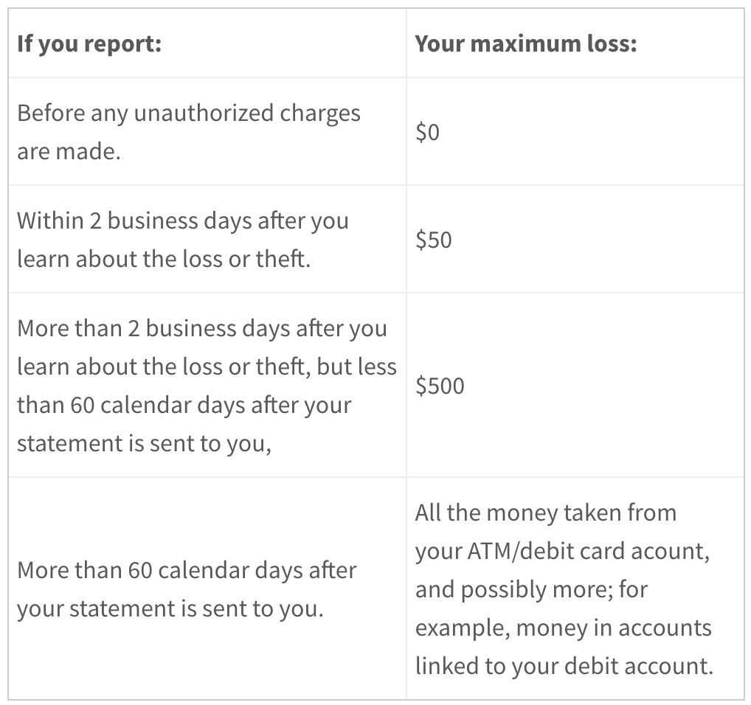
QUESTION OF THE DAY
Checking
A:
Before any unauthorized charges are made.
Source: Magnify Money

Slide 3
FOLLOW-UP QUESTIONS
Do you know anyone who has had their debit card stolen? What happened?
Since there is a thriving market in cloned debit cards, what can you do to protect yourself if your account is hacked?
If you don't tell the bank about your card being stolen and your account is drained, is the bank required to pay you back after 60 days after your monthly statement is mailed to you?

