Slide 1
THE GREAT DEPRESSION
UNIT 7: THE GREAT DEPRESSION #1

Slide 2
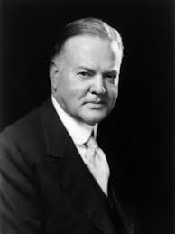
Herbert Hoover
Becomes President in 1929
“I have no fears for the future of our country. It is bright with hope…”

Slide 3
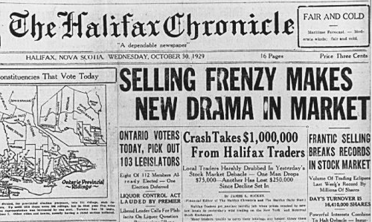
The Stock Market Crash
On Thursday, October 24th, the stock market began to decline
Bankers tried to stop the decline by buying stocks, but they were able to only delay the drop
Effect on the Depression:
What happened? Five days later on October 29, 1929, Black Tuesday, the stock market crashed
As stock prices dropped, people sold their stock - some lost everything

Slide 4
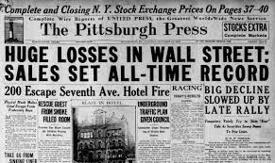
Why is it significant?
Symbolic beginning of the Great Depression

Slide 5
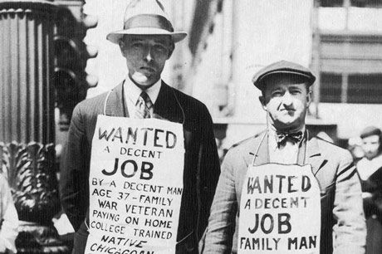
Stock Market crash will follow with:
HIGH UNEMPLOYMENT
Businesses start going under (closing) → causes a snowball effect
Low Production
Low Investment

Slide 6
Great Depression Causes

Slide 7
Stock Market Speculation

Slide 8
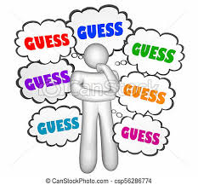
Over Speculation
Speculation: risky investments (purchasing stocks) with the hopes of getting rich quick
In the 1920s, many people bought stocks hoping to “get rich quick”
Drove stock prices even higher

Slide 9
Buying on margin: borrowing money
In the 1920s, stocks could be purchased for a 10% down-payment, called margin
Rest of the price was financed by a loan from a stock broker → similar to making a purchase on installment plan
The purchaser was responsible for the rest of the price whether stock market prices dropped or rose
SPY into the future HOPING it will be good

Slide 10
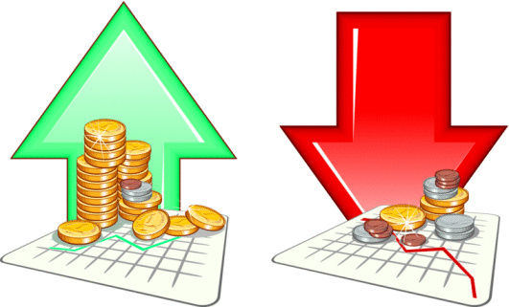
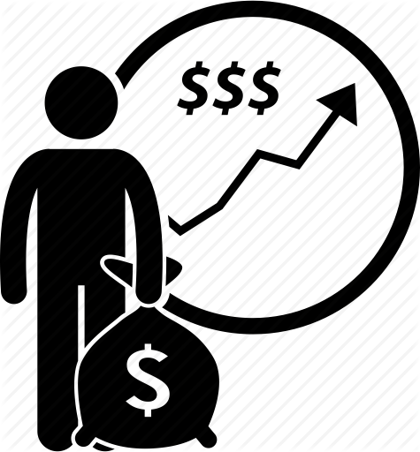
The Stock Market
You can buy a part (or stock) in a company
When company does GOOD, stock price goes UP
Sell your stocks to make money

Slide 11
2. Tariffs & Trade

Slide 12
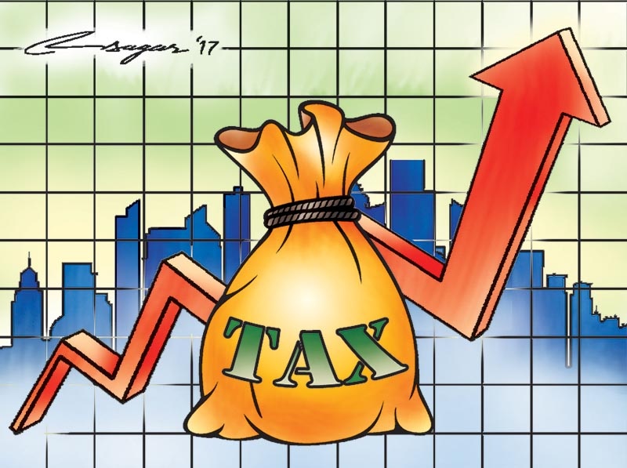
High Tariffs
Tariff: a tax on imported goods (from another country)
HIGH tariffs RAISE the price of foreign goods, LESS trade
Example: Hawley-Smoot Tariff
We stop buying other countries’ products, then they stop buying ours
Decline in trade leads to loss of money
The shrinking of world trade contributed to the Great Depression

Slide 13
3. Overproduction

Slide 14
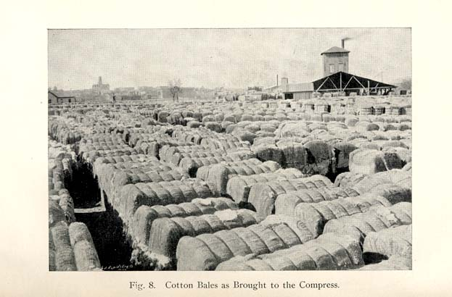
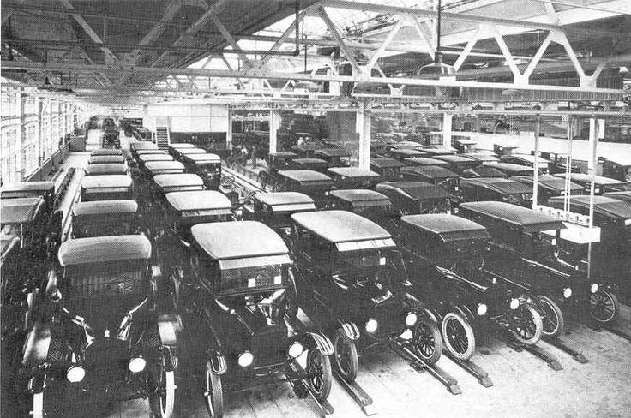
Overproduction of Goods
Economic Boom of 20s → consumerism & buying on credit
Businesses produce more goods than they can sell
Farmers didn’t benefit from the Roaring 20s (they kept farming as they did in WWI)
**Decline in crop prices**

Slide 15
Overproduction leads to?
Decline in profits
Unemployment

Slide 16
4. Policy (Monetary $$)
**Bad Banking & Bank Failures**

Slide 17
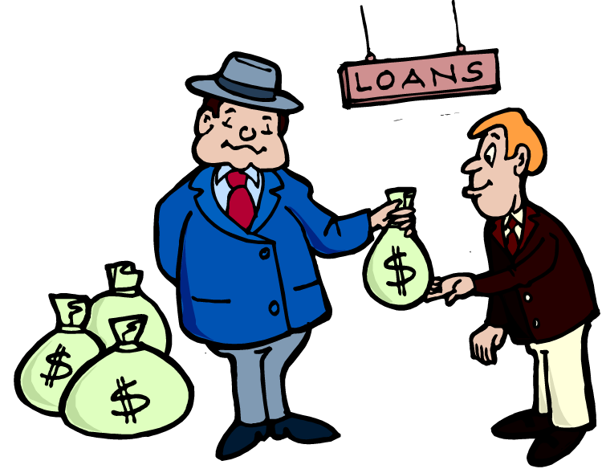
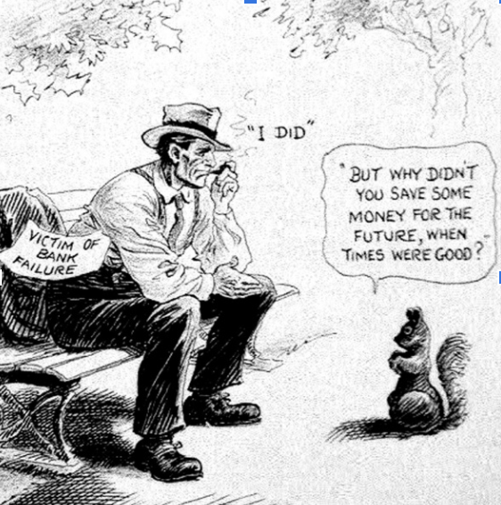
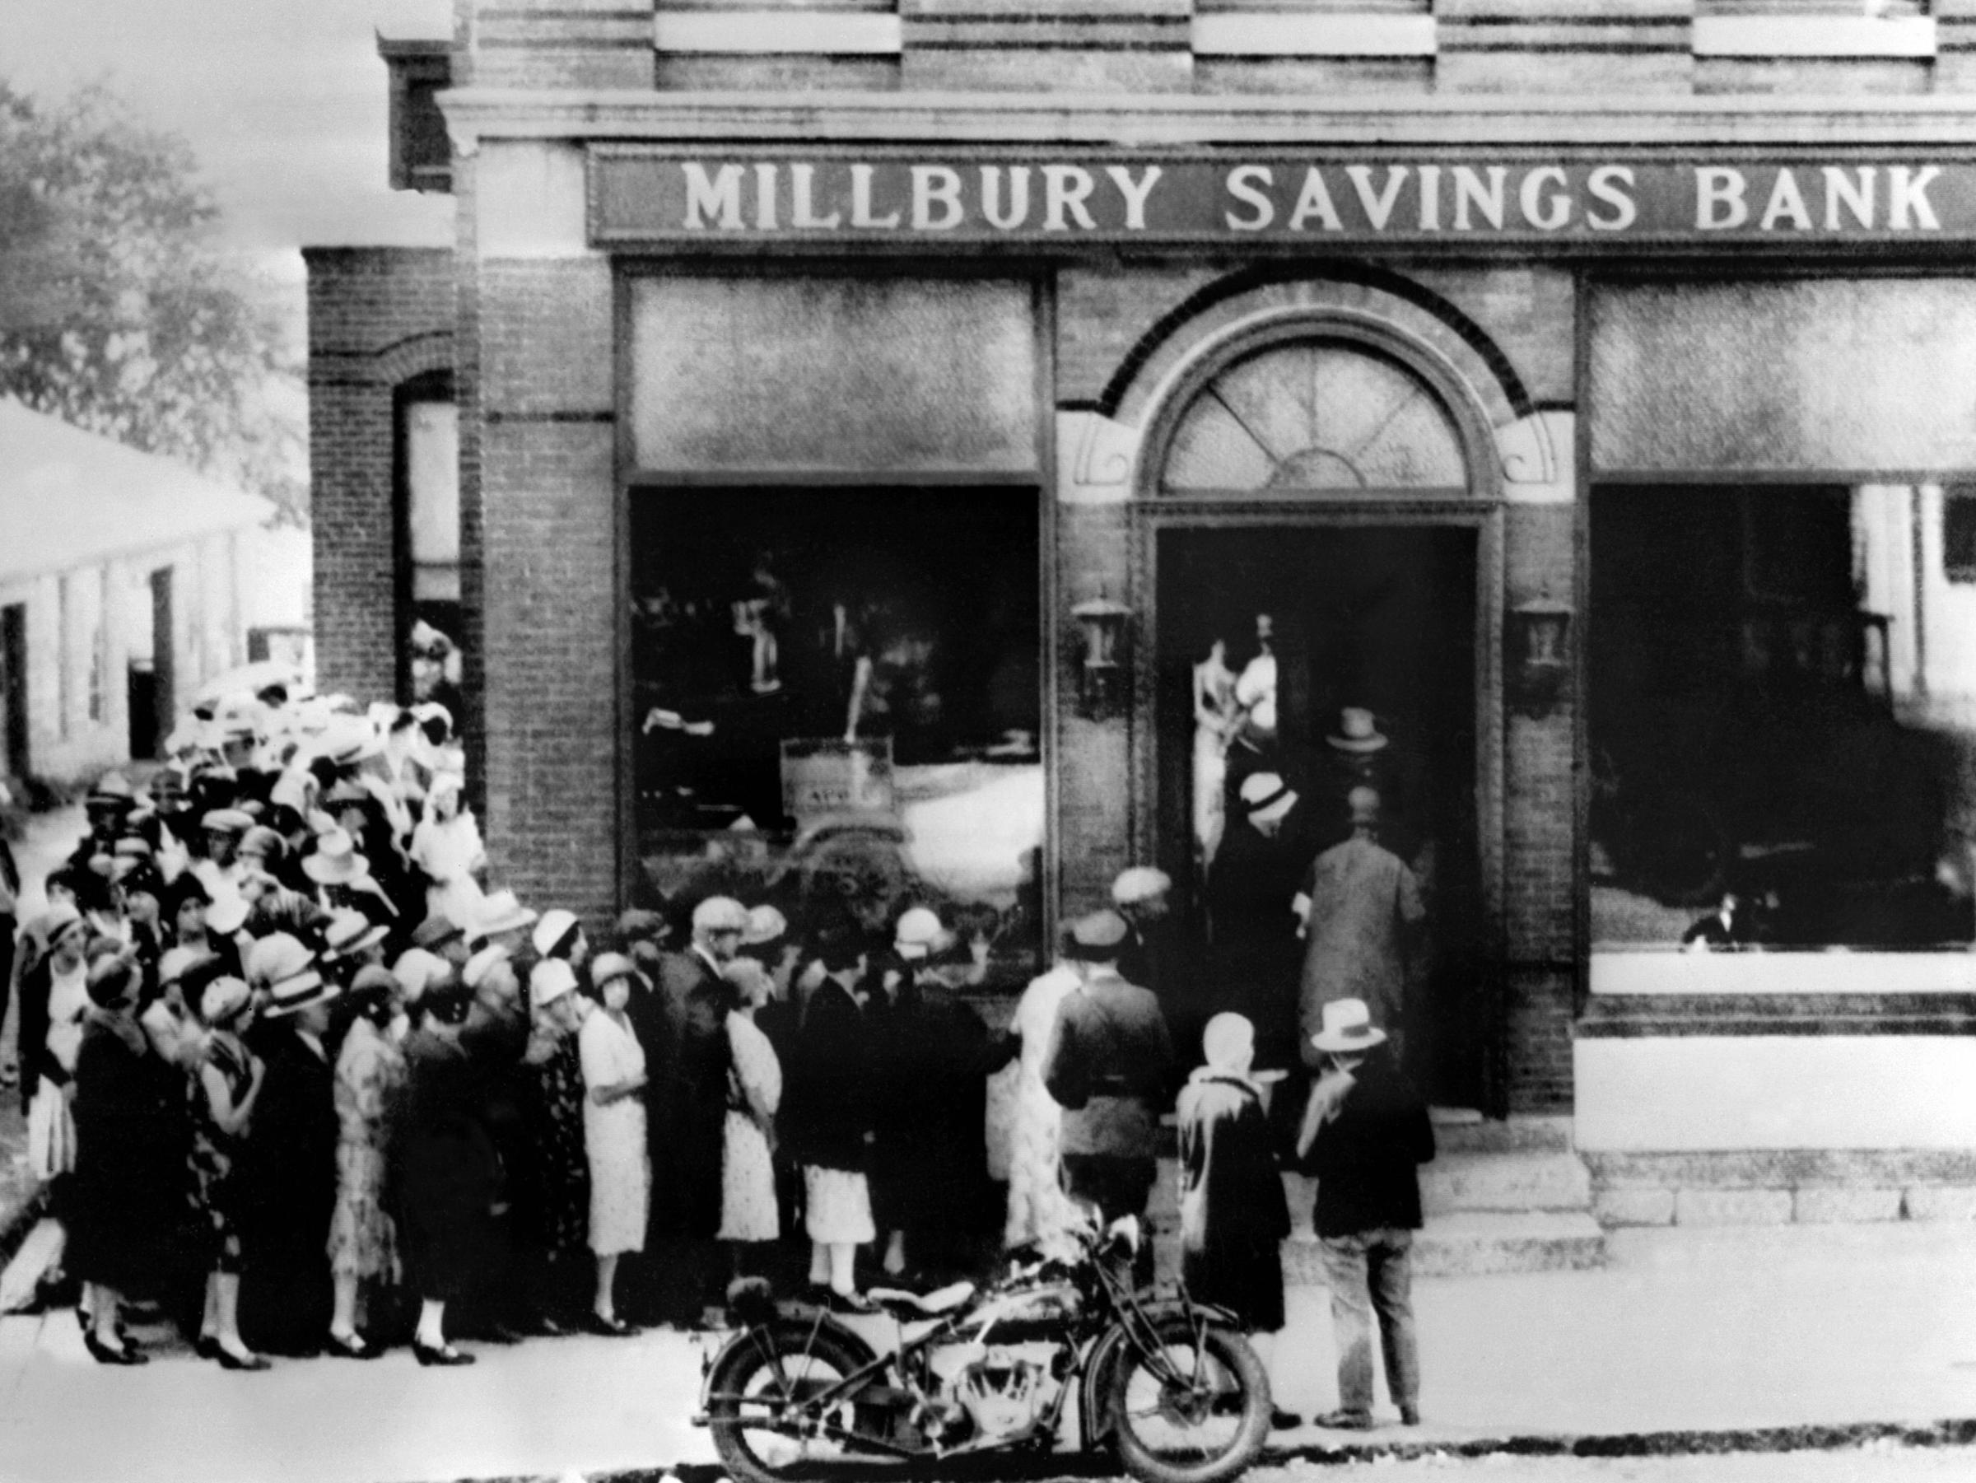
Monetary ($$) Policy
The Federal Reserve reduced the amount of money available
Banks generally collect money from depositors and then invest these funds in businesses
This enables them to earn money to pay interest on deposits

Slide 18
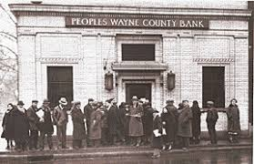
Harder to receive loans → bank failures
Banks use YOUR money to give other people loans
When everyone tries to take their money out, the bank does NOT have enough
Banks shut down and people lost money that was saved in the banks

Slide 19
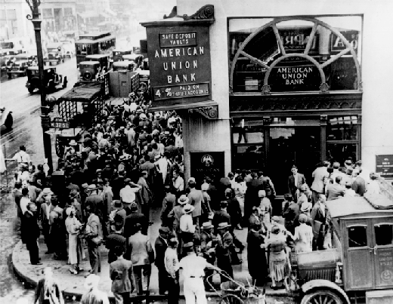
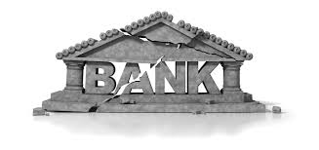
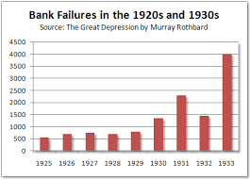
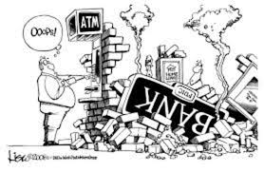
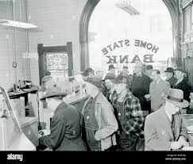

Slide 20
DUST BOWL

Slide 21
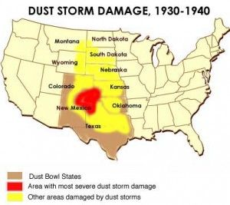
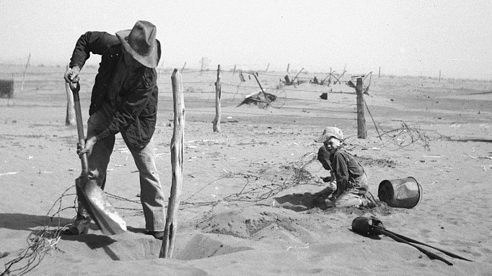
The Dust Bowl
A series of massive dust storms that destroyed much of the Great Plains farmland
It was caused by:
long, severe drought
over-farming of the land

Slide 22
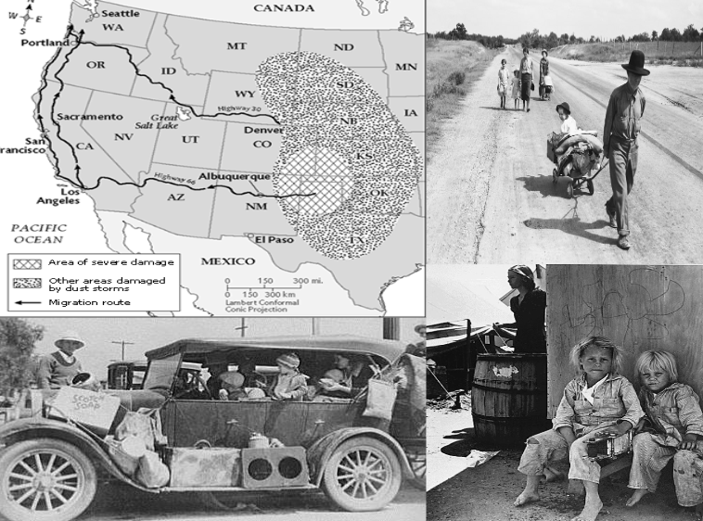
AREAS IMPACTED BY DUST BOWL:
Texas
New Mexico
Colorado
Kansas
Oklahoma

Slide 23
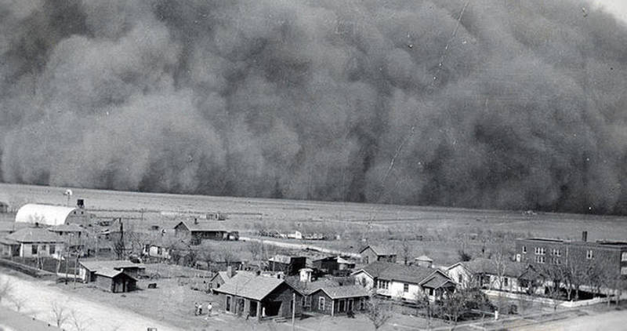
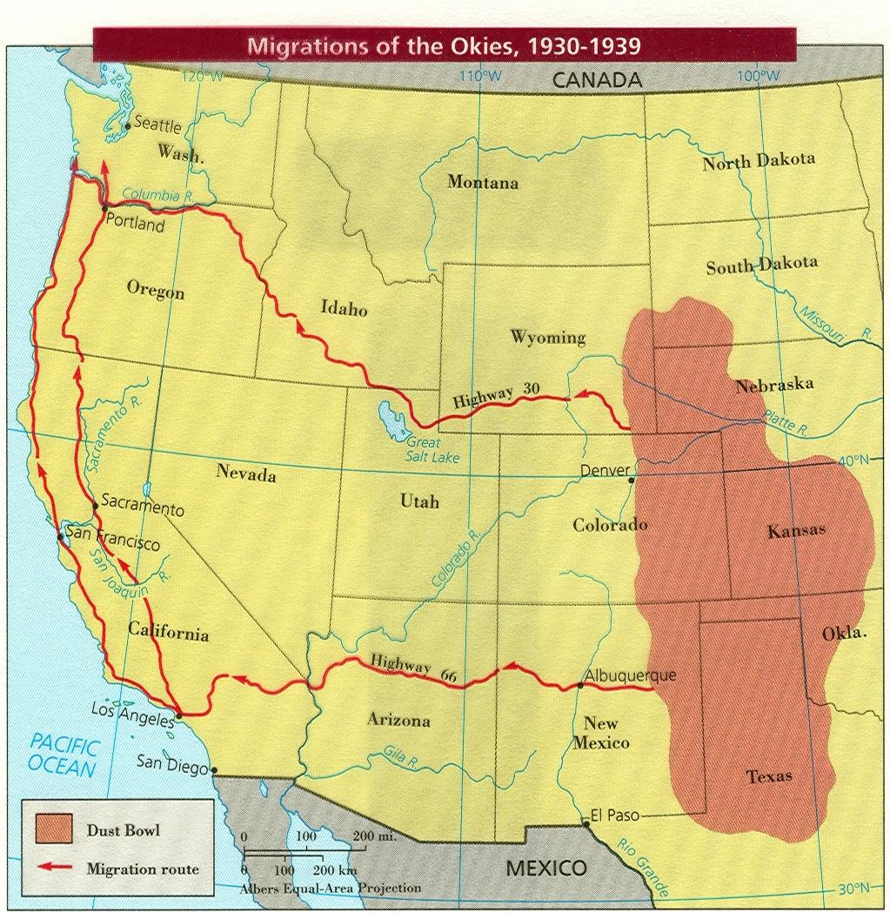
Millions were forced to flee their farms and make a life elsewhere
They mostly fled to California, hoping to be able to farm, and greatly increasing the population there

Slide 24
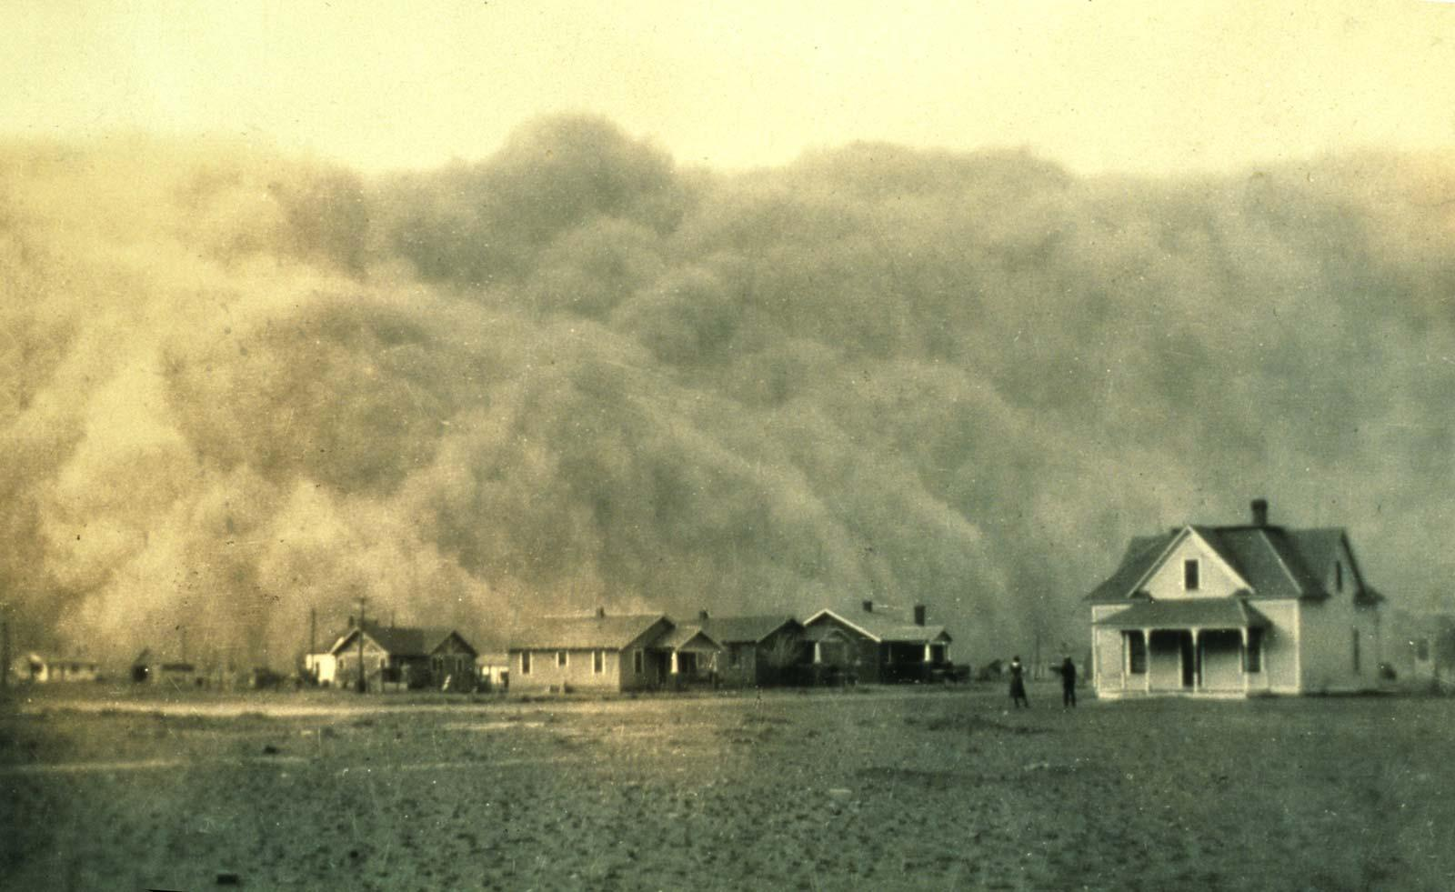

Slide 25
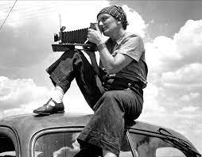
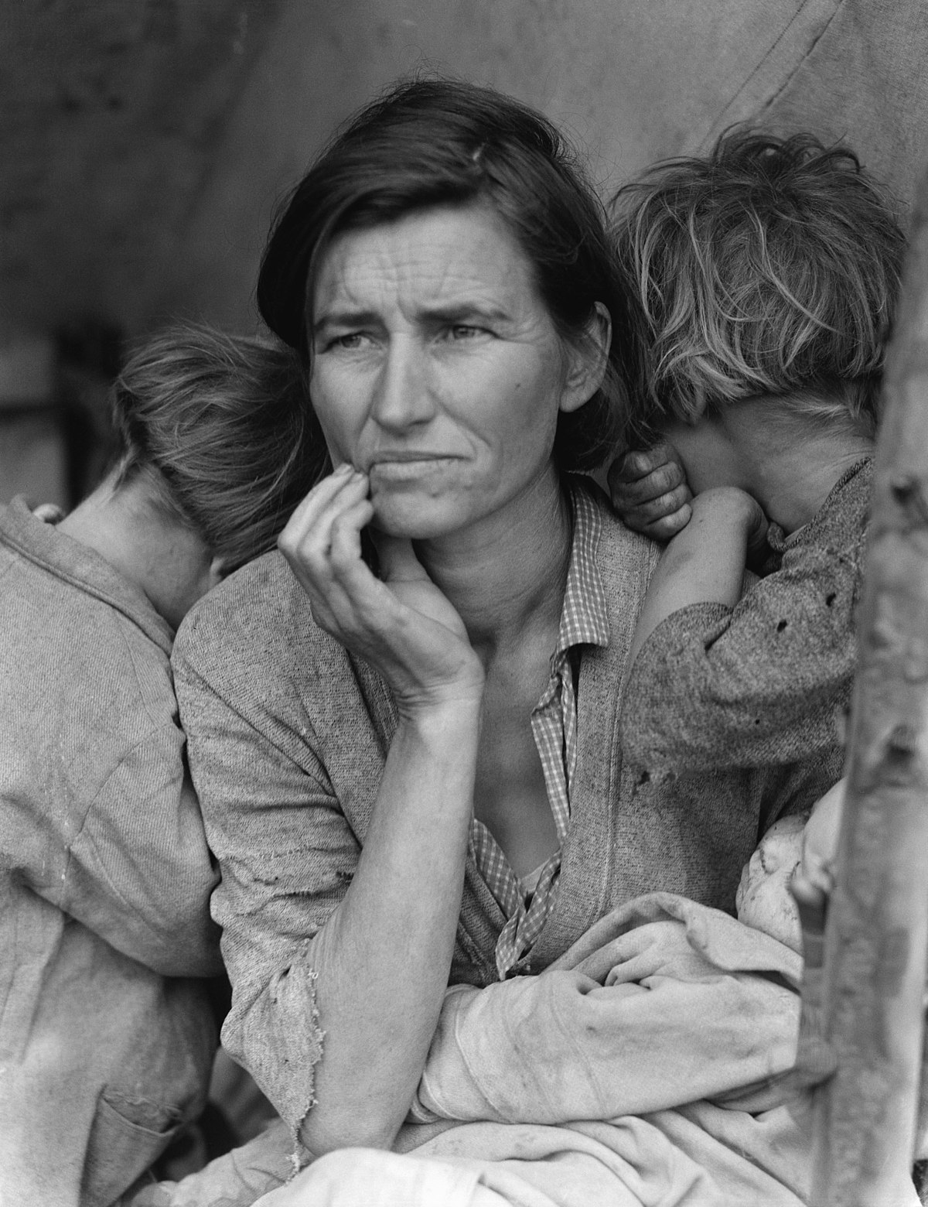
Dorothea Lange
Traveled through Dust Bowl states
Photographed living conditions
“Migrant Mother” = extremely famous image of the 1930s/Great Depression!!!
Migrant Mother

Slide 26
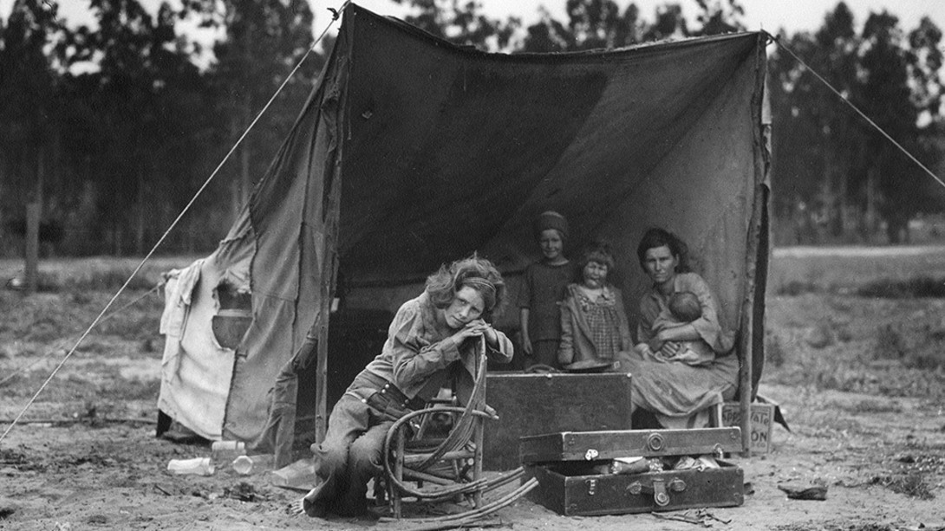
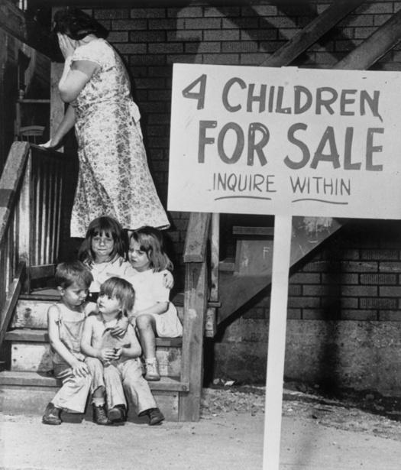
Notes:
Dorothea Lange photography

Slide 27
Effects of The Great Depression

Slide 28
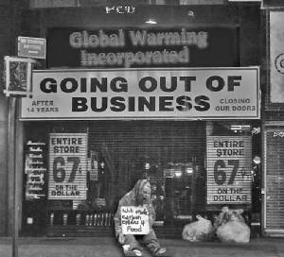
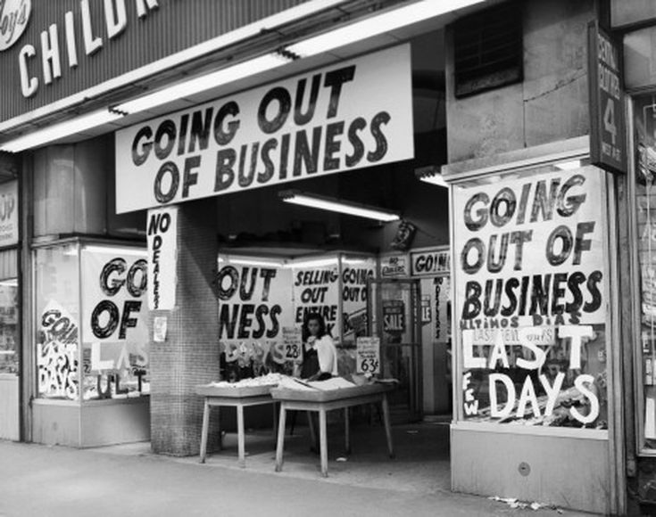
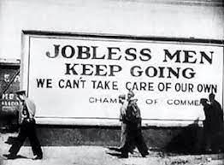
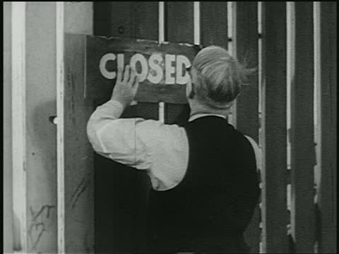

Slide 29
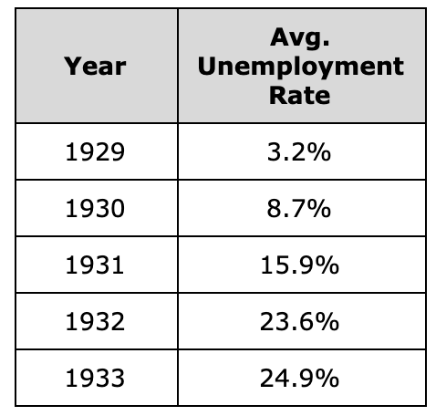
Unemployment Rate
# unemployed
everyone that can work
Over 300 thousand people looking for jobs
The Creation of the HOBO
homeless people looking for jobs

Slide 30
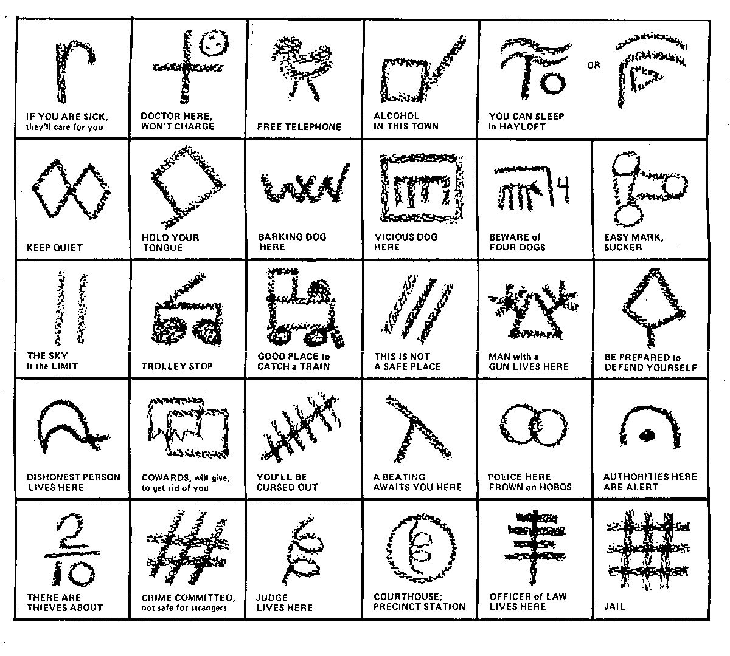
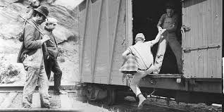

Slide 31
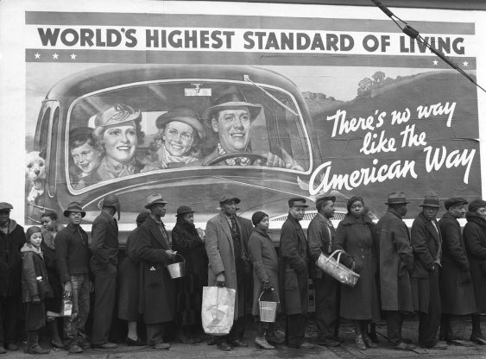
Breadlines & Soup Kitchens
Places to receive food provided by charitable organizations
How does this connect to unemployment?
Notes:
*Business failures*

Slide 32
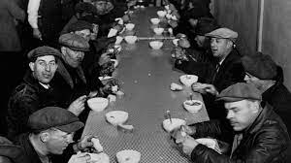
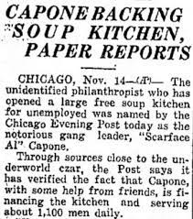
FUN FACT:
Al Capone started one of the first soup kitchens. The kitchen employed a few people but fed many more.
In fact, preceding the passage of the Social Security Act, “soup kitchens” like the one Al Capone founded, provided the only meals that some unemployed Americans had.
Gangster Al Capone's Chicago soup kitchen provided three meals a day during the Great Depression. On Thanksgiving in 1930, Capone's soup kitchen served holiday helpings to 5,000 Chicagoans. ... When the government deprived them of beer and alcohol during Prohibition, Capone delivered it to them.

Slide 33
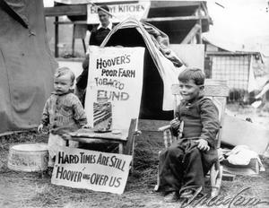
Shantytowns “Hoovervilles”
People could not pay rent so they were kicked out of homes (evicted)
Built makeshift shacks/homes
Why might they also be called “Hoovervilles”?

Slide 34
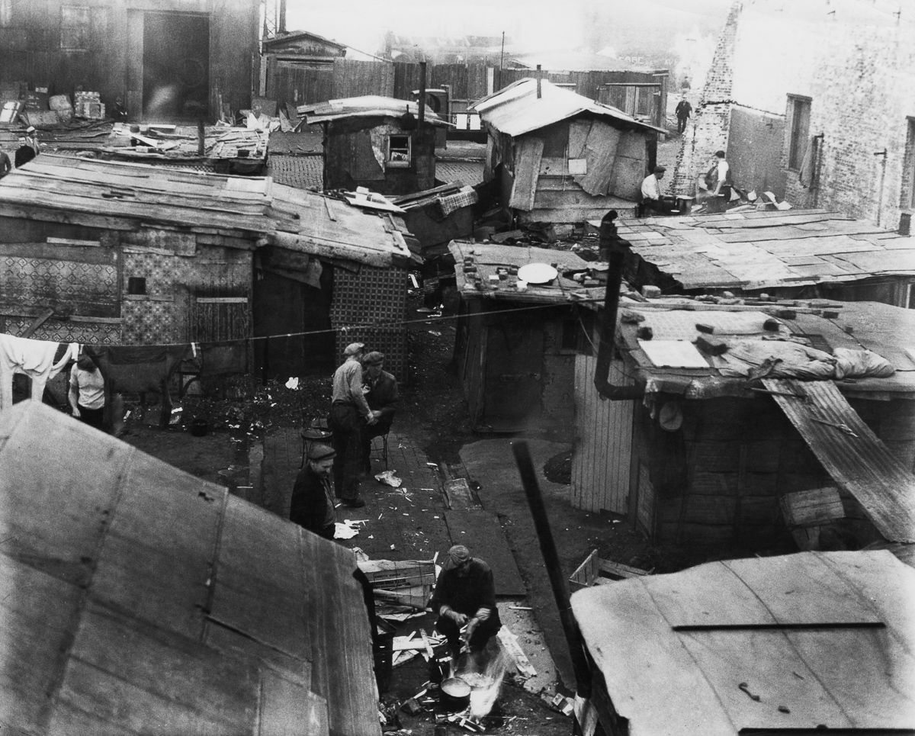
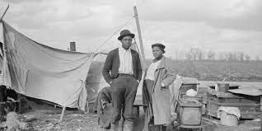
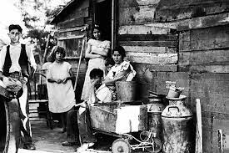
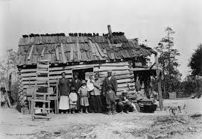

Slide 35
ART & MUSIC During The Great Depression

Slide 36
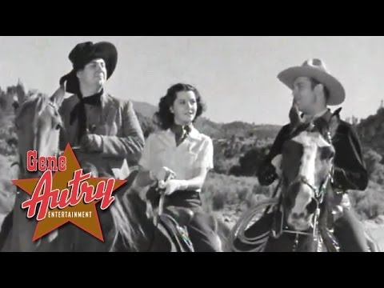
Gene Autry
People listened to music such as Gene Autry
Connection about hard times
Beginning with Tumbling Tumbleweeds in 1935, Autry's presence brought a boyish sense of relief
Notes:
Gene Autry...add to the back and add to review-add to the summary or something

Slide 37
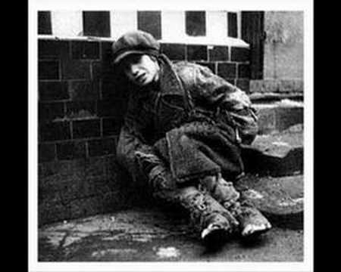
“Brother, Can You Spare A Dime”

